Slide 1
Domestic violence provisions
for tenants in NSW

Slide 2
Kimberley Mackenzie
Senior Solicitor
Inner Sydney Tenants Advice & Advocacy Service
Redfern Legal Centre

Slide 4
Outline
Changing the locks
“Bad” tenant database listings
Resources/where to get help
Questions
Tenancy law and domestic violence
Staying in the property
Leaving the property
Damage to the property
Resources: www.rlc.org.au/training/resources/dvt

Slide 5
1. Tenancy law and domestic violence

Slide 6
How the law may help tenants experiencing DV
Want the perpetrator to leave
Want to end own tenancy without penalty
Want to change the locks
Avoid financial liability for damage
Avoid being blacklisted as a “bad” tenant

Slide 7
How the law may help tenants experiencing DV
Amendments to the NSW Residential Tenancies Act 2010 (RT Act) commenced on 28 February 2019
Some of the amendments provide additional protections for tenants who have experienced domestic violence

Slide 8
Relevant provisions of the NSW RT Act
Section | What is relevant about the section
3 | Definitions of: - Apprehended Violence Order - Domestic Violence offence
54(1A) and (1B) | Limits vicarious liability (damage) if perpetrator is NOT a tenant
71 | Circumstance in which tenant can change locks
72(2) | New keys do not have to be given to a person excluded from property by AVO
79 | Change of tenants after AVO
95(4) | Prevents eviction of occupant who has not had opportunity to use s79
105A | Termination by tenant in circumstances of domestic violence
174(4) | Repayment of bond to former co-tenant who is subject to AVO
213A | Restrictions of database listing for person who give DV termination notice

Slide 9
Questions to ask the client
Do you want to stay or leave?
Are you on the lease?
Is the perpetrator on the lease?
Is the lease for a fixed term? If so, has the fixed term ended?
Is there an AVO?

Slide 10
2. Staying in the property

Slide 11
When the client wants to stay
Different options – it depends on the client’s legal status
Co-Tenant
The client and the perpetrator are both named on the lease
Sub-Tenant
The perpetrator is named on the lease but the client is not
Head-Tenant
Only the client’s name is on the lease

Slide 12
When the client wants to stay
Client is a Co-Tenant
Seek an order from the NCAT to end the perpetrator’s tenancy in the special circumstances of the case (Section 102 of the RT Act)
AVO preventing the perpetrator from being at the premises
A FINAL AVO which excludes the perpetrator from the premises ends the perpetrator’s tenancy (Section 79(1) of the RT Act)
- Make sure the address is included in the order

Slide 13
When the client wants to stay
Client is a Sub-Tenant
If the client has a final AVO with an exclusion order they can apply to the NCAT seeking an order to be recognised as a tenant (Section 79(2) of the RT Act)
Important note:
If NCAT makes an order recognizing the client as a tenant – the tenant becomes responsible for all of the rent

Slide 14
When the client wants to stay
Client is a Head-Tenant
Seek an order from the NCAT to end the perpetrator’s tenancy on the basis they have caused serious damage or injury (Section 90 of the RT Act)
Seek an order from the NCAT to end the perpetrator’s tenancy on the basis they have threatened, abused, intimidated or harassed the client (Section 92 of the RT Act)

Slide 15
When the client wants to stay
Client is a Head-Tenant (continued)
A FINAL AVO which excludes the perpetrator from the premises ends the perpetrator’s tenancy (Section 79(1) of the RT Act)
Seek an order from the NCAT to end the perpetrator’s tenancy on the basis that if the tenancy is not terminated, the client would suffer undue hardship, in the special circumstances of the case (Section 93 of the RT Act)

Slide 16
4. Leaving the property

Slide 17
When the client wants to leave
Options can depend on:
Client’s legal status (Co-Tenant/Sub-Tenant/Head-Tenant)
Whether agreement is a fixed term or a periodic agreement
Whether the client has evidence of the DV

Slide 18
Domestic Violence Termination Notice (DVTN)
A Tenant or Co-Tenant can give a DVTN if:
the Tenant, or
a Co-Tenant, or
an occupant child who is dependent on the Tenant or a Co-Tenant for support
is in circumstances of domestic violence (Section 105B of the RT Act)

Slide 19
Domestic Violence Termination Notice (DVTN)
Circumstances of domestic violence
Person was a victim of DV while they were a Tenant, Co-Tenant, or dependent child and the perpetrator has been found guilty
Person protected by ADVO in force
Person protected by Family Law injunction under section 68Bor 114 of the Family Law Act
Person declared by a “competent person” to be a victim of DV during the period of the tenancy agreement

Slide 20
Domestic Violence Termination Notice (DVTN)
DVTN must specify the date of termination
Termination date can be BEFORE the end of the fixed term
Termination date can be ON or AFTER the date notice is given
Must be given to landlord/agent and all other co-tenants
DVTN given to landlord/agent must have evidence attached
(Section 105C of the RT Act)

Slide 21
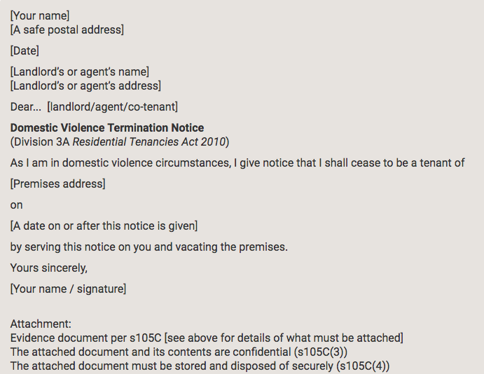
Domestic Violence Termination Notice (DVTN)
DVTN template available at:
https://www.tenants.org.au/sample/termination-domestic-violence

Slide 22
Evidence for DVTN
Certificate of conviction of domestic violence offender, or
Copy of Apprehended Domestic Violence Order, or
Copy of injunction granted under section 68B or 114 of the Family Law Act 1975, or
Declaration by a “competent person” (ie: a doctor)

Slide 23
Declaration by doctor
Information for doctors:
https://www.fairtrading.nsw.gov.au/housing-and-property/renting/ending-a-tenancy/domestic-violence-declaration
Form for doctors making declaration:
https://www.fairtrading.nsw.gov.au/__data/assets/pdf_file/0007/453247/Declaration-by-medical-practitioner.pdf

Slide 24
Serving the DVTN
Important to ensure DVTN is served correctly, this can be done by:
Hand delivery
Left in letter box
By fax
Post (must allow 7 business days)
https://www.tenants.org.au/sample/termination-domestic-violence

Slide 25
When the client wants to leave
Client is a Co-Tenant in a fixed term agreement
Serve a DVTN on the Co-Tenant and the Landlord
Seek an order from the NCAT to end the client’s tenancy in the special circumstances of the case (Section 102 of the RT Act)

Slide 26
When the client wants to leave
Client is a Co-Tenant in a periodic agreement
Serve a DVTN on the Co-Tenant and the Landlord
21 days written Notice of Termination to other Co-Tenant/s and the landlord (Section 101 of the RT Act)
Application to NCAT (tribunal) – hardship/special circumstances (Section 102 of the RT Act)

Slide 27
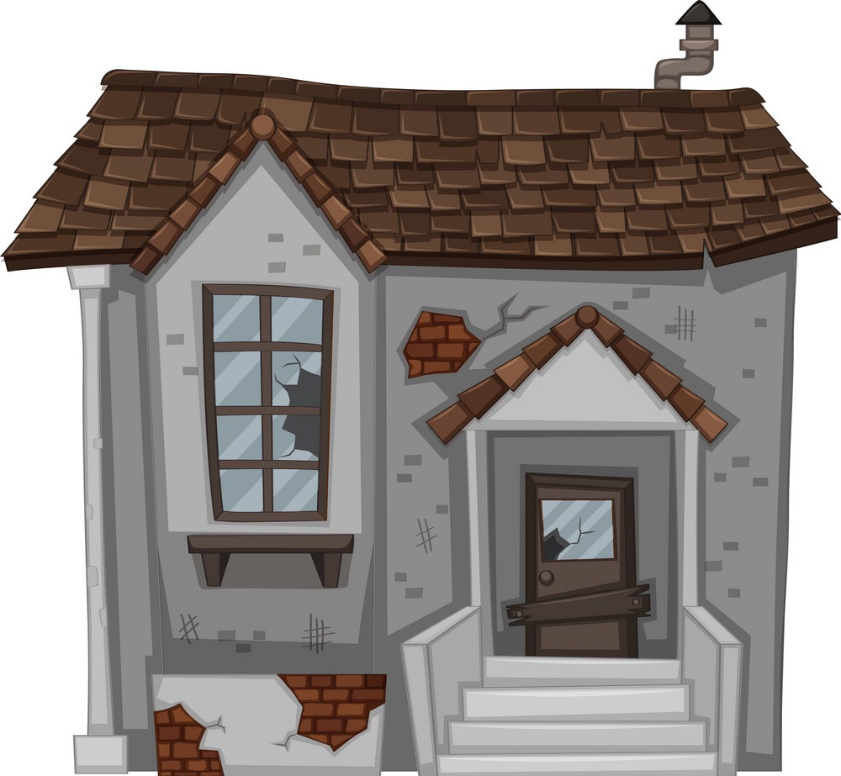
4. Damage to the property

Slide 28
Liability for damage
Usually a Tenant or Co-Tenant can be held responsible for damage caused by others in their property.
A tenant who has experienced DV is not responsible for damage caused by the perpetrator during a DV offence - if the perpetrator is not a Co-Tenant (Section 54 of the RT Act)
An exempted Co-Tenant is not responsible for damage caused by the perpetrator during a DV offence - if the perpetrator is not a Co-Tenant (Section 54 of the RT Act)

Slide 29
4. Changing the locks

Slide 30
Changing the locks
A tenant can change the locks only if they have:
The landlord’s permission, or
A reasonable excuse
EG: Tenant or Occupant is prohibited from entering the premises by AVO
Note: A copy of the new key is to be provided to the landlord within 7 days

Slide 31
4. “Bad” tenant database listings

Slide 32
Restrictions on “bad tenant” database listings
A landlord/agent must not list personal information about a person in a residential tenancy database if:
(a) the person was named as a tenant in a residential tenancy agreement that was terminated, or
(b) the person’s co-tenancy was terminated
and the person was the tenant, or the co-tenant who gave a DVTN.
(Section 213A of the RT Act)

Slide 33
4. Resources & where to get help

Slide 34
Resources / Where to get help
White Ribbon Australia
1800RESPECT / 1800 737 732)
24 hour national sexual assault, family and domestic violence counselling line
Womens Domestic Violence Court Advocacy Services
1800 WDVCAS / 1800 938 227)
https://www.wdvcasnsw.org.au/

Slide 35
Resources / Where to get help
Staying Home Leaving Violence program:
https://www.facs.nsw.gov.au/domestic-violence/services-and-support/programs/staying-home-leaving-violence
Remove violent partner from home
Provide safety and security upgrades
Support and prevention of further violence

Slide 36
Resources / Where to get help
The Tenant’s Union of NSW
https://www.tenants.org.au/resources/domestic-violence

Slide 37
Kimberley Mackenzie
Senior Solicitor
Redfern Legal Centre
Resources: www.rlc.org.au/training/resources/dvt

Slide 38
Tenants Advice & Advocacy Services
www.tenants.org.au
fact sheets and sample letters
free confidential legal advice on social housing
- enter your suburb

Slide 39
Before You Go

Slide 41
We Can Come to You

