Slide 1
Fines & Penalty Notices 1: Challenging a fine

Slide 2
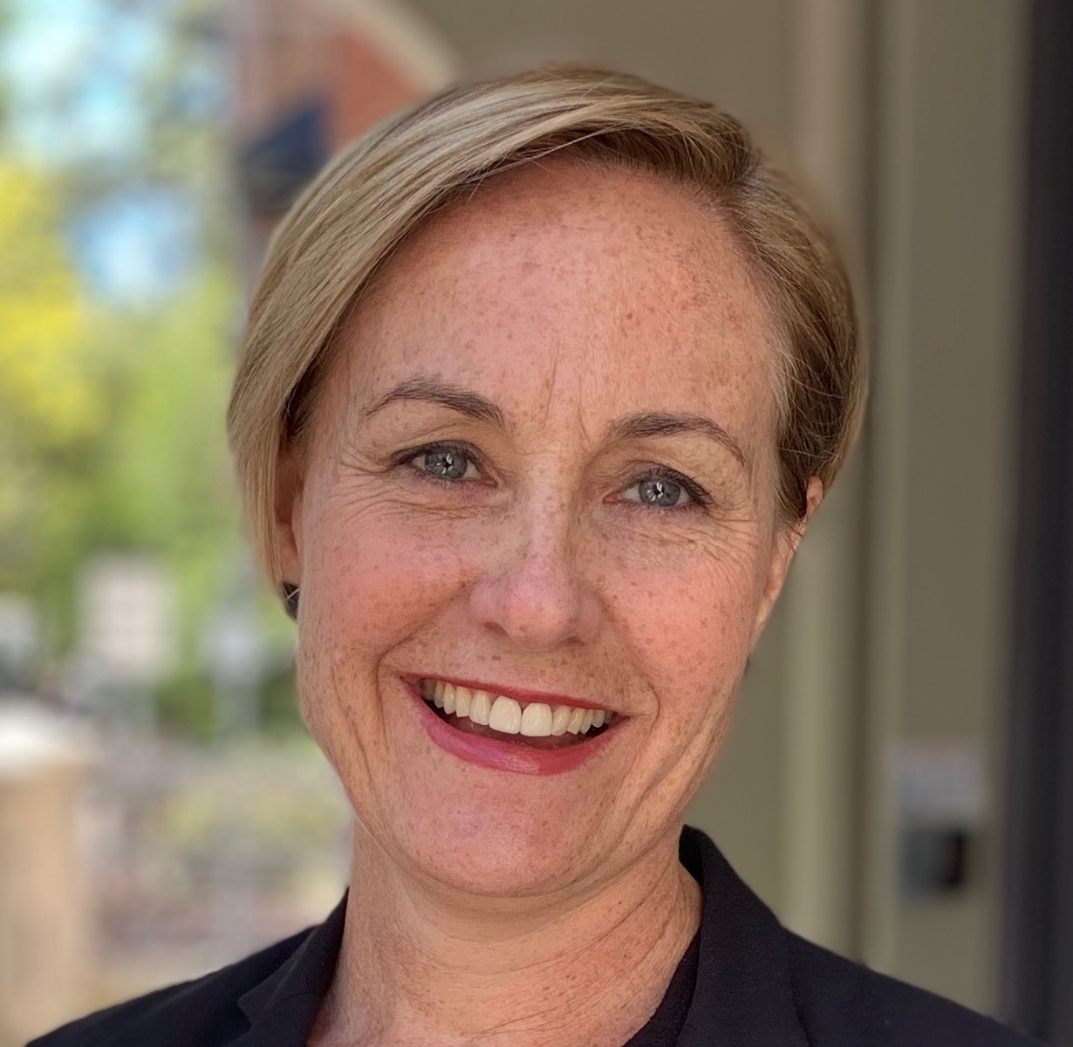
Sam Lee
Solicitor, Police Accountability and Government Law
Redfern Legal Centre

Slide 4
Outline: Fines & Penalty Notices 1: Challenging a fine
Types of fines
Internal Review
Electing to go to court
Children and fines
Questions & where to get legal advice
Resources: www.rlc.org.au/training/resources/fines

Slide 5
Types of fines
There are two types of fines:
Court fines
Penalty notices

Slide 6
Penalty Notices: Options for review
Internal review
Court election

Slide 8
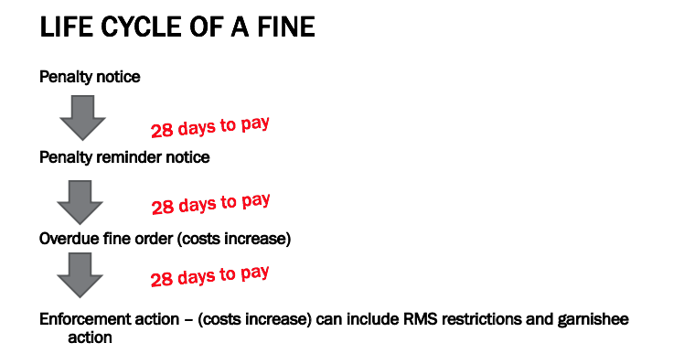
21 XX
Source: Inner City Legal Centre

Slide 9
Internal review

Slide 10
Time limits
Internal Review Application
If no payment made:
up until the due date for payment on the Penalty Reminder Notice
If paid in full and no reminder notice served:
application for review must be made within 60 days from the date the Penalty Notice was served

Slide 11
Why would you request a review?
Penalty notice wrongly issued
Mistaken identity
Exceptional circumstances
Intellectual disability, mental health issue

Slide 13
Evidence
Depending on the reason you are requesting a review:
copies of tickets
permits
police reports
medical evidence
proof of vehicle repairs
to support your claim.

Slide 14
Example: Sally’s internal review
Sally, a pensioner, attended her local council to pay her animal registration, which was approved with reduced fees.
She later received a fine from the council because they had made a mistake about her eligibility for reduced fees.
Sally applied for internal review, which was rejected
We applied again on her behalf, raising “new material”
Fine withdraw

Slide 15
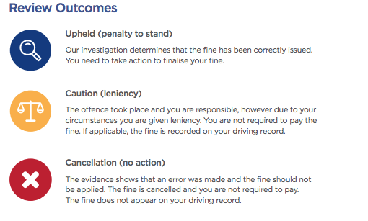

Slide 16
Electing
to go to
court

Slide 17
Time limits: Electing to go to court
If no payment or part-paid (and have not applied for a review):
The due date of the first penalty reminder notice
If paid in full (and have not applied for a review):
90 days from the date the penalty notice was received
If applied for internal review and unsuccessful:
28 days of being notified of the outcome of the review

Slide 18
Why would you take matter to court?
Don’t believe you broke the law
Want a more lenient penalty
About to lose licence

Slide 19
The dangers
Cost
Some offences are ‘strict liability’
Sometimes what you think is a defence is only an explanation, which means you are still guilty of the offence

Slide 20
The dangers (cont.)
Court could impose a higher penalty
Time consuming
Emotional
No guarantee of a good outcome

Slide 21
Court costs levy
A 'court costs levy' is a fee for having your case heard at court.
If you plead guilty or are found guilty of any offence the court will order that you pay mandatory court costs of $85 (as at July 2019) unless you:
get a section 10 for a case in the NSW Drug Court
get a section 10 dismissal for an offence that does not have a jail sentence
are convicted in the Children's Court
receive a jail sentence (other than a suspended sentence).

Slide 22
Strict liability
A strict liability crime is a crime that requires no “mens rea”.
That is, a crime that doesn't require you to intend to do something wrong or be morally blameworthy.
Example: speeding

Slide 24
Strict liability (cont.)
Honest and reasonable mistake

Slide 25
Best matters to take to court
Person with good driving record
Clear evidence that you did not break the law
Exceptional circumstances
You are willing to plead guilty, but seek leniency
You are about to lose your licence

Slide 26
What will the court consider?
Seriousness of the offence (safety)
Your traffic record
Financial situation
Age

Slide 27
What will the court consider? (cont.)
Circumstances surrounding the offence
Remorse
Evidence
Alternatives

Slide 28
What can the court do?
Dismiss the fine on the basis of not guilty
Dismiss penalty notice under s.10
Remove any demerit points
Reduce the cost of the fine
Impose a more significant fine
Nothing. Fine stands

Slide 29
Court-imposed Fines

Slide 30
Contesting a court fine
Appealing to the District Court
Applying to the court for annulment
Applying to the Minister for annulment

Slide 31
Time limits: Appealing to the District Court
You have a right to lodge a Notice of Appeal up to 28 days after the sentence date.
You can lodge an appeal up to 3 months from the sentence date if you get leave (permission) from the court.
Fee: $120

Slide 32
Not present when fine imposed
If convicted or sentenced in the Local Court less than 2 years ago, and you weren’t present when it happened, you can apply to have the sentence or conviction annulled.

Slide 33
Proof for annulment
You were not aware of the original case
You were unable to attend for a good reason
It is in the interests of justice to do so

Slide 34
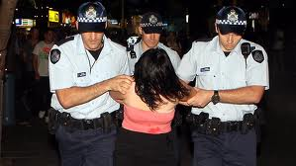
Children

Slide 35
Children (under the age of 18)
Electing to go to court:
Matter will be heard in the Children’s Court
Exception – traffic offence where the young person is old enough to have licence:
Matter heard in Local Court.

Slide 36
What can the Children’s Court do?
Caution instead
Refer to Youth Justice Conference
Dismiss the matter
If Court imposes a fine, the fine can’t be more than 10 penalty units (currently $1,100) for one offence.

Slide 37
Sam Lee
Solicitor, Police Accountability and Government Law
Redfern Legal Centre
Resources: www.rlc.org.au/training/resources/fines

Slide 38
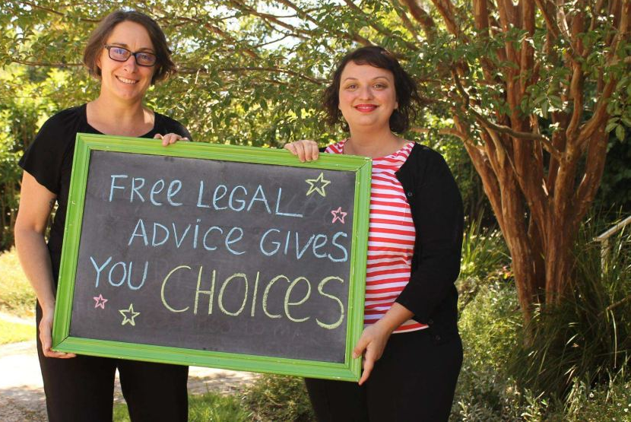
When to get legal advice on fines
If you want to challenge the penalty notice in court
If you want to annul old penalty notices, and then challenge them in court

Slide 39
Where to get free, confidential legal advice on fines
Redfern Legal Centre (local residents only) (02) 9698 7277
Most community legal centres: https://www.clcnsw.org.au/resource/community-legal-centres-nsw-directory-2018
Legal Aid NSW www.legalaid.nsw.gov.au/contact-us/legal-aid-nsw-offices
Homeless Persons Legal Service https://www.piac.asn.au/legal-help/hpls-clinic-times-locations
Shopfront Youth Legal Service (under 25s) www.theshopfront.org

Slide 40
Before You Go

Slide 42
We Can Come to You

