Slide 1
Underpaid at work?
Know your rights
24 June 2025
Seri Feldman-Gubbay
Senior Solicitor

Slide 2
Acknowledgement of Country

Slide 3
Who are we?
The Employment Rights Legal Service
The Employment Rights Legal Service (ERLS) is a new free employment law service to provide advice and representation to migrants and vulnerable workers across NSW. ERLS is a collaborative between Kingsford Legal Centre, Inner City Legal Centre and Redfern Legal Centre.

Slide 4
The information provided in this presentation is for information only.​ ​ It should not be relied on as legal advice. ​

Slide 5
Outline of discussion
What is an underpayment?
How do you work out your correct pay?
If you’ve been underpaid, what steps should you take?

Slide 6
What do underpayments look like?
FULL PAYMENT
OF ENTITLEMENTS
Sham contracting or
incorrect employment
status
Incorrect wage under the
Award / contract (including
overtime and penalty rates)
Other unpaid entitlements,
including superannuation,
personal leave, annual leave
loading, long service leave,
redundancy and tax
Occasional payments
to keep employees
interested
Misrepresenting
entitlements or
workplace rights (including deductions or requirements to spend)
Employee not paid for
all hours worked
NO PAYMENT

Slide 7
Spotting the signs: wage theft
“I got my job from Gumtree or a Whatsapp Group”
Who is the employer and what is their ABN?
What accountability does the employer have?
“My boss pays me when he can”
Missed pay and hours
Manipulation of respect and trust
“I get paid $15 per hour cash in hand”
Underpaid per national minimum wage
Tax?
Superannuation?
“I’ve never received a payslip”
Unable to check if pay is correct
Difficult to keep track of hours
Unable to check what entitlements are being paid

Slide 8
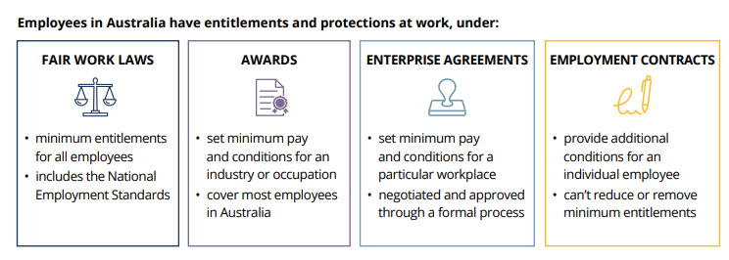
Entitlements for all employees

Slide 9
National Employment Standards
The National Employment Standards (NES) are 11 minimum employment entitlements that be provided to all employees in Australia
The NES cannot be excluded – you cannot ‘contract’ your rights away
Full-time work = 38 hours a week + reasonable additional hours
No requirement to work on a public holiday - paid day off for permanent employees
Notice of termination as per Fair Work Act – 1 - 5 weeks’ notice depending on service
Redundancy pay as per Fair Work Act - 4 - 16 weeks’ pay depending on service

Slide 10
Leave entitlements
Leave type | Permanent employee Full time/part time | Casual employee
Annual | 4 weeks’ paid leave (pro rata for part time) | X
Personal (sick/carer’s) | 10 days’ paid leave (pro rata for part time) | X
Compassionate | 2 days’ paid leave per occasion | 2 days’ unpaid leave per occasion
Family and domestic violence | 10 days’ paid leave per year | 10 days’ paid leave per year
Parental leave | After 12 months’ service, entitled to 12 months’ unpaid leave – can be extended to 24 months’ with employer’s agreement | Regular and systematic casuals (for at least 12 months) entitled to same as permanent employees
Unpaid carer’s leave | 2 days’ unpaid leave per occasion | 2 days’ unpaid leave per occasion

Slide 11
Awards
Sets out the minimum terms and conditions of employment for particular employees, on top of the NES
Almost all employees are covered by an Award, however senior management is not
Awards are either industrial or occupational, and set conditions for employees in those particular jobs or industries, including, minimum rates of pay, hours of work, rosters, breaks, allowances, penalty rates and overtime
Employees can use the ‘Find my award’ tool of the Fair Work Ombudsman website to work out their Award
Some employees will not be covered by any Award, but the minimum national wage applies to everyone and is increased each year.

Slide 12
National minimum wage
 | Until 30 June 2025 | From 1 July 2025
Permanent | $24.10 | $24.95
Casual | $30.13 | $31.19

Slide 13
Meet Fabiana
Fabiana found a job on Gumtree as a cleaner for Squeaky Kleen Pty Ltd. When she texted the boss, Greg, he told her she could start working straight away, but because she had no prior cleaning experience, she would need to complete five unpaid trial shifts. Fabiana thought this was reasonable and agreed. Greg told her she would have to pay $200 upfront to purchase the cleaning supplies for the work – she also agreed to this.
Fabiana worked the trial shifts, which were each seven hours long. After the final trial shift, Greg told her she had really proven herself and she would start to be paid. He told her that she would be paid a flat rate of $23 per hour, cash in hand, and that because their client’s needs change, her hours would change each week. He also told her that because most of their clients are corporate office spaces, she would usually get shifts on the weekend. She agreed to all of this.
Fabiana has now been working at Squeaky Kleen for one year and has never received a pay slip or superannuation.

Slide 14
The issues
Fabiana found a job on Gumtree as a cleaner for Squeaky Kleen Pty Ltd. When she texted the boss, Greg, he told her she could start working straight away, but because she had no prior cleaning experience, she would need to complete five unpaid trial shifts. Fabiana thought this was reasonable and agreed. Greg told her she would have to pay $200 upfront to purchase the cleaning supplies for the work – she also agreed to this.
Fabiana worked the trial shifts, which were each seven hours long. After the final trial shift, Greg told her she had really proven herself and she would start to be paid. He told her that she would be paid a flat rate of $23 per hour, cash in hand, and that because their client’s needs change, her hours would change each week. He also told her that because most of their clients are corporate office spaces, she would usually get shifts on the weekend. She agreed to all of this.
Fabiana has now been working at Squeaky Kleen for three months has never received a pay slip or superannuation.

Slide 15
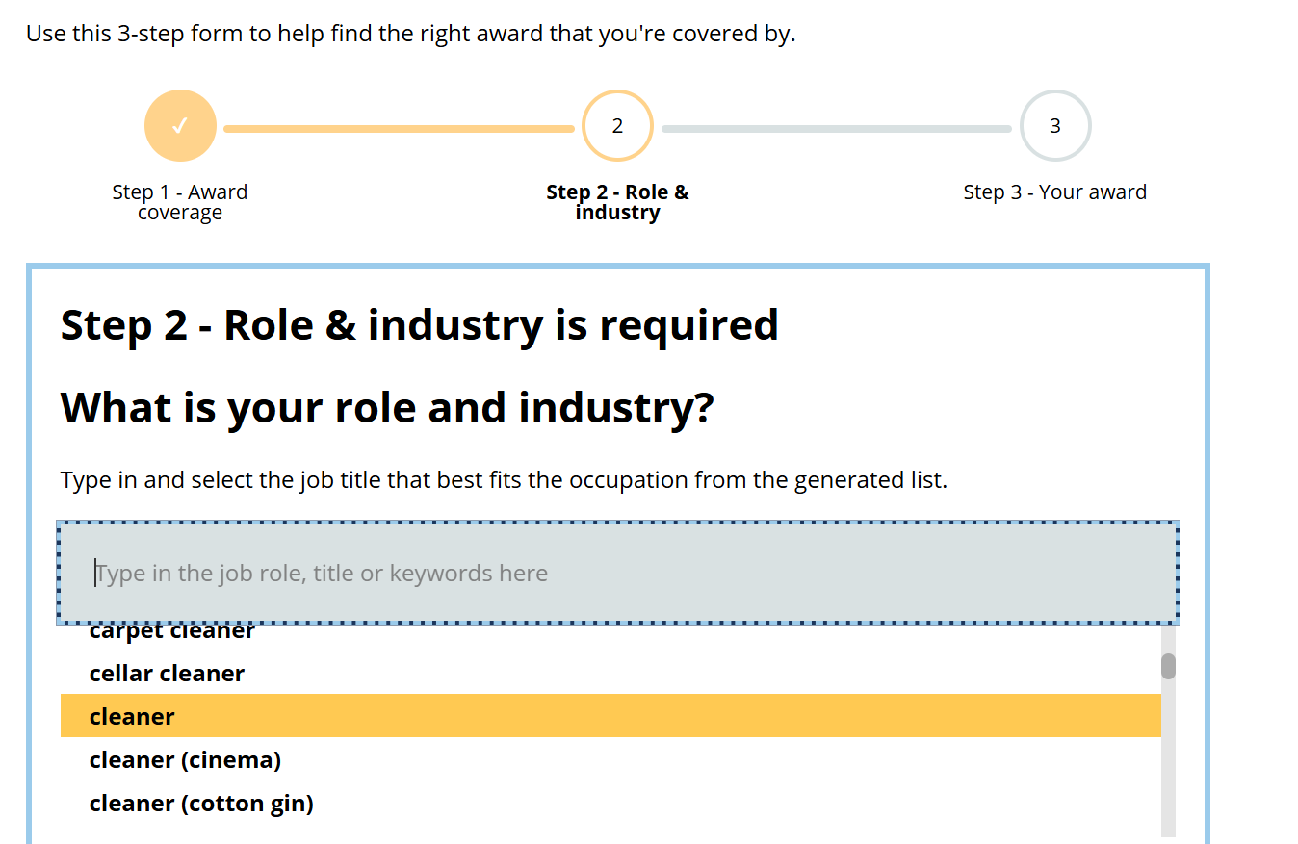
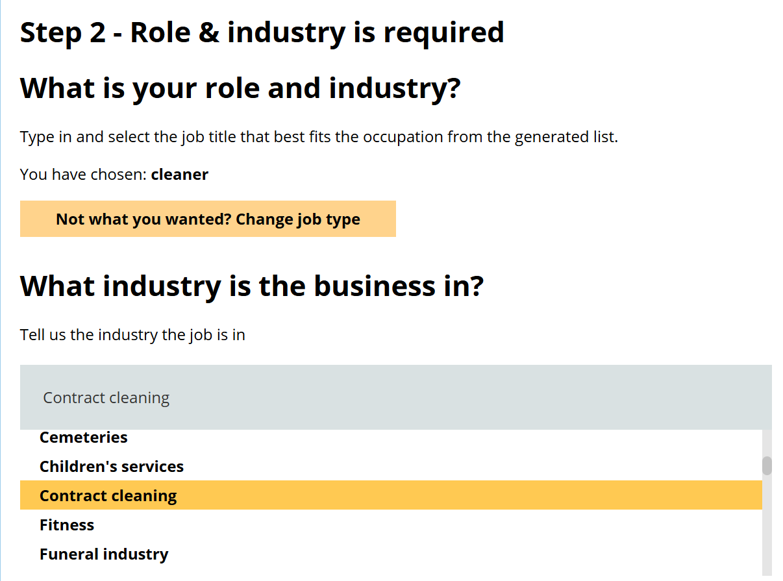
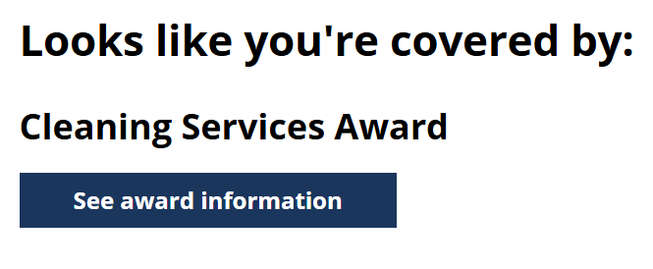
Let's help Fabiana
Find out if there is an Award for her by using the Fair Work Ombudsman’s ‘Find my Award’ tool.

Slide 16
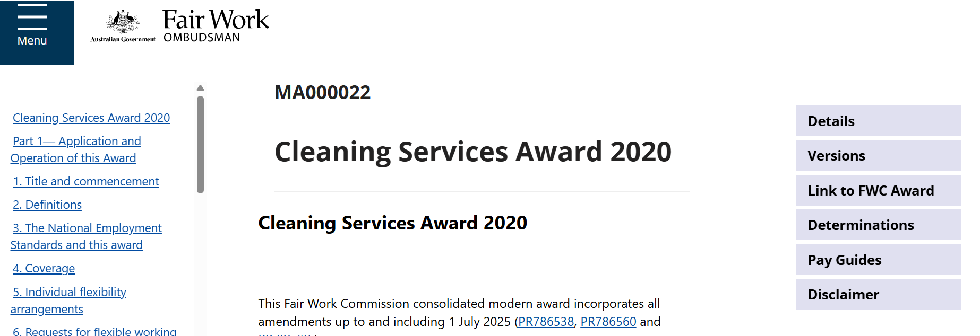
Let’s find out her proper entitlements

Slide 17
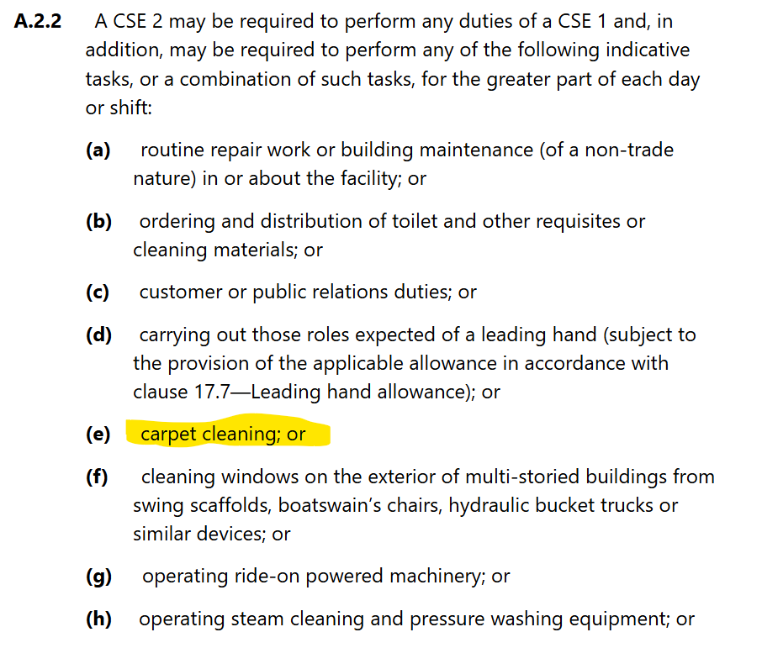
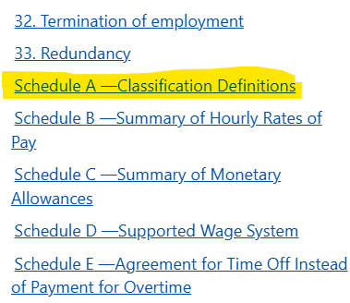
What is her classification?

Slide 18
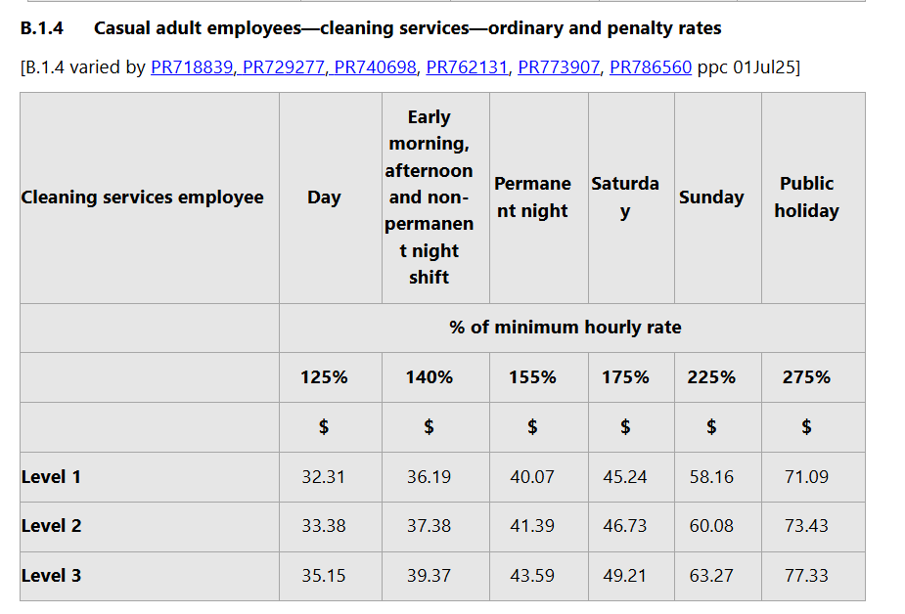
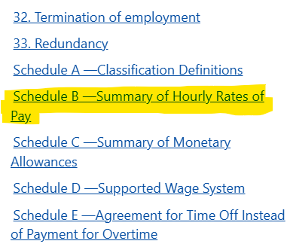
What is her correct pay?
No fixed hours = casual employee

Slide 19
What else do we need to check?
Ordinary hours vs overtime hours – the ‘normal’ spread of hours for this type of work
Penalty rates – special rates for work performed at certain times, for example after 6pm, or on a weekend

Slide 20
What is Fabiana owed?
Fabiana tells you that in the last three months, including the trial shift, she has worked a total of:
152 hours on Mondays to Fridays between 10am and 5pm
74 hours on Saturdays between 10am and 5pm
50 hours on Sundays between 10am and 5pm
She never worked more than seven hours in one shift
She was paid a total of ((152+74+50) x $23) = $6,348
The Award tells us she was entitled to be paid:
152 x $33.38 = $5,073.76
74 x $46.73 = $3,458.02
50 x $60.08 = $3,004
She should have been paid a total of $11,535.78
Fabiana has been underpaid
$11,535.78 - $6,348 =
$5,187.78

Slide 21
What about superannuation?
Period | Super guarantee (%)
1 July 2019 – 30 June 2020 | 9.50
1 July 2020 – 30 June 2021 | 9.50
1 July 2021 – 30 June 2022 | 10.00
1 July 2022 – 30 June 2023 | 10.50
1 July 2023 – 30 June 2024 | 11.00
1 July 2024 – 30 June 2025 | 11.50
1 July 2025 – 30 June 2026 | 12.00
All employees are entitled to be paid superannuation for ordinary hours of work (i.e. for anything that isn’t overtime)
Fabiana has also been underpaid superannuation
$11,535.78 x 11.5% = $1,326.61

Slide 22
How does Fabiana get her money back?
Write to her employer with a ‘letter of demand’
Proceed to Court
Make a complaint to the Fair Work Ombudsman
Make a complaint to the ATO
Get legal advice

Slide 23
Local Court, Industrial Court or Federal Courts
Small Claims or General Division
Filing Fee
Service
Dispute Resolution
Filing Evidence and Submissions
Hearing
Enforcement
Depending on the $ amount, small claims is usually quicker, cheaper, and easier for self-represented litigants
You can fill out a ‘fee waiver’ form if you cannot afford the filing fee

Slide 24
Who can we help?
Employment Rights Legal Service
Income threshold: $70,000
No employers
No workers’ compensation or personal injury
No union members
No independent contractors unless sham contracting is raised or suspected
https://rlc.org.au/what-we-do/our-services/employment-rights-legal-service

