Slide 1
28 May 2025 Financial abuse in family law: Understanding the new reforms Redfern Legal Centre
Notes:
Welcome to Redfern Legal Centre’s webinar, Financial abuse in family law: Understanding the new reforms. My name is Amelia Klein, and I’m the Supervising Solicitor of the Financial Abuse Service. I am not a family lawyer, but I am the MC of this webinar today.

Slide 2
Acknowledgement of Country
Notes:
I’d like to acknowledge the custodians of the land we all join you from. I believe that all of our presenters are joining from the land of the Gadigal people of the Eora nation, and all across Australia we are on unceded Aboriginal and Torres Strait Islander land. I’d like to pay my respects to Elders across this land, past and present, and recognise their ongoing stewardship of land, sea and community. This webinar is held during National Reconciliation Week, which spans each year from the date of the 1967 referendum to the date of Mabo decision, as a yearly reminder of the impacts Australian laws have on Indigenous Australians, and a time to learn about rich culture and history of Indigenous Australians, stretching back tens of thousands of years.

Slide 3
Bryan Do
Senior Associate, Accredited Family Law Specialist
Barry Nilsson
Skye Owen
Special Counsel, Accredited Family Law Specialist
Lander & Rogers
Catherine Liebel
Family Law Solicitor
Financial Abuse Service
Notes:
Today we are incredibly lucky to be joined by a wonderful panel of presenters. We really appreciate the time our pro bono partners give to both our clients in giving advice directly, and also in the generosity in time in being here for this presentation.
Today’s presentation is a collaboration between Bryan Do, Senior Associate and Accredited Family Law Specialist at Barry Nilsson, Skye Owen, Special Counsel and Accredited Family Law Specialist at Lander and Rogers, and Catherine Liebel, Family Law Solicitor at the Financial Abuse Service at Redfern Legal Centre. Bryan assists clients across Australia for financial, parenting and child support matters in family law, is a former secondee lawyer for the Financial Abuse Service and current volunteer. Skye was an Associate to a Federal Circuit Court Judge before becoming a family lawyer, is engaged for expert advice on issues involving complex parenting and family violence matters, and was one of the first family law volunteers for the Financial Abuse Service. Catherine works exclusively with victim survivors of financial abuse, prioritising access to support for victim survivors and has worked at the Financial Abuse Service since early 2024.

Slide 4
Content Warning
Notes:
This webinar contains reference to family violence. This may be distressing for some viewers. The webinar will be recorded and available on our website afterwards, if you need to take a break for any reason, and come back later.
If you need immediate or ongoing help in relation to issues raised in this webinar, contact 1800 RESPECT (1800 737 732) to talk to a counsellor from the national sexual assault and domestic violence hotline

Slide 5
Outline
Historical Decisions and Position
Current Legislative Amendments
How Changes Affect Current Practice
Question & Answer
Resources: https://rlc.org.au/training/resources/financial-abuse
Notes:
This is the outline of our presentation today. I will be monitoring the Q&A box for questions, including tech issues, and will attempt to address any issues that I see, but otherwise, the recording will be available after the fact. I can’t guarantee we’ll get to any questions, as we did have a number come through in advance, but if after this you’d like to refer any clients for advice, you can contact falsintake@rlc.org.au – and I might put our presenters on the spot.
I’ll hand over now to Cath and Bryan for the first part of our webinar.

Slide 6
1 Historical Decisions and Position

Slide 7
“The system”: Family Law in 60 seconds
Family law is loosely divided into several areas:
Parenting,
Property,
Separation or divorce,
Child support, and
Spousal maintenance.
These usually cross over and clients will deal with multiple aspects.
KEY TERMS:
“Property” does not simply refer to real estate – it is everything that is owned or owed by the parties.
“Property settlement” refers to the division of the matrimonial asset pool

Slide 8
Divorce and Separation
Divorce is a Court Order stating that a marriage is dissolved.
Divorce allows a client to re-marry and sets the clock ticking on property settlement.
Clients must either finalise property settlement or file within 12 months of the date of divorce.
De facto couples must finalise property settlement or file within 2 years of separation.
There is nothing official clients need to do to separate other than communicate it to the other party.

Slide 9
Property: the four step process
Asset pool
All assets and liabilities up until present date, including super and HECS.
2. Contributions?
Initial contributions, financial, non-financial, parenting and homemaker, windfalls, gifts from family members, etc
3. Future Needs?
Age, health, parenting or other responsibilities, income earning disparity
4. What would be fair under all the circumstances?
Length of the relationship is relevant

Slide 10
Parenting
No time limit for a parenting application
Best interests of the child paramount
Changes to the legislation came into effect 6 May 2024.

Slide 11
Spousal Maintenance & Child Support
Clients need to show two things:
1. That they have need; and
2. That the other party has capacity to pay
Child support can be formal or informal.
Informal: as agreed between parties.
Formal: by assessment or formal agreement.
2 types of child support agreements: limited and binding.

Slide 12
Kennon & Kennon (1997) FamCA 27 AR 84, 294
“ It is essential to bear in mind the relatively narrow band of cases to which these considerations apply. To be relevant, it would be necessary to show that the conduct occurred during the course of the marriage and had a discernible impact upon the contributions of the other party. It is not directed to conduct which does not have that effect and of necessity it does not encompass (as in Ferguson) conduct related to the breakdown of the marriage (basically because it would not have had a sufficient duration for this impact to be relevant to contributions). ”

Slide 13
Key Cases
Spagnardi & Spagnardi [2003] FamCA 905
Discernible Impact
Britt & Britt (2017) FamCA 982
Admissibility of evidence
Keating & Keating [2019] FamCAFC 46
Quantifying the effect of violence upon the party’s capacity to contribute
Benson & Drury [2020] FamCAFC 303
Holistic assessment
Financial Abuse in Family Law | 28 May 2025
Notes:
Kennon arguments have had a torturous history. Parties and practitioners have been left with some confusion as to what is required to meet the threshold and what that means in practical terms of outcomes.
Some key cases have fleshed out the judgement in Kennon.

Slide 14
Challenges in running a ‘Kennon’ claim
High evidentiary threshold
Meaning of ‘quantification’
Risk of inconsistent outcomes

Slide 15
2 Current Legislative Amendments

Slide 16
Summary of amendments to the Family Law Act 1975 (Cth)
Passed on 10 December 2024 and comes into effect on 10 June 2025
Provides for a range of significant amendments:
Schedule 1—Property reforms [today’s focus]
Part 1—Property framework
Part 2—Principles for conducting property or other non‑child‑related proceedings
Part 3—Duty of disclosure and arbitration
Schedule 2—Children’s contact services
Schedule 3—Case management and procedure
Schedule 4—General provisions
Schedule 5—Review of amendments

Slide 17
Property reforms – today’s focus
Definition of family violence to include “economic or financial abuse”
Property reforms – specific references to family violence
Companion animals
Disclosure obligations

Slide 18
Amendment to section 4AB FLA – definition of family violence
(2A) For the purposes of paragraph (2)(g), examples of behaviour that might constitute economic or financial abuse of a family member include (but are not limited to) the following:
(a) unreasonably denying the family member the financial autonomy that the family member would otherwise have had, such as by:
(i) forcibly controlling the family member’s money or assets, including superannuation; or
(ii) sabotaging the family member’s employment or income or potential employment or income; or
(iii) forcing the family member to take on a financial or legal liability, or status; or
(iv) forcibly or without the family member’s knowledge, accumulating debt in the family member’s name;
(b) unreasonably withholding financial support needed to meet the reasonable living expenses of the family member, or the family member’s child (including at a time when the family member is entirely or predominantly dependent on the person for financial support);
(c) coercing a family member (including by use of threats, physical abuse or emotional or psychological abuse):
(i) to give or seek money, assets or other items as dowry; or
(ii) to do or agree to things in connection with a practice of dowry;
(d) hiding or falsely denying things done or agreed to by the family member, including hiding or falsely denying the receipt of money, assets or other items, in connection with a practice of dowry.
18

Slide 19
Amendment to section 79(3) / 90SM(3) FLA – orders in property settlement proceedings
(3) In considering what order (if any) should be made under this section in property settlement proceedings, the court:
(a) is to identify:
(i) the existing legal and equitable rights and interests in any property of the parties to the marriage or either of them; and
(ii) the existing liabilities of the parties to the marriage or either of them; and
(b) is to take into account (except for the purpose of making an order with respect to the ownership of property that is a companion animal):
(i) the considerations set out in subsection (4) (considerations relating to contributions); and
(ii) the considerations set out in subsection (5) (considerations relating to current and future circumstances).
19

Slide 20
Amendment to section 79(4) / 90SM(4) FLA – consideration of contributions
(4) For the purposes of subparagraph (3)(b)(i), the court is to take into account the following considerations, so far as they are relevant:
[…]
(ca) the effect of any family violence, to which one party to the marriage has subjected or exposed the other party, on the ability of a party to the marriage to make the kind of contributions referred to in paragraphs (a), (b) and (c);
[…]
20

Slide 21
Amendment to section 79(5) / 90SM(5) FLA – consideration relating to current and future circumstances
(5) For the purposes of subparagraph (3)(b)(ii), the court is to take into account the following considerations, so far as they are relevant:
(a) the effect of any family violence, to which one party to the marriage has subjected or exposed the other party, on the current and future circumstances of the other party, including on any of the matters mentioned elsewhere in this subsection;
[…]
(d) the effect of any material wastage, caused intentionally or recklessly by a party to the marriage, of property or financial resources of either of the parties to the marriage or both of them;
(e) any liabilities incurred by either of the parties to the marriage or both of them, including the nature of the liabilities and the circumstances relating to them;
21

Slide 22
Amendment to section 75(2) / 90SF(3) FLA – matters to be taken into consideration in relation to maintenance
The matters to be so taken into account are:
[…]
(aa) the effect of any family violence to which one party has subjected or exposed the other party, including on any of the matters mentioned elsewhere in this subsection
22

Slide 23
Amendment to section 4 [definitions] and section 79(5) [property settlement] – companion animals
Companion animal means an animal kept by the parties to a marriage or either of them, or the parties to a de facto relationship or either of them, primarily for the purpose of companionship (save for some exceptions listed under section 4)
Court may make an order (including a consent order or an interim order) for the companion animal:
to be retained by a party to proceedings
to be transferred to another person who has consented to transfer
sold
Considerations include:
circumstances in which the companion animal was acquired
who has ownership or possession of the companion animal
extent to which each party cared for, and paid for the maintenance of, the companion animal
any family violence to which one party has subjected or exposed the other party
any history of actual or threatened cruelty or abuse by a party towards the companion animal
any attachment by a party, or a child of the marriage, to the companion animal
the demonstrated ability of each party to care for and maintain the companion animal in the future, without support or involvement from the other party;
any other relevant fact or circumstance
23

Slide 24
Addition of disclosure obligations to FLA
Currently – a party’s disclosure obligations set out under the Family Law Rules
From 10 June 2025 – codification of disclosure obligations under the Family Law Act:
sections 71B – for spouses
section 90RI – for de facto spouses
24

Slide 25
3 How Changes Affect Current Practice

Slide 26
Examples of Financial Abuse
(a) unreasonably denying the family member the financial autonomy that the family member would otherwise have had, such as by:
(i) forcibly controlling the family member’s money or assets, including superannuation; or
(ii) sabotaging the family member’s employment or income or potential employment or income; or
(iii) forcing the family member to take on a financial or legal liability, or status; or
(iv) forcibly or without the family member’s knowledge, accumulating debt in the family member’s name;
(b) unreasonably withholding financial support needed to meet the reasonable living expenses of the family member, or the family member’s child (including at a time when the family member is entirely or predominantly dependent on the person for financial support);
(c) coercing a family member (including by use of threats, physical abuse or emotional or psychological abuse):
(i) to give or seek money, assets or other items as dowry; or
(ii) to do or agree to things in connection with a practice of dowry;
(d) hiding or falsely denying things done or agreed to by the family member, including hiding or falsely denying the receipt of money, assets or other items, in connection with a practice of dowry.

Slide 27
Court to consider:
(d) the effect of any material wastage, caused intentionally or recklessly by a party to the marriage, of property or financial resources of either of the parties to the marriage or both of them;
(e) any liabilities incurred by either of the parties to the marriage or both of them, including the nature of the liabilities and the circumstances relating to them;
(f) the extent to which either party to the marriage has the care of a child of the marriage who has not attained the age of 18 years, including the need of either party to provide appropriate housing for such a child;

Slide 28
Companion animals
Considered separately to chattels

Slide 29
Disclosure
(1) Each party to a proceeding relating to financial or property matters of a marriage (other than proceedings on appeal) has a duty to the court and to each other party to give full and frank disclosure, in a timely manner, of all information and documents relevant to:
(a) for a party to the marriage—the issues in the proceeding that relate to financial or property matters of the marriage; or
(b) for any other party to the proceeding—so much of the party’s financial circumstances as are relevant to the issues in the proceeding that relate to financial or property matters of the marriage.
(2) The duty under subsection (1) applies from the start of the proceeding and continues until the proceeding is finalised.

Slide 30
Questions... & answers Resources: https://rlc.org.au/training/resources/financial-abuse

Slide 31
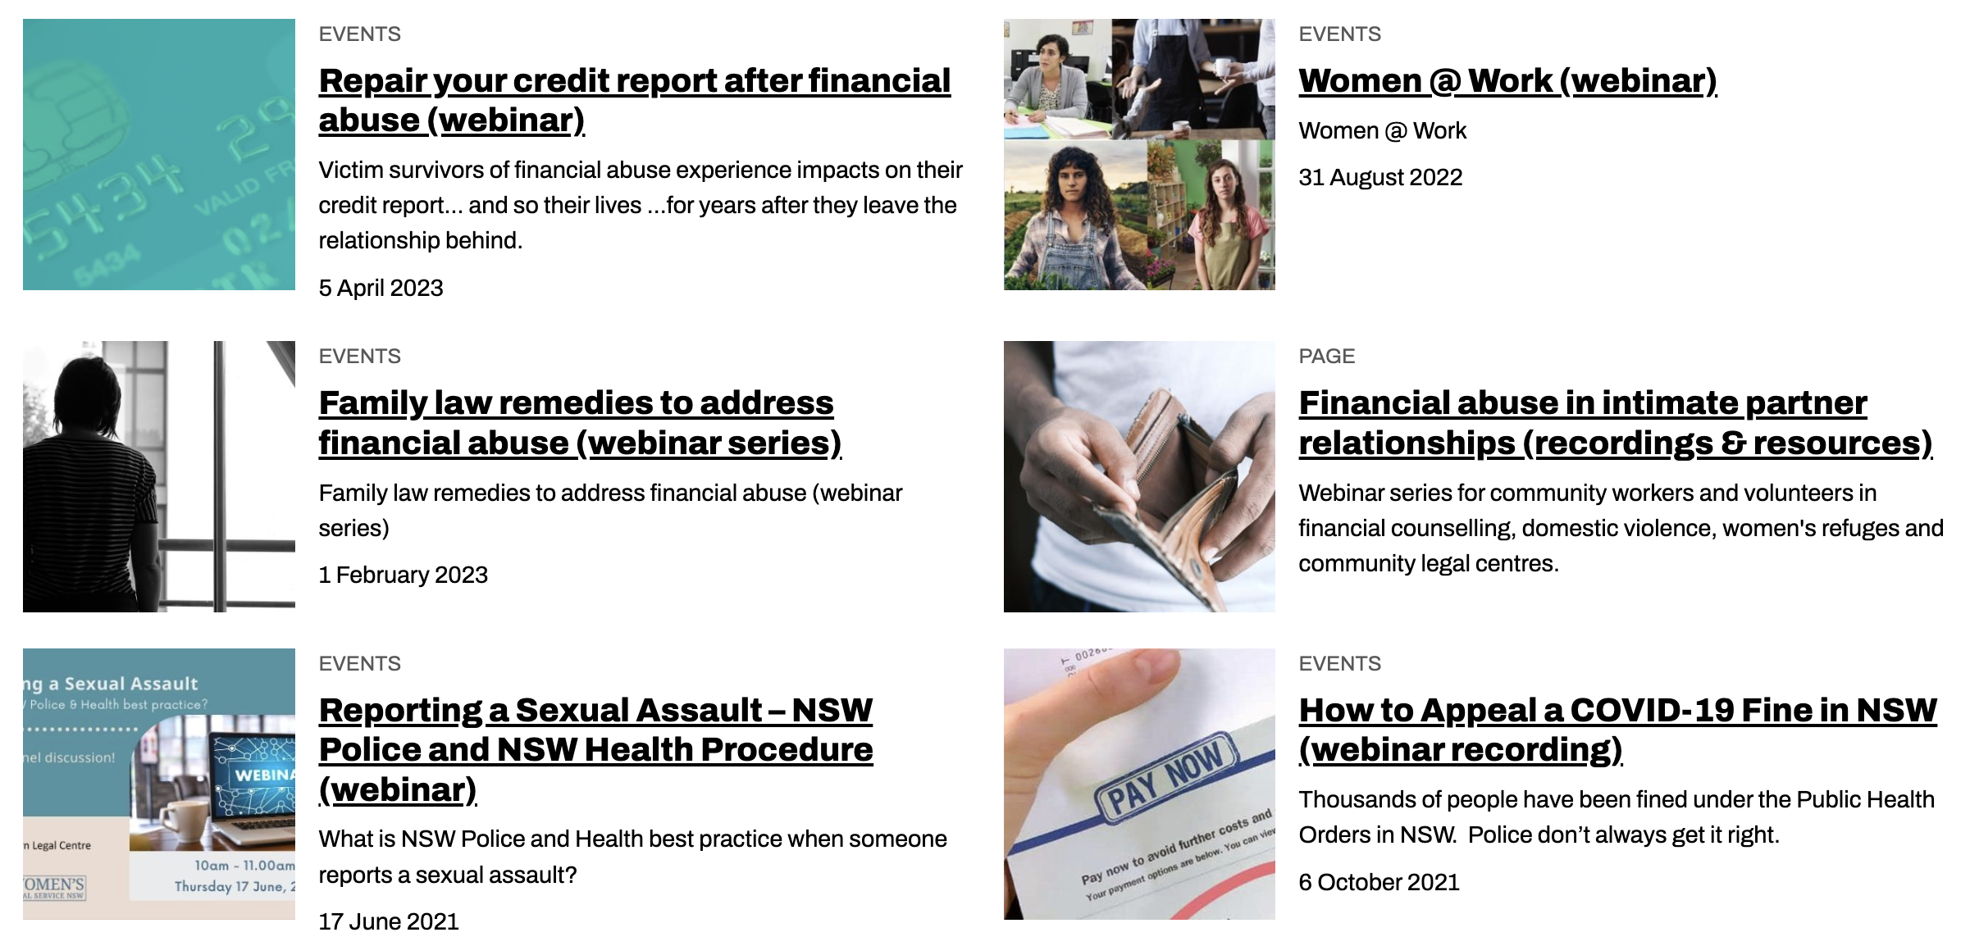
Community legal education - free webinars & recordings www.rlc.org.au/training education@rlc.org.au

Slide 32
Your feedback is important to us! www.rlc.org.au/feedback or scan the QR code >>>

