Slide 1
5 March 2025 Help! My Client Has Problem Debts #1: Navigating Internal Dispute Resolution

Slide 2
Francesco Terranova Credit, Debt & Consumer Law Solicitor
Redfern Legal Centre

Slide 3
Acknowledgement of Country

Slide 4
Outline
Simon’s Story
Identify
Gather Information
Determine the issues
Assess Urgency
Negotiate a resolution
Simon’s Story: The Outcome
Questions & more information Resources: rlc.org.au/training/resources/debts

Slide 5
What is internal dispute resolution?
Referred to as IDR
Internal process for consumers to resolve disputes quickly and directly
Raises awareness of systemic problems.

Slide 6
Internal Dispute Resolution (IDR)
External Dispute Resolution (EDR)
Court

Slide 7
Who has IDR procedures?
Businesses that provide consumer credit and loans
Insurance companies
Utility providers

Slide 8
Simon’s story
30 years old
Disability support pension
Living with parents in social housing
$45,000 credit card debt to Big Bank Inc.

Slide 9
Simon #2
Simon comes to see you with a file full of bank statements spanning the last 10 years
Repayments are unmanageable, stopping him from living independently
Stress from debt is exacerbating his mental illness
What would you do?

Slide 10
1 Identify

Slide 11
Is there a problem debt?
Get a list of all debts the person is aware of
Ask questions – shame or limited financial literacy can be barriers to disclosure of debts
Rarely only one problem debt

Slide 12
Who is making the claim?
Debt Collection Agency
Creditor
Debtor
Agent
Assignment

Slide 13
2 Gather information

Slide 14
Request information from the debtor #1
Any written communication from the creditor or debt collector regarding the debt, eg. bills, emails, texts, letters, default notice, letter of demand, court document
Information about any verbal communication from the debtor, eg. phone calls, in person
Evidence of current income, eg. pay slips, Centrelink income statement, Tax return / Business Activity Statement (BAS)

Slide 15
Request information from the debtor #2
Evidence of any health issues, eg. letter from GP, report from psychologist, test results summary
Current living situation, eg. tenant, home owner, homeless
Family situation, eg. any dependents , partner contributing to household expenses (or not contributing)
The value of any assets, eg. motor vehicle, property, investments.

Slide 16
Request information from the creditor / debt collector #1
Ideally request in writing
Get a signed written authority to release information (some creditors have specific authority forms)
Letter should identify the debtor’s name, date of birth, account number / reference number (if known)
Refer to “alleged debt”

Slide 17
Request information from the creditor / debt collector #2
Copy of the original contract / agreement
Most recent bill / invoice / claim
Itemised account statement summary
Payout figure
Any default notices sent to the client

Slide 18
Request information from the creditor / debt collector #3
For credit / loans from financial service provider, also request:
A copy of the credit / loan application form
A copy of the final credit assessment/s and verification documents
Any notices under the National Credit Code previously sent to the client
Details of the original limit and any limit increases on the client’s credit card account, including date of the limit increase

Slide 19
Request information from the creditor / debt collector #4
Request the documents to be provided within 30 days of the letter, and ask the creditor to refrain from taking any further legal action until 30 days after the documents requested above have been received.
If the creditor is unable to make this undertaking, inform the client in writing immediately.

Slide 20
3 Determine the issues

Slide 21
Red flags for legal issues #1
Expert legal advice is required to determine a legal cause of action and the prospects of success, but some obvious signs to look out for include:
Client was on a Centrelink income when they were approved for a credit card / loan
Client had multiple payday loans at the same time
Client’s bill is extremely high compared to previous bills
Client has multiple loans from the same / different lenders

Slide 22
Red flags for legal issues #2
Client has experienced domestic violence – see RLC’s webinar series on financial abuse in intimate personal relationships for specific information on how to resolve debts arising from financial abuse: www.rlc.org.au/training/resources/financial-abuse
Client does not speak English or has another significant vulnerability that was exploited by the creditor.
Links above are also on the Resources page at: www.rlc.org.au/training/resources/debts

Slide 23
Common legal issues
Credit Matters – Grounds for a Responsible Lending complaint?
Buy Now Pay Later (BNPL) will be regulated!
Goods and Services – Breach of the Australian Consumer Law?
Insurers and Motor Vehicle Accidents – Is there a Defence?
Is the debt 6 years old or more.

Slide 24
Time limit for debt recovery
For most debts, a creditor must begin court action to recover the debt within 6 years of:
the date that the debt first arose, or
the date that the client last made a payment; or
the date that the client last acknowledged in writing that they owed the debt,
whichever is the most recent.

Slide 25
Old debt #1
If the debt is past the 6 year time limit, it is an old debt:
Don’t make a repayment
Don’t confirm in writing that client owes the debt.

Slide 26
Old debt #2
Do:
Get legal advice immediately
Tell the debt collector/creditor that the debt is disputed because it is statute barred (more than 6 years old)
Request debt collector/creditor to provide copies of the contract and account statements – be careful not to acknowledge alleged debt - use the term “alleged debt” to avoid acknowledgement.

Slide 27
Financial hardship
Debtor agrees they owe the money and the amount is not in dispute but cannot afford to pay
Change in circumstances eg. loss of work, health problems
Can occur with a legal / other dispute.

Slide 28
4 Assess urgency

Slide 29
Stages in a debt
Overdue
Formal demand
Statement of Claim
Creditor chasing client
Creditor or Debt Collection Agency threatening court recovery
Court recovery commenced

Slide 30
Stage 1: Low urgency
Overdue
Formal demand
Statement of Claim
Overdue bill
Reminder letter

Slide 31
Debt collection guidelines
A debt collector must not:
Use physical force or coercion
Harass or hassle the client to an unreasonable extent
Mislead or deceive the client
Take unfair advantage of any vulnerability, disability or other similar circumstances affecting the client
(Source: ASIC and ACCC)

Slide 32
Debt collector conduct
As a guide, if contact is necessary, unless client agrees otherwise, it should be limited to:
A maximum of 3 phone calls or letters per week (or 10 per month)
No contact on national public holidays
Phone contact only 7:30am-9pm weekdays and 9am-9pm weekends
Face to face contact only between 9am-9pm weekdays and weekends
Home visits only if there is no other effective way of contacting client
Showing up at client’s workplace as a last resort if all above fails.

Slide 33
Avoid debt negotiation firms
Debt negotiation firms market themselves as “professional debt negotiators”, but do not need to have any qualifications, skills or training.
They are not required to satisfy any particular standards or disclosure obligations to the client. This leaves the client vulnerable.
Firms can charge a fee based on the percentage of amount of debt. Fees can add up to thousands depending on the size of the client’s debt.
There are free alternatives: financial counselling, community legal centres or Legal Aid, National Debt Hotline in NSW.

Slide 34
Stage 2: Don’t panic, but don’t ignore
Overdue
Formal demand
Statement of Claim
Letter and/or default notice requesting full payment by a particular date
Will threaten further recovery action if not paid
May be sent from the creditor / debt collector’s lawyer

Slide 35
Stage 3: High urgency – act quickly!
Overdue
Formal demand
Statement of Claim
Statement of Claim: A document that starts a court claim
Must be personally served on the debtor or posted by the court
Plaintiff: The Creditor / Debt Collector
Defendant: The debtor

Slide 36
Stage 3: High urgency – act quickly #2
Overdue
Formal demand
Statement of Claim
Debtor has 28 days to respond.
If no response, after 28 days, the plaintiff can apply for default judgment.
Judgment can be enforced through the court.
Get legal advice immediately.

Slide 37
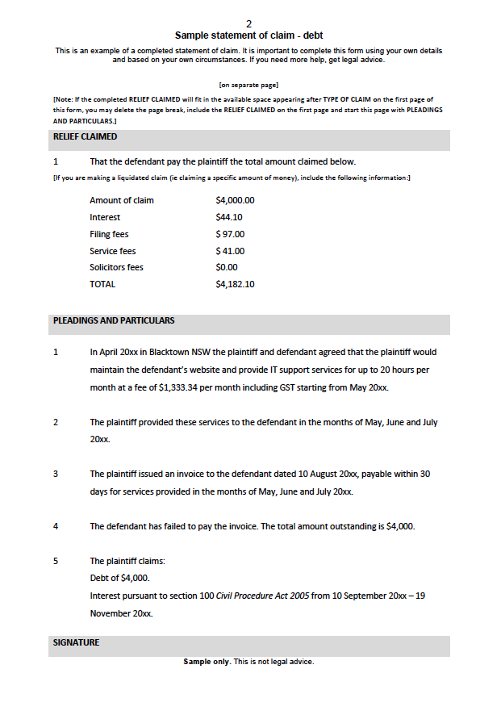
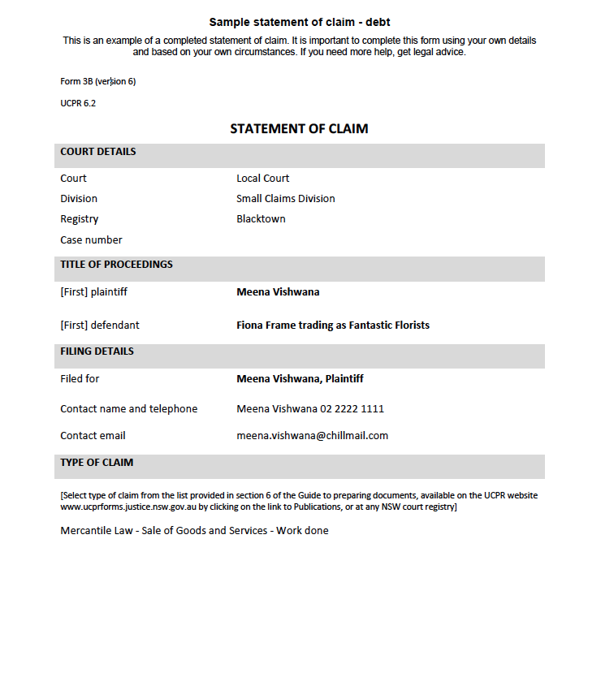

Slide 38
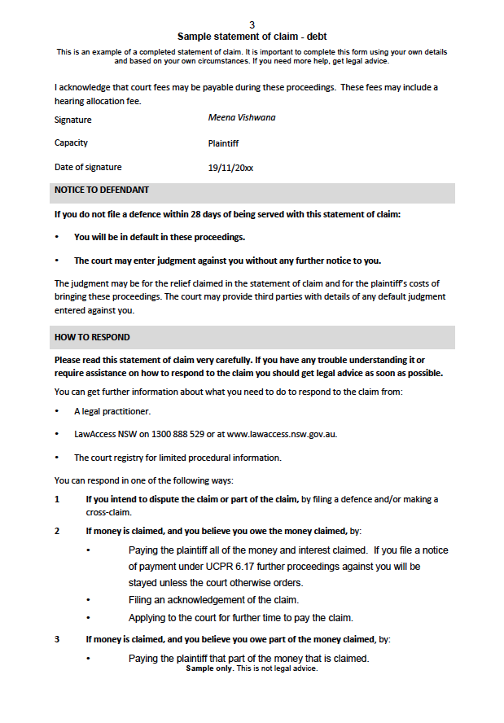

Slide 39
What to do if your client is served with a statement of claim?
The defendant should get legal advice about a defence / possible settlement.
If the plaintiff is a member the Australian Financial Complaints Authority (AFCA), the defendant can lodge a complaint with AFCA. All enforcement action (including court proceedings) will be put on hold while AFCA determines the complaint.
See RLC’s webinar or recording on external dispute resolution for more information about the above process: www.rlc.org.au/training/debts2
Links above are also on the Resources page at: www.rlc.org.au/training/resources/debts

Slide 40
Other circumstances when your client should seek legal advice immediately!
The client has a judgement order against them.
Enforcement action has been taken against the client, eg. a garnishee order for their wages or bank account.
The client is required to attend court under an examination order.
Any court proceedings are on foot.
The debt is more than 6 years old.

Slide 41
Why it is best to avoid court
Costs orders can be made against the unsuccessful party
Evidence standards are higher than for IDR and EDR
Legal representation is expensive / unattainable for most people
Stress from meeting court deadlines
Loss of income from attending court
Judgment order enforceable for 12 years
Court enforcement options
Pre and post judgment interest may be added to the debt.

Slide 42
Impact on credit report #1
Mandatory reporting for major banks
Late or missed payments, financial hardship, contract variations will show up on credit reports
Judgment debts/defaults stay on client’s file for 5 years.

Slide 43
Impact on credit report #2
Repayment history will remain on credit reports for 24 months
Grace period of 14 days
But... credit reports should only reflect a person’s credit worthiness
If there are errors on a credit report, you can assist clients to contact the financial service provider to fix them.

Slide 44
Impact on credit report #3
Don’t do nothing!
Encourage clients to engage in IDR
Get financial counselling or legal advice
Financial hardship notations remain on credit reports for 12 months
Telcos and energy providers will not be able to see repayment history or financial hardship notations

Slide 45
5 Negotiate a resolution

Slide 46
What debts can be dealt with by IDR?
Financial services are required to have in place an internal process to resolve complaints with consumers.
Insurance companies who have adopted the General Insurance Code of Practice are required to have an IDR process.
Utility providers have financial hardship teams that help customers who are struggling to pay their bills.

Slide 47
General process
Identify the IDR contact for the creditor
Send a written dispute / submission
Record the date when a response is required
Request a written response from creditor

Slide 48
General process (cont.)
Receive a response – rejection or offer
Seek instructions from client
Negotiate further if required
Agree an outcome – always in writing and ideally signed by both parties.

Slide 49
How to find the IDR contact
A member of AFCA (Australian Financial Complaints Authority): find the contact on AFCA’s website: https://my.afca.org.au/ff-search
A telco: find the contact on Telecommunications Industry Ombudsman (TIO) website: www.tio.com.au/members/who-we-work-with
A NSW energy or water company: find the contact on Energy & Water Ombudsman NSW (EWON) website: www.ewon.com.au/page/suppliers/list-of-member-providers
Links above are also on the Resources page at: www.rlc.org.au/training/resources/debts

Slide 50
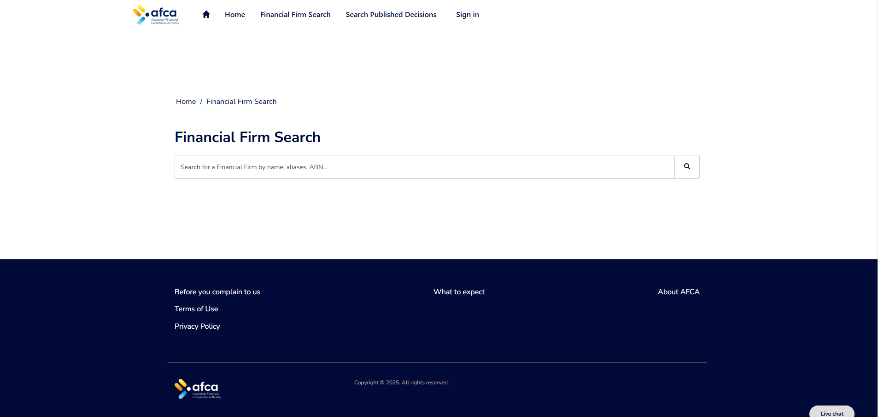

Slide 51
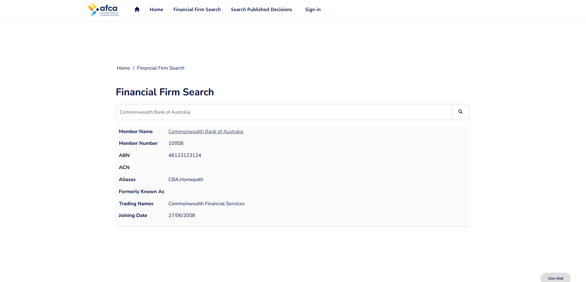

Slide 52
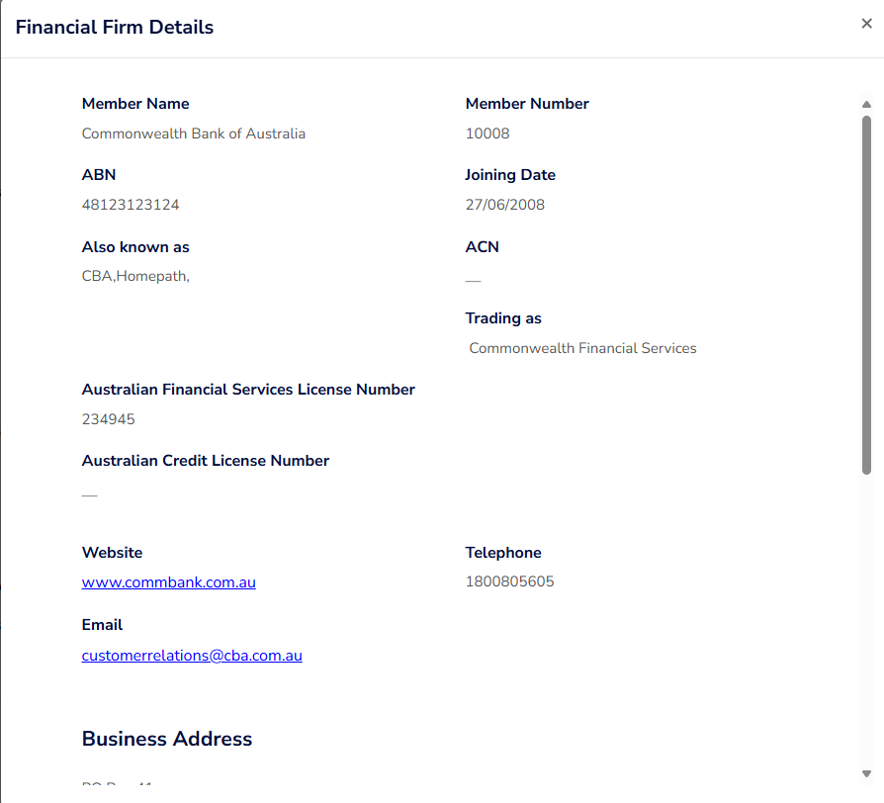

Slide 53
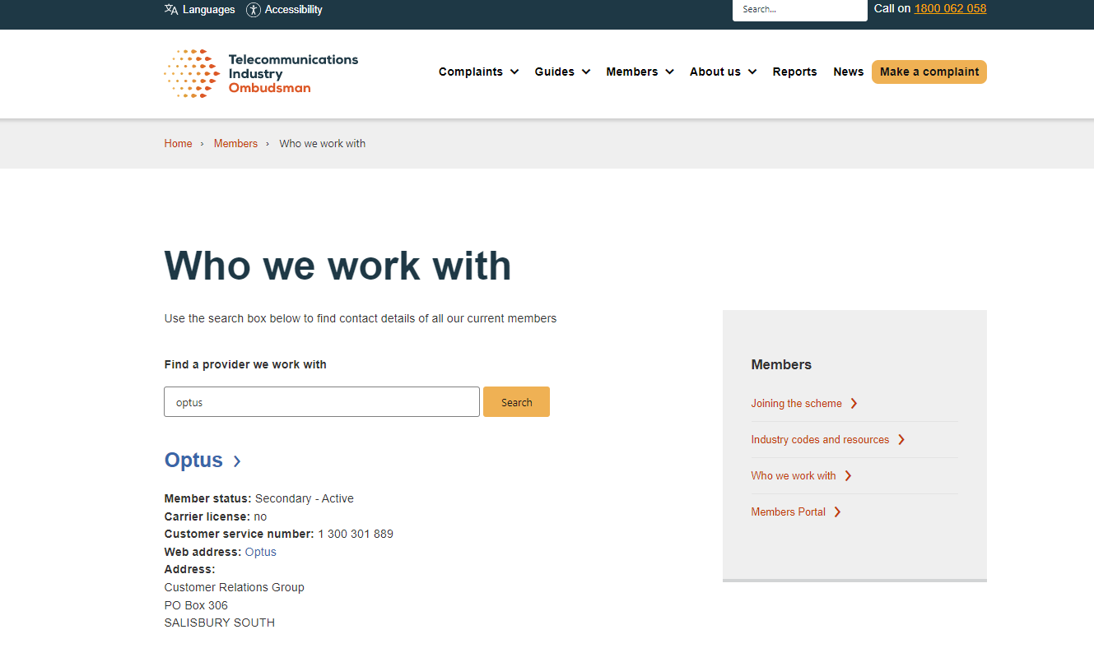

Slide 54
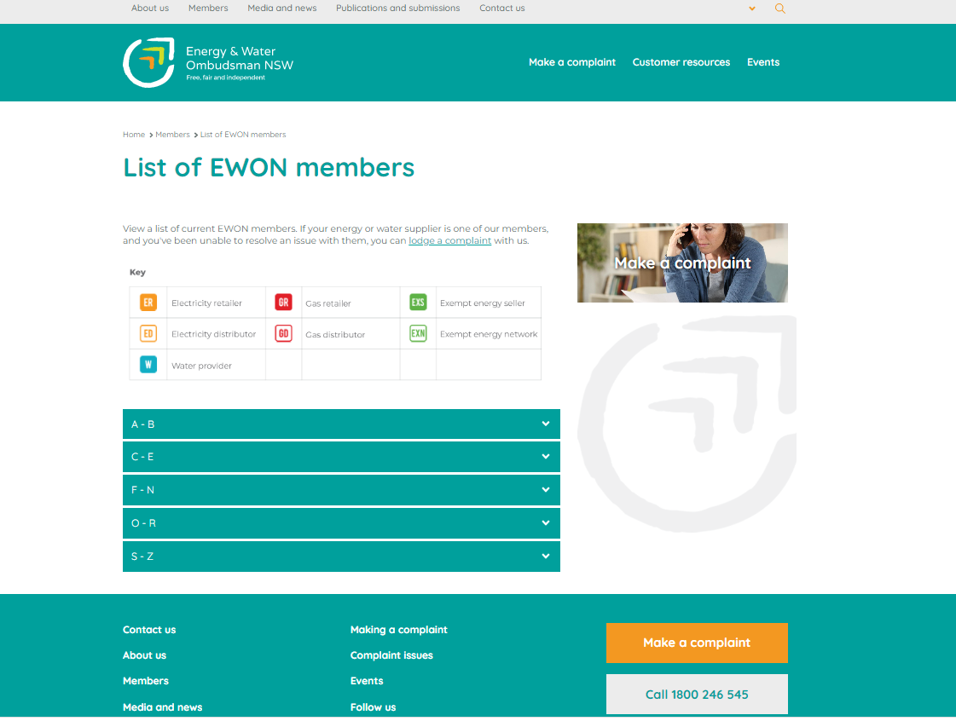

Slide 55
Send a written dispute / submission
Include the client’s name, contact details, date of birth, account / reference number.
Explain the issue. A chronology of events may assist.
State clearly the client’s desired outcome (start with most ideal outcome so there is room to negotiate).
Include evidence or supporting documents relevant to issues raised, eg. evidence of financial hardship such as a financial position statement.

Slide 56
How to decide on an outcome
Is the client’s hardship short term or long term (eg. will they ever return to work)? When will they be able to get back on their feet?
Do they have any savings, assets, expected payments that may assist in the short / long term?
Can the client offer a lump sum in full and final settlement of the debt? Graphic: Tom Parsons on https://unsplash.com

Slide 57
How to decide on an outcome (cont.)
Can the client maintain a reduced payment plan?
Can the client start repayments again in the future if payments are put on hold for a period of time?
Can the debt be reduced and a sustainable payment plan be agreed?
Is the debt going to result in the restriction / cancellation of an essential service (eg. electricity)?

Slide 58
When is a response required?
Depending on the type of creditor, different time limits apply requiring them to respond:
Financial service providers like banks have up to 30 days to respond before consumer can escalate the complaint to External Dispute Resolution (21 days for financial hardship complaints)
Telco companies have to acknowledge complaints and provide a resolution for urgent financial hardship requests within 2 working days, or provide reasons for delay if longer, and provide a resolution within 15 working days for non-urgent complaints
Insurance companies are required to respond to the complaint within 30 days of receiving the complaint.

Slide 59
Negotiating with the creditor
Make sure you are dealing with the “advocates” or “represented customers” team if available
Further information may be requested by IDR
You don’t have to accept first offer
You can request the dispute be escalated to a more senior team member / manager
Some creditors / debt collectors have a second tier of IDR for special cases.

Slide 60
Can’t reach an agreement
Consider making a complaint to the external dispute resolution (EDR) service.
RLC’s webinar on external dispute resolution (EDR) discusses the options and process: www.rlc.org.au/training/debts2
Links above are also on the Resources page at: www.rlc.org.au/training/resources/debts

Slide 61
Agreement reached – now what?
Make sure you have something in writing from the creditor accepting the agreement.
The creditor may want your client to sign a written agreement / settlement deed / release.
This is a document that sets out the terms and conditions of an agreement to resolve the issue.

Slide 62
Agreement reached – now what? (cont.)
It is generally a confidential document.
Often the creditor will make no admission of liability.
May release creditor or any third party from any future liability or action.
Client should get legal advice before signing.

Slide 63
Simon – the outcome
Requested credit card application, original assessment and assessment for each credit limit increase.
Assessed as stage 1, low urgency due to no demands / court action but moderate urgency for client’s health.
Issues identified: responsible lending and financial hardship.

Slide 64
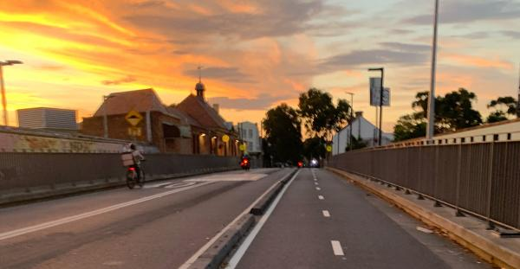
Simon – the outcome #2
First level of IDR – no offer made.
Escalated to senior team member – unsuitable offer made and rejected by client.
Further submission made to second level of IDR: Big Bank Inc agreed to waive the debt.
Settlement agreement signed.

Slide 65
Questions... & answers Resources: rlc.org.au/training/resources/debts

Slide 66
Free, confidential legal advice
Legal Aid (NSW) 1300 888 529 www.legalaid.nsw.gov.au
Community legal centres www.clcs.org.au/legal-help
Financial Rights Legal Centre (legal advice and financial counselling for people across Australia) https://financialrights.org.au
National Debt Helpline 1800 007 007 (financial counselling) www.ndh.org.au
Links above are also on the Resources page at: www.rlc.org.au/training/resources/debts

Slide 67
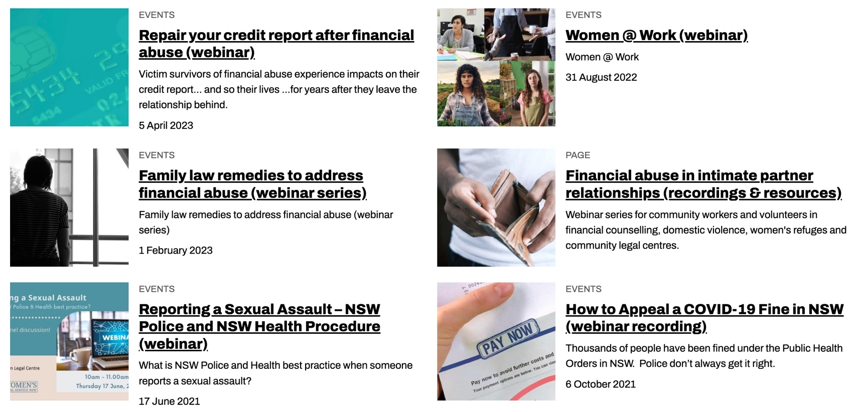
Community legal education - free webinars & recordings rlc.org.au/training Nick Manning: education@rlc.org.au

Slide 68
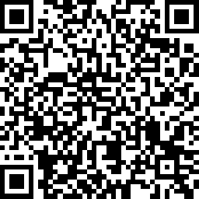
Your feedback is important to us! Scan the QR code >>>

