Slide 1
Fines & Penalty Notices 2: Instalments, Waivers & WDOs

Slide 2
AMELIA KLEIN
Credit, Debt and Consumer Solicitor
Redfern Legal Centre

Slide 3
Acknowledgement of Country

Slide 4
Outline
Fines & Penalty Notices
Fine Collection Process
Revenue NSW Advocacy Hotline
Options for managing fines
Questions and more information
RESOURCES: www.rlc.org.au/training/resources/fines

Slide 5
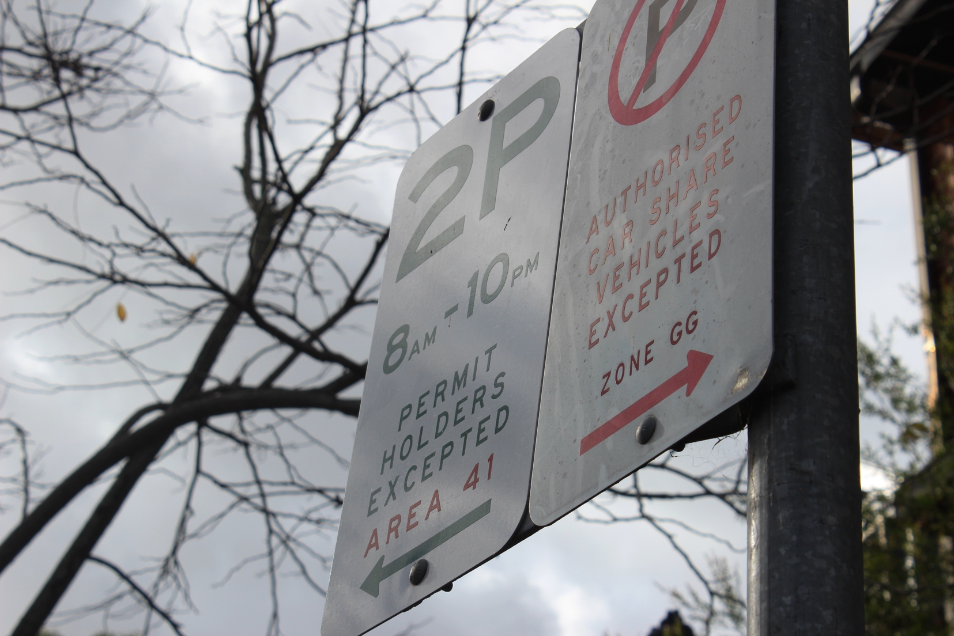
Fines & Penalty Notices

Slide 6
Fines & Penalty Notices
Three types of fines:
Court Fines
Victims Restitution Orders
Penalty Notices (or Fines).
Revenue NSW (formally State Debt Recovery) receive, process and enforce fines. www.revenue.nsw.gov.au

Slide 7
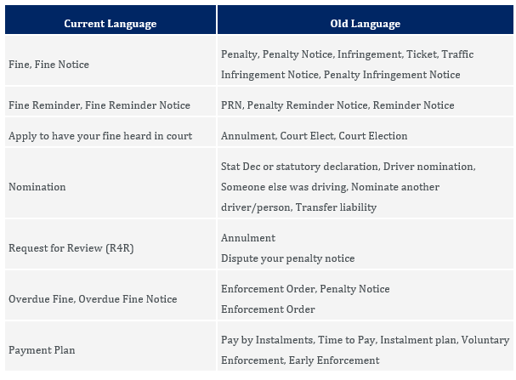
Revenue NSW language

Slide 8
Revenue NSW – other fees
State government fees eg:
Hotel quarantine fees
Service NSW
Births, Deaths and Marriages.
Utilities fees eg:
Water NSW.
Some Councils eg:
Mosman
Shellharbour
Central Coast.
These fees are not governed by the Fines Act and not all of the options in this webinar apply to these fees.
Please contact credit@rlc.org.au if you have any questions about enforcement of these fees.

Slide 9
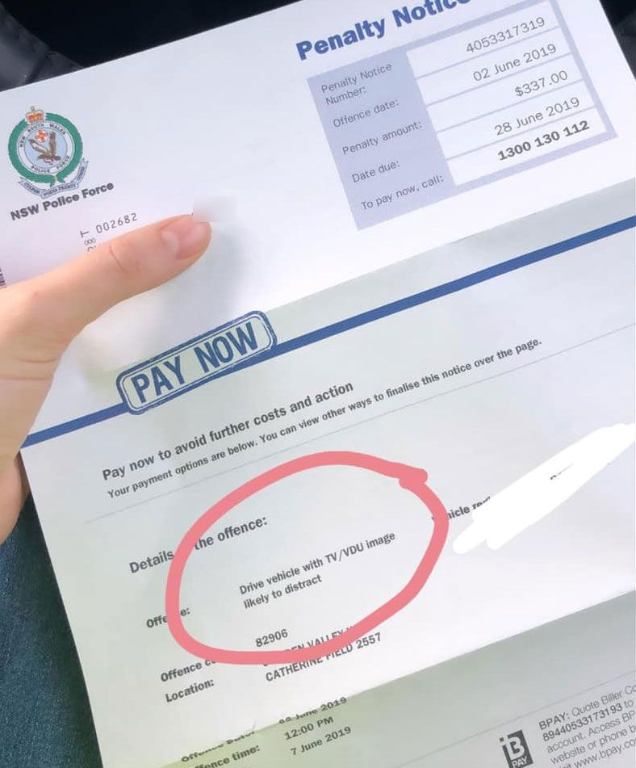
Fine Collection Process

Slide 10
Fine Collection Process
Fine (21 days to pay)
Fine Reminder (28 days to pay)
Fine Overdue
(costs increase)
Enforcement Action
(costs increase)

Slide 11
Enforcement Options
Transport NSW Restrictions
Drivers Licence Suspension
Vehicle Registration Cancellation
Customer Business Restriction.
$40 fee per action to each overdue fine.
Civil Action
Garnishee order
Property seizure order
Examination Order
Charge on land.
$65 fee per action to each overdue fine.
Community Service
Community service order or
Community Corrections Order.

Slide 12
Revenue NSW Advocacy Hotline

Slide 13
Advocacy Hotline
Registration
Register as an organisation AND as an individual employee online.
What can it offer?
Provide information over the phone and by email
Dedicated phone number and email address
Hold on enforcement action (including licence suspensions and business restrictions) to allow time to gather documents and give advice.
Contact
1300 135 627
www.nsw.gov.au/money-and-taxes/fines-and-fees/advocates

Slide 14
Options for Managing Fines

Slide 15
Payment Options
Pay as a lump sum
Apply for a payment plan
with Centrepay or direct payment
Reduce amount to pay by 50% (eligibility criteria apply).
None of these options impact demerit points!
A financial counsellor may be able to assist with debts generally.

Slide 16
Non-Payment Options – Part 1
Work and Development Order
Unpaid work, courses, counselling and other activities to ‘pay off’ fines
Up to a max $1000 per month
Sponsor must apply to Revenue NSW and report monthly
Eligibility criteria (one of these):
Under 18
Serious financial hardship
Receiving Centrelink
Experiencing homelessness
Experiencing mental illness, intellectual disability or cognitive impairment
Serious addition to drugs, alcohol or other volatile substances.

Slide 17
Non-Payment Options – Part 2
Waiver, Withdrawal and Internal Review
Specific criteria apply
eg 24E of Fines Act
Special circumstances
eg not safe to nominate driver due to domestic violence, medical emergency.
Covered in our first Fines webinar (recording online)!

Slide 18
Non-Payment Options – Part 3
Write off
Due to serious financial, medical or personal circumstances, a person:
Is unable to pay the fine now/or in the future; and
Does not own any goods that can be seized; and
Does not have any income that can be garnished; and
Does not own any property that Revenue NSW can impose a charge on; and
Is not able to do community service (through a CCO) or a WDO is inappropriate.
Streamlined process available for CLCs in NSW – for fine totals under $5,000.

Slide 19
Review Option
Hardship Review Board:
Review of Revenue NSW decisions about:
A payment plan
A WDO application or order
Writing off all or part of an unpaid fine

Slide 20
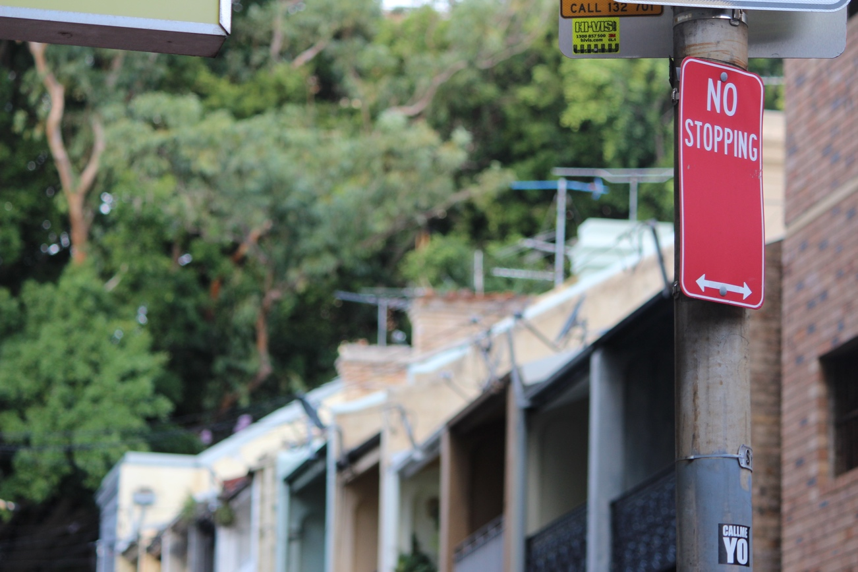
Case Study: Sam
Sam is a university student who is reliant on Youth Allowance to meet his needs.
He received a fine for running a red light. It is his first demerit offence.

Slide 21
Case Study: Sam
Sam is a university student who is reliant on Youth Allowance to meet his needs.
He received a fine for running a red light. It is his first demerit offence.
If Sam’s difficulty with paying is related to financial hardship only, he may be suited for a payment plan. $10-$15 per fortnight via Centrepay may be accepted.
He cannot apply for a 50% reduction as it is a red light offence.
With his consent we can apply for a stay of enforcement while he gathers documents for his application, or before his advice appointment.

Slide 22
Case Study: Kira
Kira comes in with her case worker as she has recently tried to apply to renew her licence and has been told there is a customer business restriction in place.
She doesn’t know how many fines she has and she cannot pay any amount. She is currently in transitional housing and has been diagnosed with schizophrenia.

Slide 23
Case Study: Kira
Kira comes with her case worker as she has recently tried to apply to renew her licence and has been told there is a customer business restriction in place.
She doesn’t know how many fines she has and she cannot pay any amount. She is currently in transitional housing and has been diagnosed with schizophrenia.
Obtain a copy of her client statement from Revenue NSW.
This confirms there are five fines dating back the last six years.
Seek a stay of enforcement to give time to consider what options Kira has.

Slide 24
Case Study: Kira
Kira comes with her case worker as she has recently tried to apply to renew her licence and has been told there is a customer business restriction in place.
She doesn’t know how many fines she has and she cannot pay any amount. She is currently in transitional housing and has been diagnosed with schizophrenia.
Obtain a copy of her client statement from Revenue NSW.
This confirms there are five fines dating back the last six years.
Seek a stay of enforcement to give time to consider what options Kira has.
Does her case worker’s organization provide WDOs?
If not, is there evidence which meets the criteria for a write-off which Kira can reasonably obtain?

Slide 25
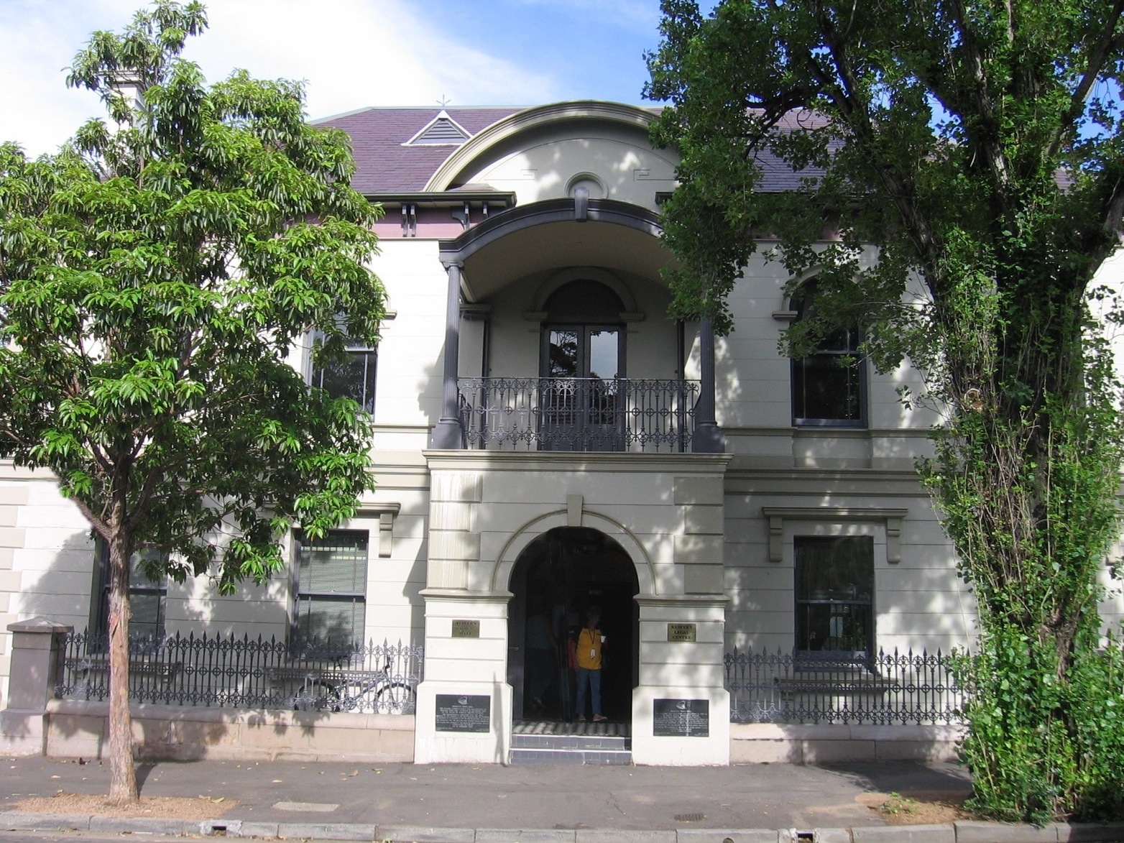
Questions and More Information

Slide 26
Questions?
Resources: www.rlc.org.au/training/resources/fines

Slide 27
Where to get free confidential legal advice on fines in NSW
Most local community legal centres: www.clcs.org.au/legal-help
Legal Aid NSW www.legalaid.nsw.gov.au
Homeless Persons Legal Service https://www.piac.asn.au/legal-help/hpls-clinic-times-locations
Shopfront Youth Legal Service (under 25s) www.theshopfront.org

Slide 28
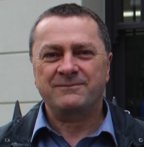
Before You Go
Your feedback helps us improve our training.
Please stay with us for another 60 seconds…
Training: rlc.org.au/training
Enquiries: Nick Manning
education@rlc.org.au
This workshop is a guide to the law in NSW, Australia. It is not a substitute for legal advice. If you have a legal problem, seek legal advice from a legal centre or Legal Aid.

Slide 29
Thank you!

