Slide 1
17 October 2024 Fines and Penalty Notices in NSW (part 1): Disputing the Fine

Slide 2
Samantha Lee
Supervising Solicitor Police Powers and Administrative Law Redfern Legal Centre

Slide 3
Acknowledgement of Country

Slide 4
Outline
Types of fines
Internal review
Electing to go to court
Court-imposed fines
Children and fines
Questions and more information
Resources: rlc.org.au/training/resources/fines

Slide 5
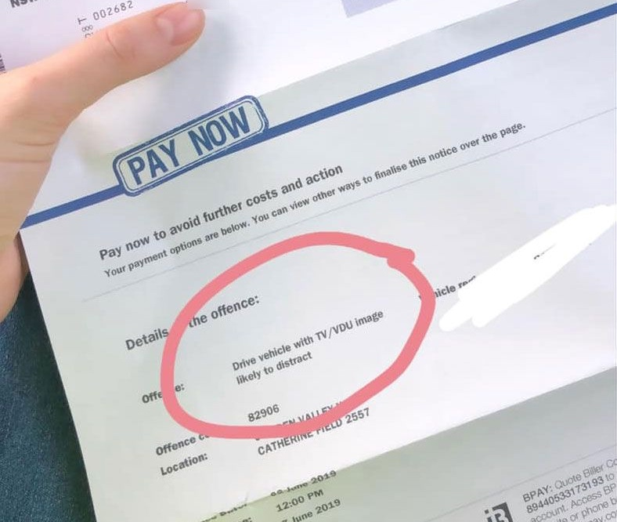
1 Types of fines

Slide 6
Types of fines:
Penalty Notices
Court fines

Slide 7
Dispute Resolution Options
Internal review
Court election
Graphic: Tom Parsons on https://unsplash.com

Slide 9
Life Cycle of a Fine
Penalty Notice - 21 days to pay ↓
Penalty Reminder Notice - 28 days to pay ↓
Overdue Fine Order (costs increase) - 28 days to pay ↓
Enforcement Action (costs increase) - can include Transport for NSW restrictions and garnishee action

Slide 10
2 Internal Review

Slide 11
Internal Review
Time limits:
Anytime, even after payment or when an enforcement order has been issued.
Exception: If you paid in full and haven’t received a Penalty Reminder Notice, you have 60 days from the date the Penalty Notice was issued.

Slide 12
Why would you request a review?
Penalty notice issued contrary to law
Mistaken identity
Exceptional circumstances - eg. medical emergency
Intellectual disability, cognitive impairment, mental illness

Slide 13
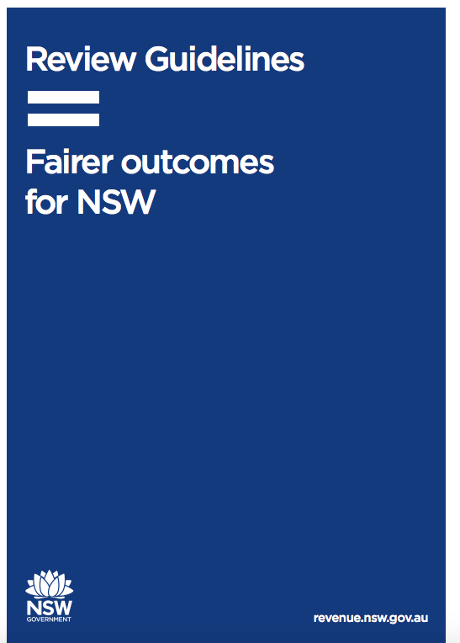

Slide 14
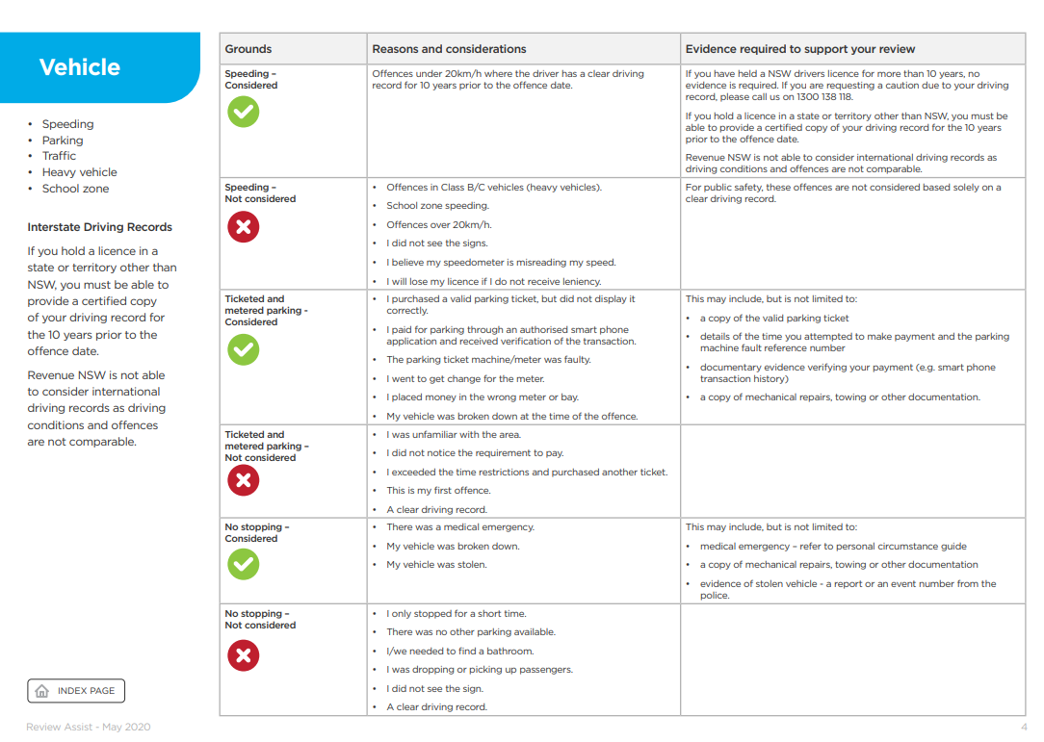

Slide 15
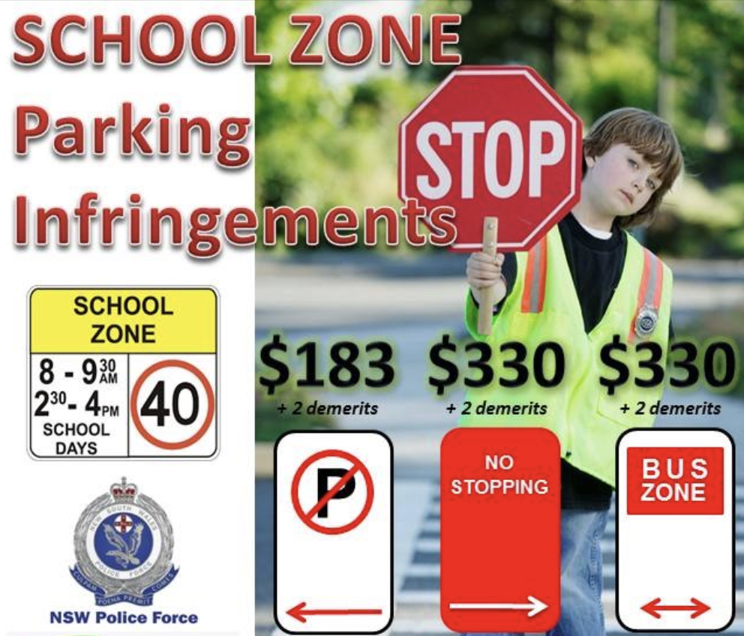
Evidence
permits (eg. disability permit)
Service NSW receipt
photo of parking
police reports
medical evidence
proof of vehicle repairs
statutory declaration or statement

Slide 16
Paula’s internal review
Paula was feeling unwell and got a COVID test. She was required to isolate after taking the test.
She arrived home and parked in a 2-hour parking spot as there were no other all-day spots available.
She later received a fine for parking in the spot for longer than two hours.
Paula applied for internal review.
Fine withdrawn.

Slide 17
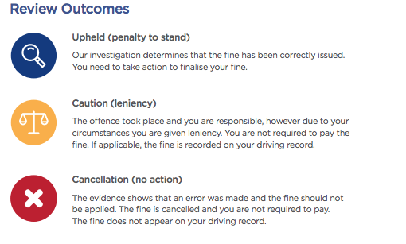

Slide 18
2 Electing to go to court Graphic: Tom Parsons on https://unsplash.com

Slide 19
Time limits: Electing to go to court
If you have not applied for an internal review:
If no payment or part-paid: must elect before the due date on Penalty Reminder Notice.
If paid in full, you have 90 days from when the Penalty Notice was received.
If you have applied for review:
Before the due date of the new Penalty Reminder Notice issued.

Slide 20
Why would you take a Penalty Notice to court
Don’t believe you broke the law
Seeking a more lenient penalty
Loss of demerit points
Graphic: Tom Parsons on https://unsplash.com

Slide 21
Going to court
Once the Court Attendance Notice is issued, there is no turning back
Guilty
Not guilty

Slide 22
The dangers
Cost and time
‘Strict liability’ offences
A defence is only an explanation
Criminal record/ traffic record
May not obtain the outcome you seek
Potential higher penalty

Slide 23
Court costs levy
A court costs levy is a fee for having your case heard at court.
If you plead guilty or are found guilty of any offence, the court will order you to pay mandatory court costs of $85 (as at July 2024) unless you:
are convicted in the Drug Court or the Children's Court
get a section 10(1)(a) dismissal for an offence that does not impose a prison sentence
receive a prison sentence (other than a suspended sentence).

Slide 24
Victims Support Levy (VSL)
An amount imposed on people who plead guilty or are found guilty in court.
The money goes to the Victims Support Fund.
If you plead guilty or are found guilty of a summary offence, you will need to pay a VSL of $90 (as of July 2022).

Slide 25
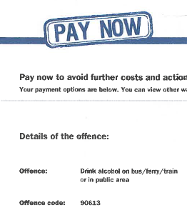
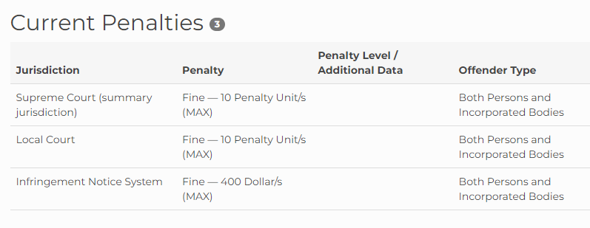
Higher Penalty
Check Lawcodes: https://lawcodes.judcom.nsw.gov.au

Slide 26
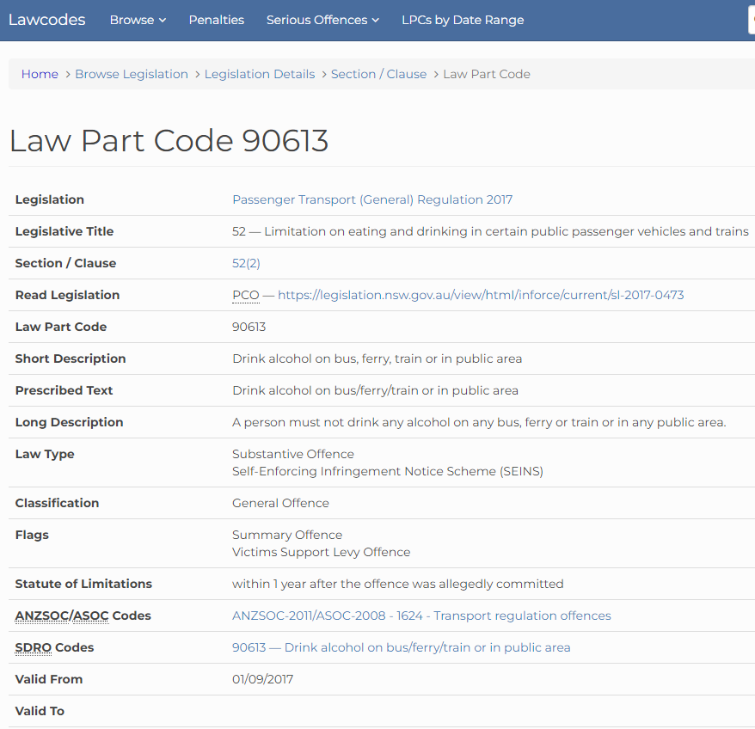

Slide 27
Strict liability
A strict liability crime is a crime that requires no mens rea.
That is, a crime that requires no proof that you intended to commit an offence.
For example: speeding, drink driving.
Defence: honest and reasonable mistake.

Slide 28
Best matters to take to court
Clear evidence that you did not break the law
Good driving record
Exceptional circumstances
You are willing to plead guilty, but seek leniency
You are about to lose your licence

Slide 29
Leniency: What will the court consider?
Seriousness of the offence (safety)
Circumstances surrounding the offence
Financial situation
Age
How long you have been driving
Full licence / Provisional / Learner
Traffic record history
Contrition

Slide 30
What can the court decide
Find you not guilty – offence dismissed
Find you guilty, dismissal and no conviction - s10(1)
Remove any demerit points
Reduce the cost of the fine
Impose a more significant fine
Nothing. Fine stands.

Slide 31
3 Court-imposed fines

Slide 32
Contesting a court fine
Appealing to the District Court
Applying to the court for annulment

Slide 33
Time limits: Appealing to the District Court
Must lodge a Notice of Appeal no more than 28 days after the sentence date.
You can lodge an appeal up to 3 months from the sentence date if you get leave (permission) from the court.
Fee: $126

Slide 34
Annulment: not present when fine imposed
If you were convicted or sentenced in the Local Court less than 2 years ago, and you weren’t present, you can apply to have the sentence or conviction annulled.

Slide 35
Proof for annulment
You were not aware of the original case
You were unable to attend for a good reason
It is in the interests of justice to do so

Slide 36
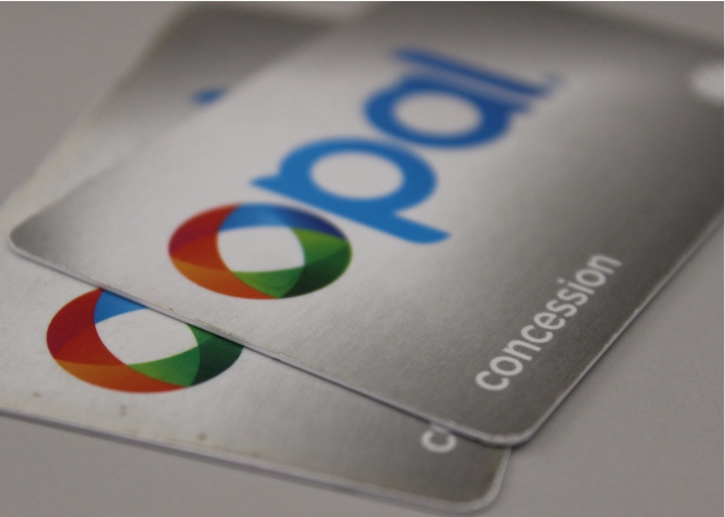
4 Children and fines

Slide 37
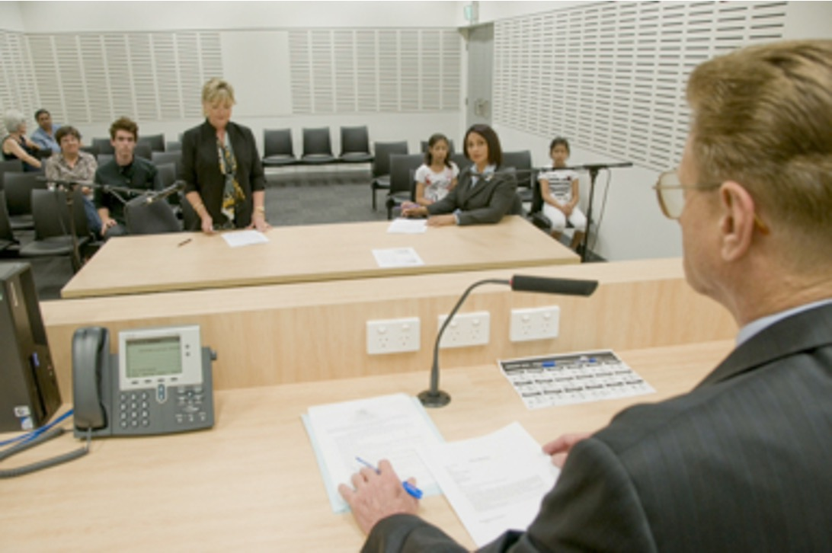
Children (under 18)
Electing to go to court:
Matter heard in the Children’s Court
Exception – traffic offence where the young person is old enough to have a licence:
Matter heard in the Local Court.
Image source: Law Access NSW

Slide 38
What can the Children’s Court decide?
Caution
Refer to Youth Justice Conference
Dismiss the matter
Fine - If Children’s Court imposes a fine, the fine can’t be more than 10 penalty units ($1,100) for one offence.
Image source: Law Access NSW

Slide 39
Questions... & answers Resources: rlc.org.au/training/resources/fines

Slide 40
Free, confidential legal advice
Community legal centres www.clcs.org.au/legal-help
Legal Aid NSW: www.legalaid.nsw.gov.au - Law Access 1300 888 529 - Legal Aid Hotline for Under 18s: 1800 10 18 10
The Shopfront Youth Legal Centre (under 25 year olds) www.theshopfront.org
Aboriginal Legal Service (ALS) www.alsnswact.org.au
Homeless Persons Legal Service (HPLS) www.piac.asn.au/legal-help/hpls-clinic-times-locations
rlc.org.au/training/resources/fines

Slide 41
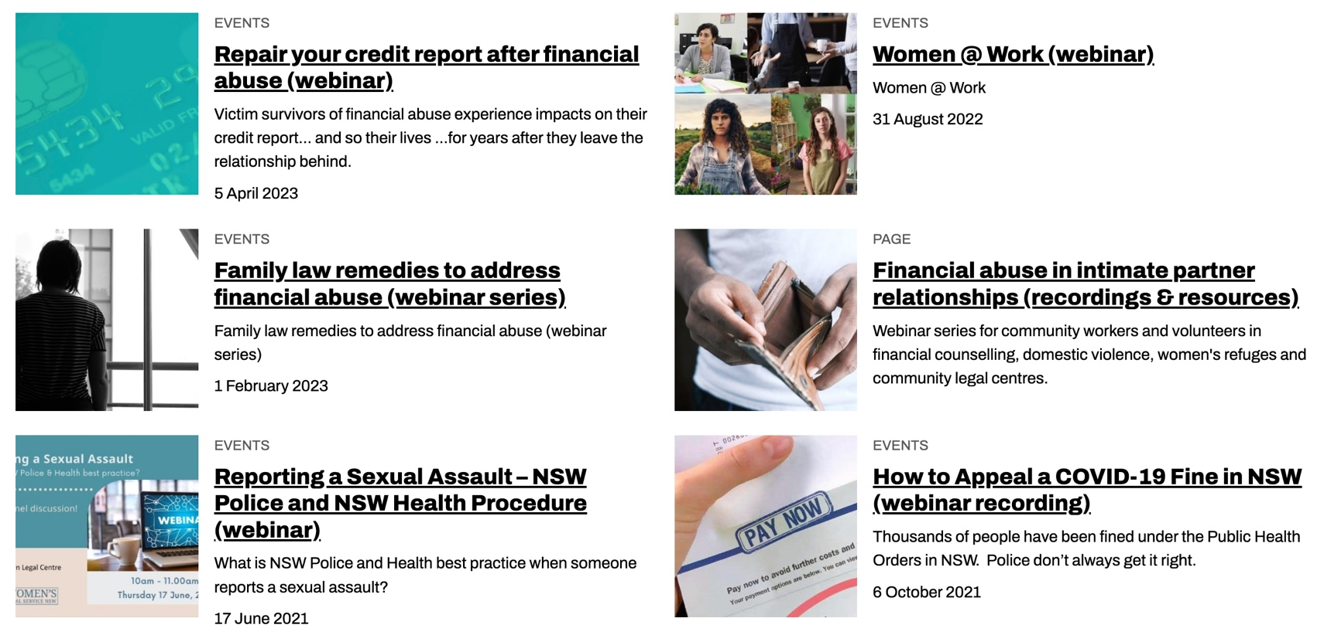
Community legal education - free webinars & recordings rlc.org.au/training Nick Manning: education@rlc.org.au

Slide 42
Your feedback is important to us! rlc.org.au/feedback

