Slide 1
27 November 2024 Domestic Violence & Tenancy in NSW

Slide 2
Alison Mackey
Solicitor & Tenants’ Advocate
Inner Sydney Tenants Advice & Advocacy Service
Redfern Legal Centre

Slide 3
Acknowledgement of Country

Slide 4
Outline
Tenancy law and domestic violence
Staying in the property
Leaving the property
Damage to the property
Changing the locks
“Bad tenant” database listings
Questions and more information
Resources: www.rlc.org.au/training/dvtenancy

Slide 5
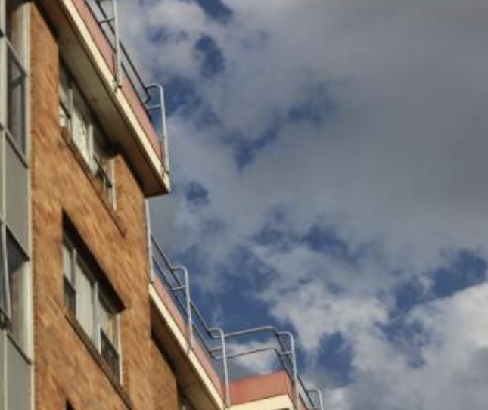
1 Tenancy law and domestic violence

Slide 6
How the RT Act may help tenants experiencing DV
The NSW Residential Tenancies Act (RT Act) may help tenants experiencing domestic violence who:
Want the perpetrator to leave
Want to end own tenancy without penalty
Want to change the locks
Want to avoid financial liability for damage
Want to avoid being blacklisted as a “bad” tenant

Slide 7
How the RT Act may help tenants experiencing DV
Domestic violence amendments to the RT Act commenced in February 2019.
In December 2022 the NSW Government called for submissions to review the domestic violence rental laws.
As of yet, we have not seen any further changes to the law as a result of the review. Watch this space.

Slide 8
Relevant provisions of the RT Act
Section | What is relevant about the section
3 & 105A | Definitions of: Apprehended Violence Order/Domestic Violence Order Domestic violence offence Relevant domestic violence offender
54 (1A) and (1B) 54A | Limits vicarious liability (damage) if perpetrator is NOT a tenant Limits vicarious liability (damage) if perpetrator IS a tenant
71 | Circumstance in which tenant can change locks
72(2) | New keys do not have to be given to a person excluded from property by AVO
79 | Change of tenants after AVO
95 (4) | Prevents eviction of occupant who has not had opportunity to use s79
Division 3A (105A – 105I) | Termination by tenant in circumstances of domestic violence
174 (4) | Repayment of bond to former co-tenant who is subject to AVO
213A | Restrictions of database listing for person who give DV termination notice

Slide 9
Questions to ask your client
Do you want to stay or leave?
Are you on the lease?
Is the perpetrator on the lease?
Is the lease for a fixed term? If so, has the fixed term ended?
Is there an AVO in place?

Slide 10
Understanding the client’s legal status as a renter
Co-Tenant: The client and the perpetrator (or others) are named on the lease
Sub-Tenant: The perpetrator is named on the lease but the client is not
Head-Tenant: Only the client’s name is on the lease

Slide 11
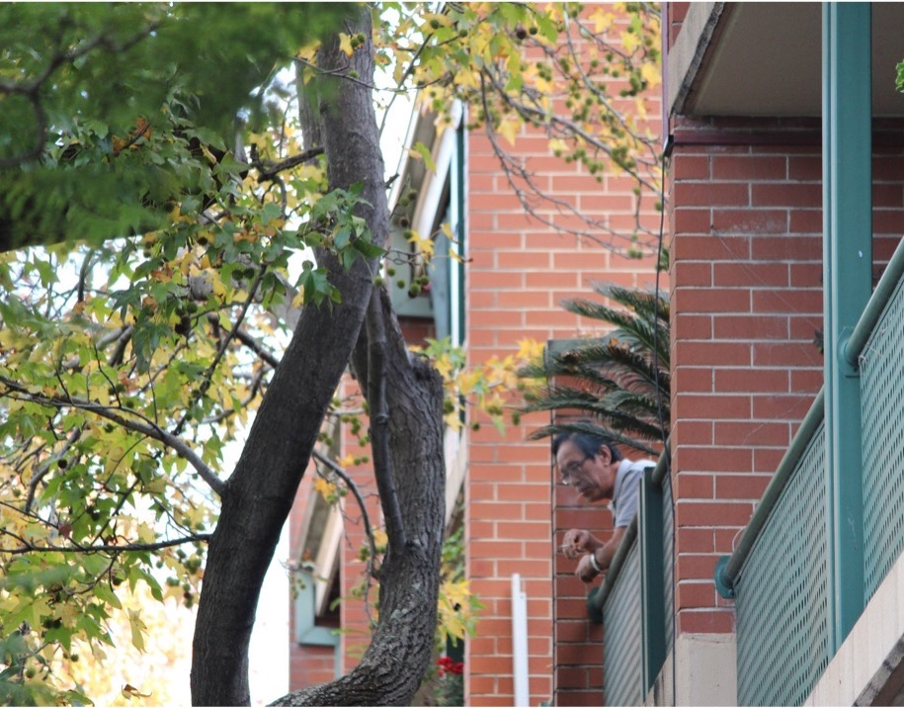
2 Staying in the property

Slide 12
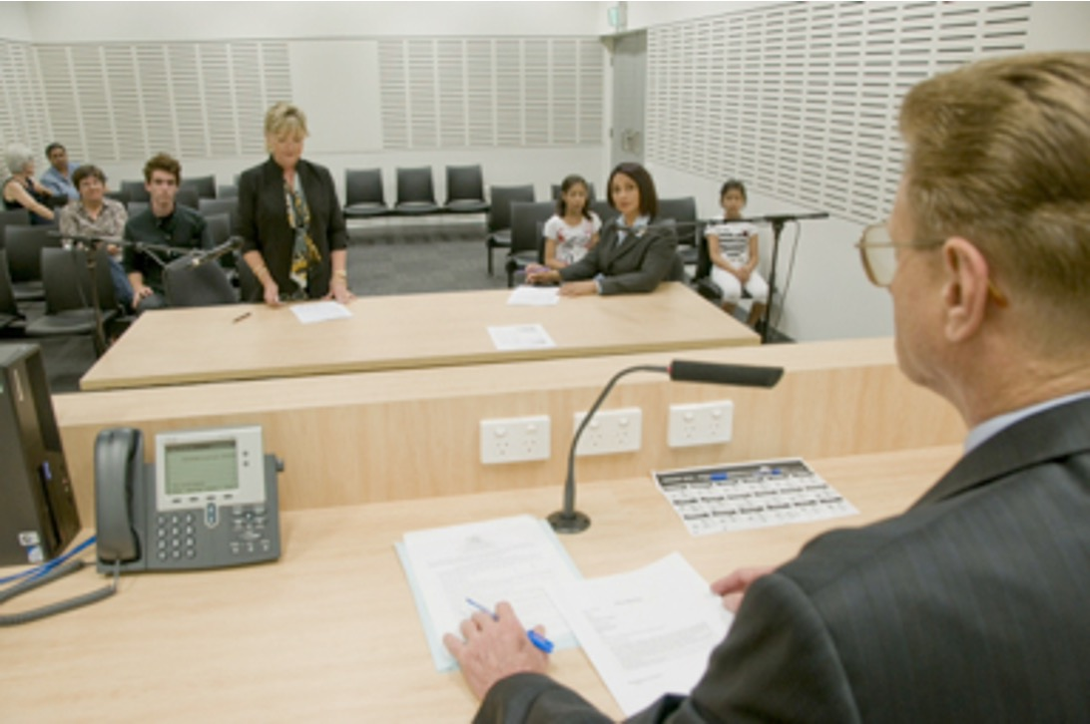
When the client wants to stay: Client is a co-tenant
1. Seek an order from NCAT (Tribunal) to end the perpetrator’s tenancy (Section 102 of the RT Act)
- Termination is discretionary
- NCAT must form the opinion it is “appropriate to [terminate] in the special circumstances of the case”
2. AVO preventing the perpetrator from being at the premises
3. A FINAL AVO which excludes the perpetrator from the premises ends the perpetrator’s tenancy. Make sure the address is included in the order. (Section 79 (1) of the RT Act)

Slide 13
When the client wants to stay: Client is a sub-tenant
If the client has a final AVO with an exclusion order, they can apply to NCAT seeking an order to be recognised as a tenant (Section 79 (2) of the RT Act)
Important note:
If NCAT makes an order recognizing the client as a tenant, the client assumes liability for the tenancy – all rent, risk of liability for pre-existing damage.

Slide 14
When the client wants to stay: Client is a head-tenant (perpetrator sub-tenant)
Seek an order from NCAT to end the perpetrator’s tenancy on the basis they have caused serious damage to the premises or injury to the client as head tenant (Section 90 of the RT Act)
Seek an order from NCAT to end the perpetrator’s tenancy on the basis they have threatened, abused, intimidated or harassed the client (Section 92 of the RT Act)

Slide 15
When the client wants to stay: Client is a head-tenant (perpetrator sub-tenant)
A FINAL AVO which excludes the perpetrator from the premises ends the perpetrator’s tenancy (Section 79 (1) of the RT Act)
Alternatively, the client can seek an order from NCAT to end the perpetrator’s tenancy: - Termination is discretionary - Client needs to show they would suffer undue hardship, in the special circumstances of the case (Section 93 of the RT Act)

Slide 16
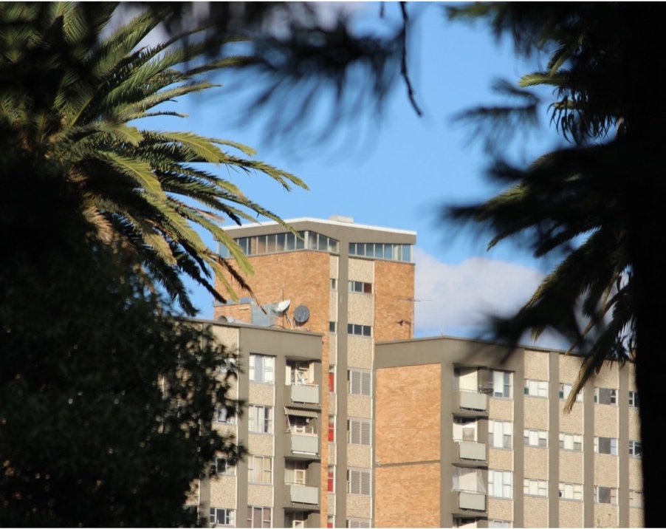
3 Leaving the property

Slide 17
When the client wants to leave
Options can depend on:
Client’s legal status - Co-Tenant / Sub-Tenant / Head-Tenant
Whether the agreement is in a fixed term or a periodic agreement
Whether the client has evidence of the domestic violence

Slide 18
Domestic Violence Termination Notice (DVTN)
A Tenant or Co-Tenant can give a DVTN if:
the Tenant, or
a Co-Tenant, or
an occupant child who is dependent on the Tenant or a Co-Tenant for support
is in circumstances of domestic violence (Section 105B of the RT Act).

Slide 19
Domestic Violence Termination Notice (DVTN)
Circumstances of domestic violence:
Person was a victim of DV while they were a Tenant of the premises (or dependent child of a Tenant) and the perpetrator has been found guilty
Person protected by ADVO in force
Person protected by Family Law injunction under section 68B or 114 of the Family Law Act 1975.
Person declared by a “competent person” to be a victim of DV during the period of the tenancy agreement

Slide 20
Domestic Violence Termination Notice (DVTN)
General notice requirements: in writing, signed, specify the date for termination and ground for the notice (ie. Section 105B)
Termination date for DVTN:
- Can be before the end of a fixed term
- Termination date must be on or after the date notice is given
Must be given to landlord/agent and all other co-tenants
DVTN given to landlord/agent must have evidence attached
(Section 105C of the RT Act)

Slide 21
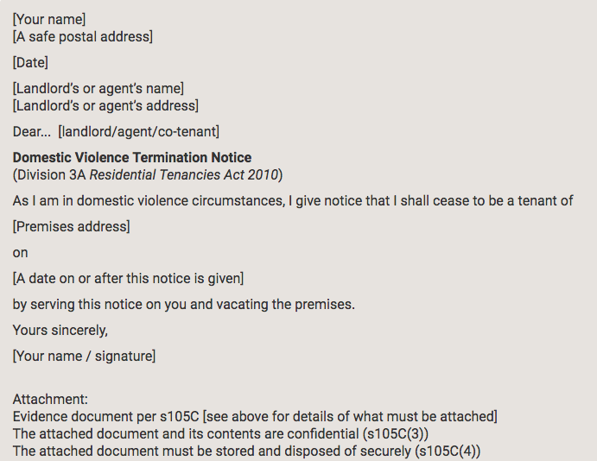
Domestic Violence Termination Notice
DVTN templates available from:
Tenants’ Union
https://www.tenants.org.au/sample/termination-domestic-violence
NSW Fair Trading https://www.nsw.gov.au/housing-and-construction/rules/ending-a-tenancy-because-of-domestic-violence#toc-sample-domestic-violence-termination-notices
Information above is repeated at: www.rlc.org.au/training/dvtenancy

Slide 22
Evidence for DVTN
Certificate of conviction in proceedings against the domestic violence offender, or
Copy of Apprehended Domestic Violence Order, or
Copy of injunction granted under section 68B or 114 of the Family Law Act 1975, or
Declaration by a competent person.

Slide 23
Who is a competent person?
Some Registered Health Practitioners (includes GP, midwife, occupational therapist, pharmacist, dentist, chiropractor)
Social Worker (member of AASW)
Approved counsellor providing services under the Victims Rights and Support Act
Employee of government agency providing child protection services
Employee of NGO receiving government funding to provide DV or sexual assault services, or refuge or emergency accommodation
https://www.fairtrading.nsw.gov.au/housing-and-property/renting/professionals-who-can-make-a-declaration
*** The link above is repeated at: www.rlc.org.au/training/dvtenancy

Slide 24
Serving the DVTN
Important to ensure the Domestic Violence Termination Notice (DVTN) is served correctly:
Hand delivery
Left in letter box
By fax
Post (must allow 7 business days)
Important note: Email can only be used in some circumstances.

Slide 25
When the client wants to leave
Alternatives to DVTN:
If in a periodic agreement, given 21 days notice of termination to the landlord and all other co-tenants (Section 101 RT Act)
Seek an order from NCAT to end the client’s tenancy (Section 102 of the RT Act):
Termination is discretionary
Tribunal must form the opinion that it is appropriate to terminate in the special circumstances of the case.

Slide 26
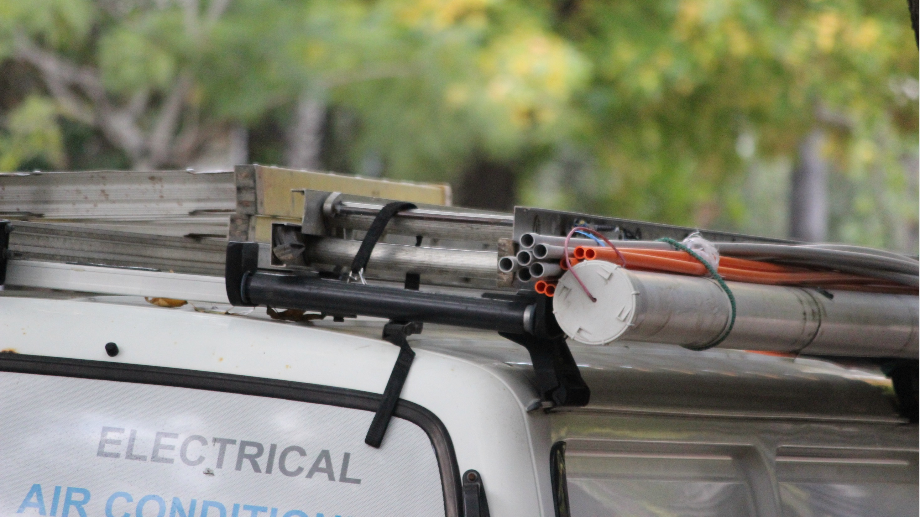
4 Damage to the property

Slide 27
Liability for damage
Generally, a Tenant or Co-Tenant can be held responsible for damage caused by others at their property.
A Tenant experiencing DV is not responsible if the damage caused to the premises occurs during a DV offence (Section 54 & 54A of the RT Act)
Co-Tenant exemption – if a Tenant experiencing DV has a Co-Tenant that is NOT the perpetrator, then this Co-Tenant is exempt from liability (Section 54 & 54A of the RT Act)
Evidence is key in being able to utilise these exemptions.

Slide 28
5 Changing the locks Image: George Becker, pexels.com

Slide 29
Changing the locks
A tenant can change the locks only if they have:
The landlord’s permission, or
A reasonable excuse (Section 71 RT Act) Expressly includes circumstances where a Tenant or Occupant is prohibited from entering the premises by AVO
A copy of the new key to be provided to the landlord within 7 days (Section 72 RT Act)

Slide 30
6 “Bad tenant” database listings

Slide 31
General restrictions on listings
Listings can only be made in certain circumstances (Section 212 RT Act):
The person was named as a tenant in a tenancy agreement and the tenancy/co-tenancy was terminated AND
The person named as a tenant breached the agreement AND
Because of the breach, NCAT made a termination order OR the person owes the landlord more money than the amount of bond.

Slide 32
Further restrictions on listings - DVTN
A landlord/agent must not list personal information on a residential tenancy database if:
(a) the person was named as a tenant in a tenancy agreement that was terminated, or
(b) the person’s co-tenancy was terminated
by using the DV termination provisions and the person was the tenant or co-tenant giving a DVTN.
(Section 213A of the RT Act)

Slide 33
Questions... & answers Resources: rlc.org.au/training/dvtenancy

Slide 34
Where to get help
1800RESPECT / 1800 737 732
24 hour information, counselling and support service for people impacted by sexual assault, family and domestic violence and abuse.
DV Helpline – 1800 656 463
24 hour crisis counselling, assistance with emergency accommodation and referral services
Women’s Domestic Violence Court Advocacy Services 1800 WDVCAS / 1800 938 227
Information, court advocacy and referral for women experiencing DV.
*** Information above is repeated in the resources at: www.rlc.org.au/training/dvtenancy

Slide 35
Where to get help
Staying Home Leaving Violence program
Remove violent partner from home
Provide safety planning and security upgrades
Assistance with navigating legal processes
Casework support and support for children
https://dcj.nsw.gov.au/service-providers/supporting-family-domestic-sexual-violence-services/dfv-programs-funding/staying-home-leaving-violence.html
*** Information above is repeated in the resources at: www.rlc.org.au/training/dvtenancy

Slide 36
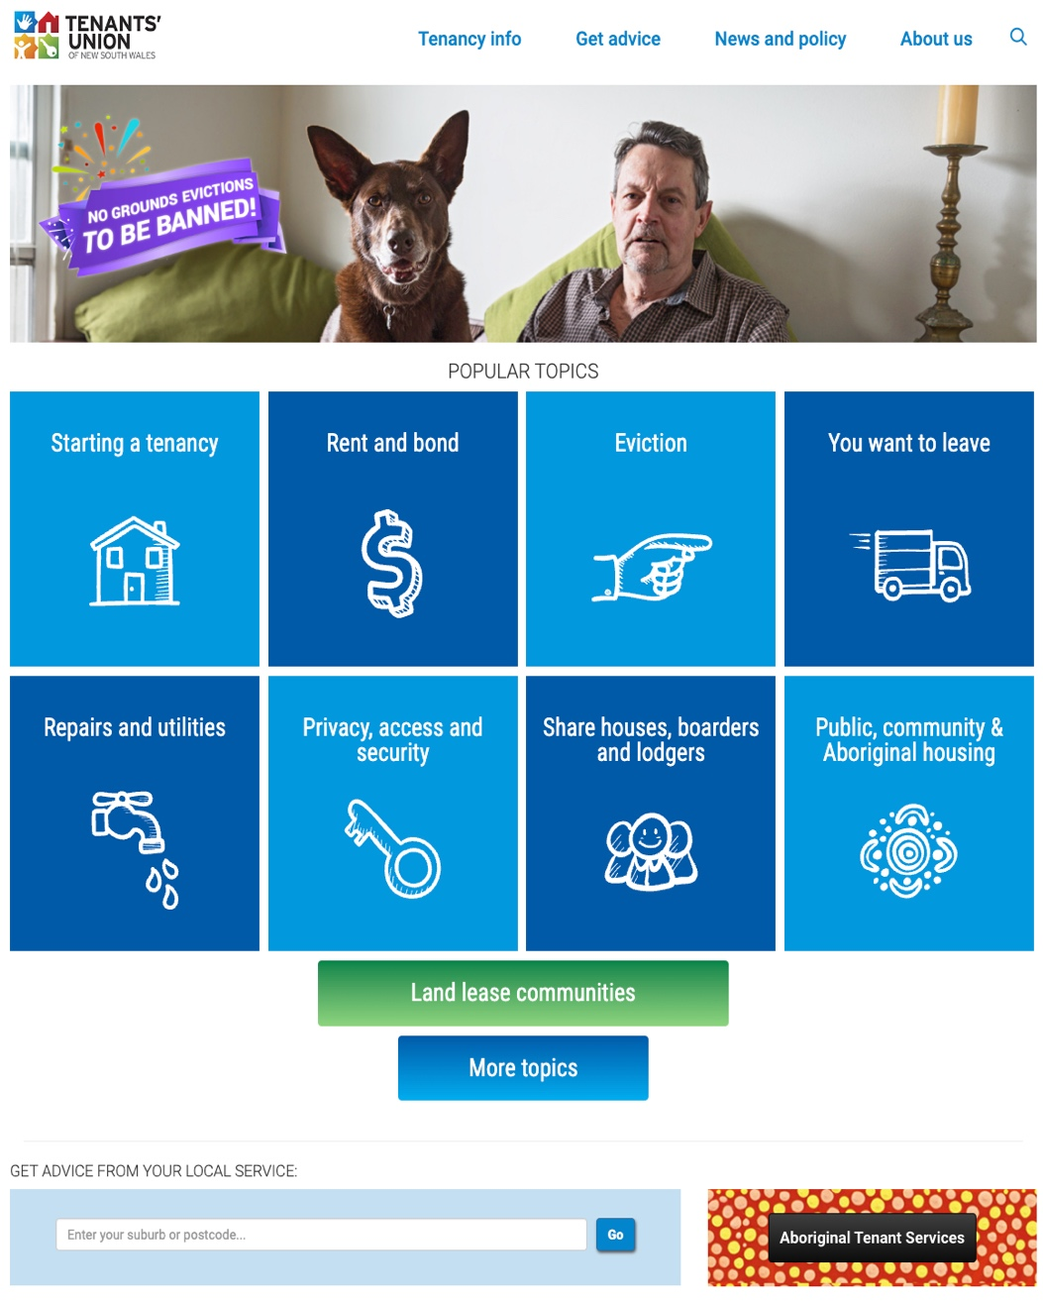
Information & advice for tenants at tenants.org.au
www.tenants.org.au
fact sheets and sample letters >>>>>
free confidential legal advice for tenants – to find you Tenants Advice & Advocacy Service, enter your suburb or town >>>>>
*** Information above is repeated in the resources at: www.rlc.org.au/training/dvtenancy

Slide 37
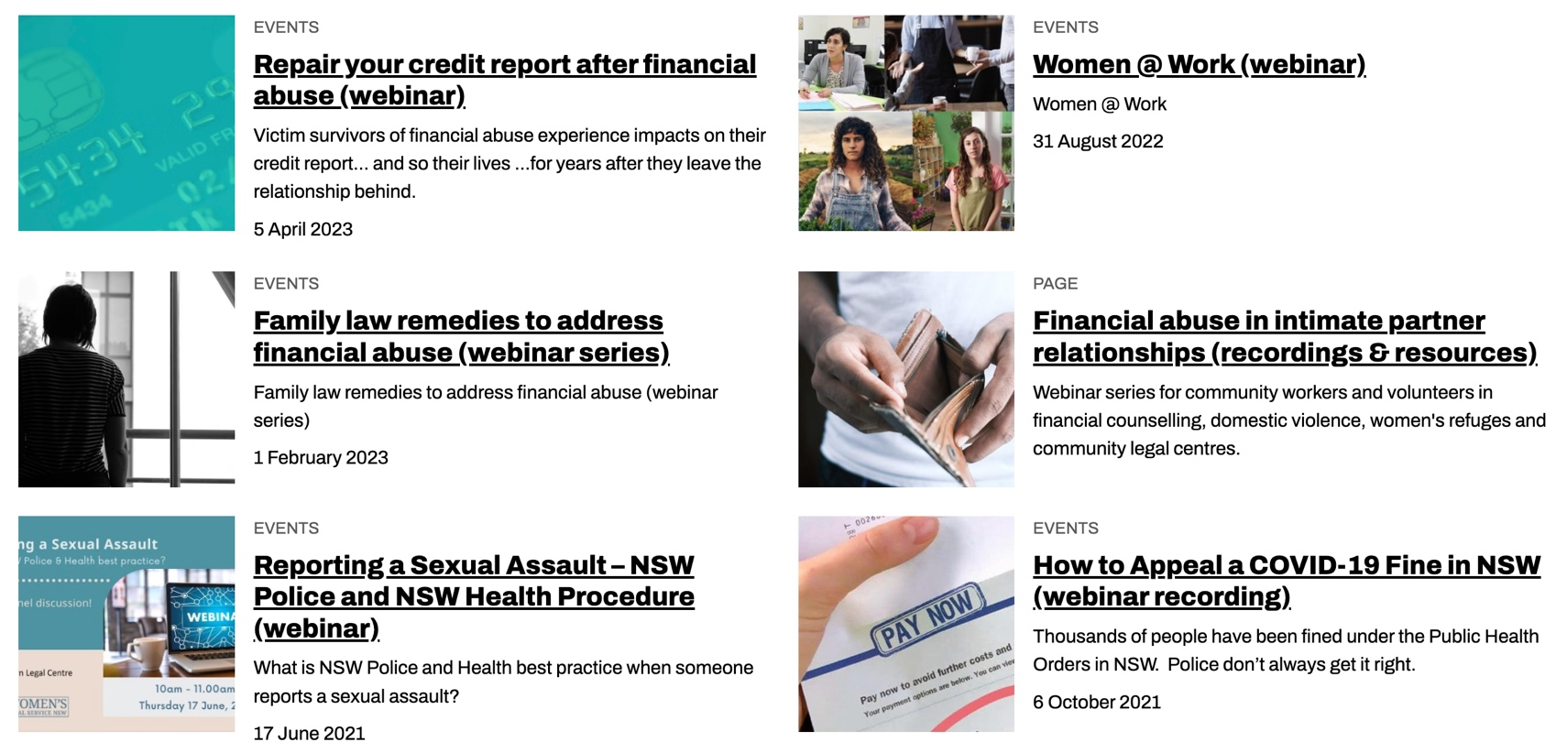
Community legal education - free webinars & recordings rlc.org.au/training Nick Manning: education@rlc.org.au

Slide 38
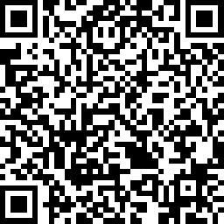
Your feedback is important to us! rlc.org.au/feedback or scan this QR code >>>

