Slide 1
30 July 2024
Money Matters in NSW Social Housing
Ned Cooke, Solicitor & Team Leader
Inner Sydney Tenants Advice & Advocacy Service

Slide 2
Ned Cooke
Solicitor & Team Leader
Inner Sydney Tenants Advice & Advocacy Service
Redfern Legal Centre

Slide 3
Acknowledgement of Country

Slide 4

Outline
Types of charges in social housing
Rent & water arrears
Subsidy cancellations
Questions and more Information
Resources: www.rlc.org.au/training/resources/housing

Slide 5

1
Types of charges in social housing

Slide 6
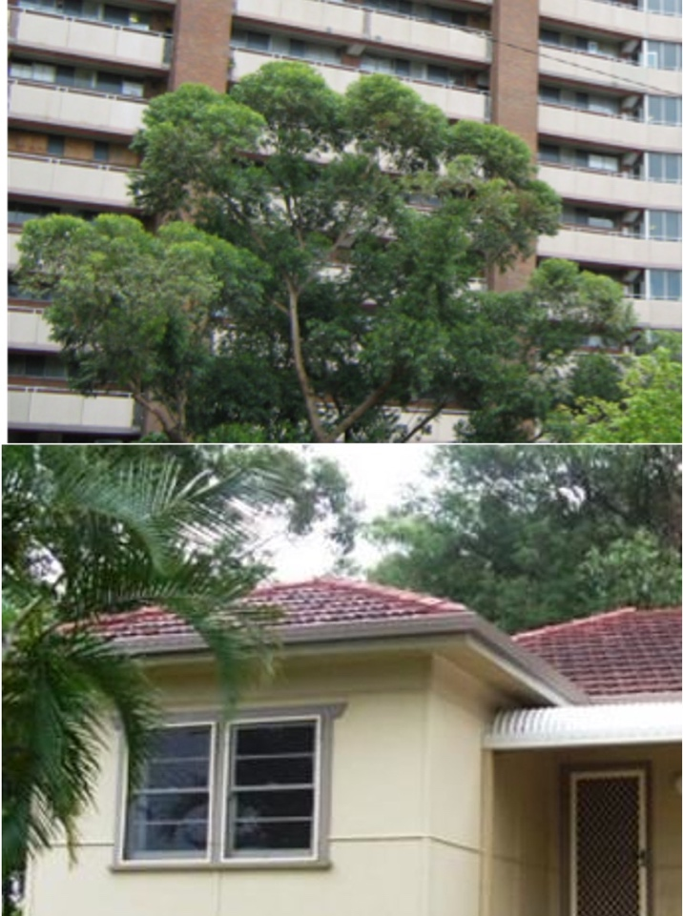
Social housing
Public Housing
Homes NSW
NSW Land & Housing Corporation
Community Housing
Over 150 community housing providers in NSW
Aboriginal Housing

Slide 7

Types of charges in social housing
Rent
Water usage
Tenant repair costs
Debts from a former tenancy
Photo by Caleb Lucas on Unsplash

Slide 8
Market rent
Subsidised rent

Slide 9

How do rent subsidies work?
“A rent subsidy is the difference between the market rent and the rent a tenant pays…
DCJ does not pay the rent subsidy to the tenant, but deducts it directly from the market rent.”
- DCJ Housing - Charging Rent Policy

Slide 10
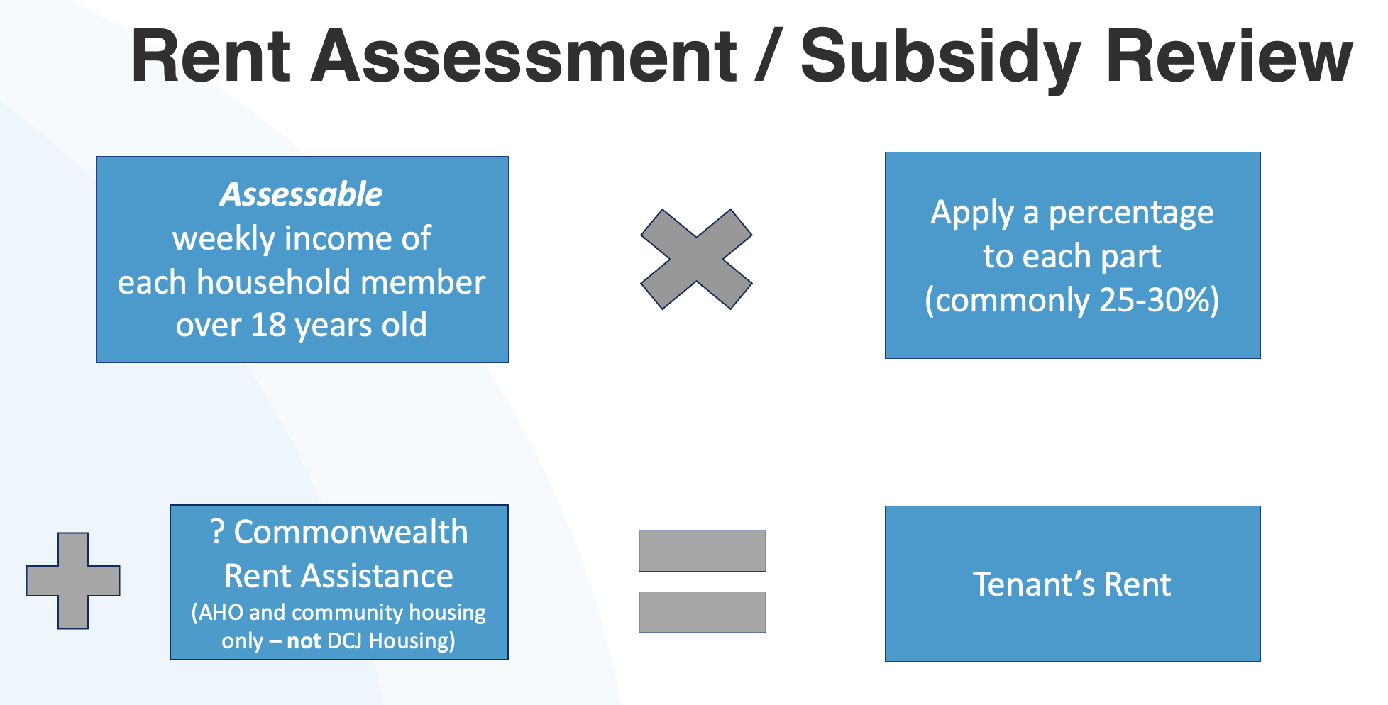

Slide 11
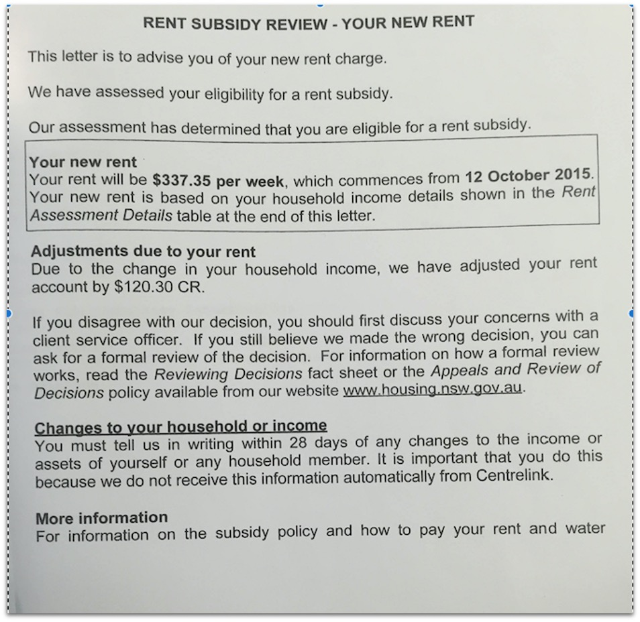
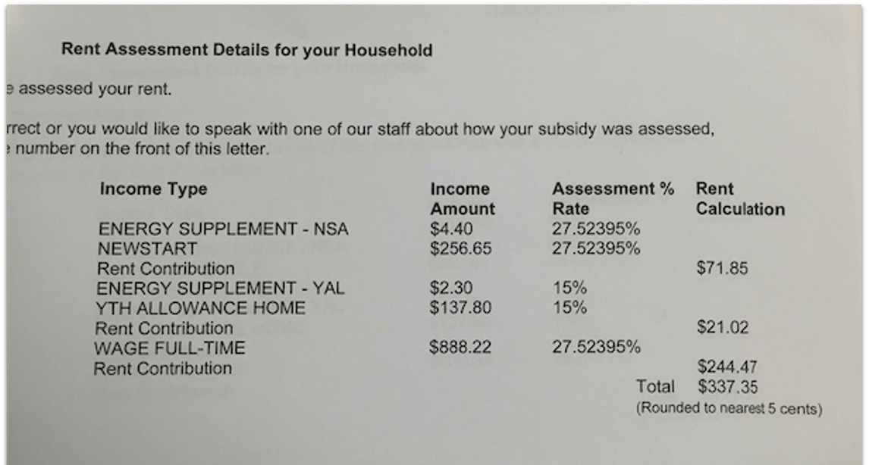

Slide 12
Water charges
Percentage
Actual usage

Slide 13
Tenant repair costs
Property damage caused by the tenant or a guest
Only if tenant accepts the damage, or it’s proven in the NSW Civil and Administrative Tribunal (NCAT)
Some exceptions: Fair wear & tear, criminal damage, damage caused through domestic or family violence

Slide 14
Debts after a tenancy ends
Combined former debt account
Debt collection / legal action
Categorisation when tenant re-applies for housing:
Satisfactory
Less than satisfactory
Unsatisfactory
Ineligible

Slide 15

2
Rent and water arrears

Slide 16
Rent and water arrears
Tenant’s rent or water remains unpaid for 14 days
Termination notice (14 days)
NCAT tribunal:
  termination and vacant possession
  specific performance order
  dismissed
Application for / enforcement of a warrant by the Sheriff

Slide 17
Can the tenant pay-to-stay?
No finding of frequent failure to pay rent
Finding of frequently failed to pay rent
Termination order or warrant issued has no effect if a tenant pays all the rent or charges owing before the warrant is enforced.
Termination process must stop.
A termination order stands even if the tenant pays all rent owing.
Sheriff can still enforce a warrant for possession.

Slide 18
Management of arrears
“Whenever a tenant’s account goes into arrears, DCJ will work with the tenant to try to resolve the problem.
When deciding how to respond to a tenant’s account being in arrears, DCJ will consider the following factors:
The tenant’s payment patterns
The amount of time the tenant has been in arrears and the arrears amount
The reason the tenant is in arrears
The tenant’s capacity and willingness to repay the arrears
The need for involvement of support services
Previous arrears patterns, including the steps that have been taken to resolve the problem.”
- DCJ Housing Account Management Policy

Slide 19
DCJ Housing repayment proposal
Tenant to show what is manageable for them / their financial position:
Statement of financial position and/or budget
Letters of support
Evidence of other debts / repayments

Slide 20

3
Subsidy cancellations

Slide 21
Subsidy cancellations
Eligibility
No response to subsidy review request
Rent subsidy non-disclosure
Rent subsidy fraud

Slide 22
Rent subsidy non-disclosure
Occurs when a tenant has failed to advise DCJ of any change to their household circumstances, but has not done so deliberately.
- DCJ Housing Rent Subsidy Non-Disclosure Policy

Slide 23
Rent subsidy fraud
Occurs when:
A tenant is aware of their obligation to advise DCJ of any change to their household circumstances;
and
Deliberately does not advise of the change. This can occur either by deliberate omission, or through a false, incomplete or misleading statement.
- DCJ Housing Rent Subsidy Non-Disclosure Policy

Slide 24
Obligations before cancelling rent subsidy
Investigate
Advise tenant of allegation in writing
Give the tenant an opportunity to respond to the allegation
Advise tenant of the outcome and right to appeal

Slide 25
Consequences of rent subsidy non-disclosure / fraud investigation
No further action by landlord
Adjust rent subsidy
Cancel rent subsidy > debt, possible termination for arrears or on eligibility grounds
Criminal prosecution
Internal Appeals – Housing Appeals Committee

Slide 26

4
Questions & more information

Slide 27

Questions & answers
Ned Cooke
Solicitor & Team Leader
Inner Sydney Tenants Advice
& Advocacy Service
Resources: www.rlc.org.au/training/resources/housing

Slide 28

Free, confidential tenancy advice
Tenants advice services
www.tenants.org.au
rlc.org.au/training/resources/housing

Slide 29

Community legal education - free webinars & recordings www.rlc.org.au/training
Nick Manning: education@rlc.org.au

Slide 30
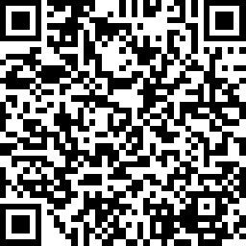
Your feedback is important to us! www.rlc.org.au/feedback or scan the QR code >>>

