Slide 1
Money Matters in Social Housing
Webinar

Slide 2
Leanne O’Reilly
Tenancy and Housing Law Advisor
Redfern Legal Centre

Slide 4
Outline
Types of charges in social housing
Rent & water arrears
Subsidy cancellations
Questions and More Information
Resources: https://rlc.org.au/training/resources/housing

Slide 5
1. Types of Charges in Social Housing

Slide 6
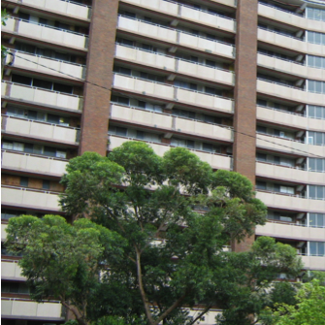
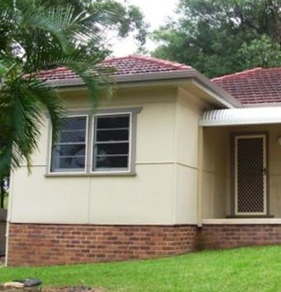
Social Housing
Public Housing
NSW Land & Housing Corporation
DCJ Housing
Community Housing
Over 150 community housing providers in NSW
Aboriginal Housing

Slide 7
Types of charges in social housing
Rent
Water usage
Tenant repair costs
Debts from a former tenancy

Slide 8
Market rent
Subsidised rent
Rent

Slide 9
How do rent subsidies work?
“A rent subsidy is the difference between the market rent and the rent a tenant pays…
DCJ does not pay the rent subsidy to the tenant, but deducts it directly from the market rent.”
- DCJ Housing - Charging Rent Policy

Slide 10
Rent Assessment / Subsidy Review
Assessable weekly income of each household member over 18 years old
Apply a percentage to each part (commonly 25-30%)
? Commonwealth Rent Assistance
(AHO and community housing only – not DCJ Housing)
Tenant’s Rent

Slide 11
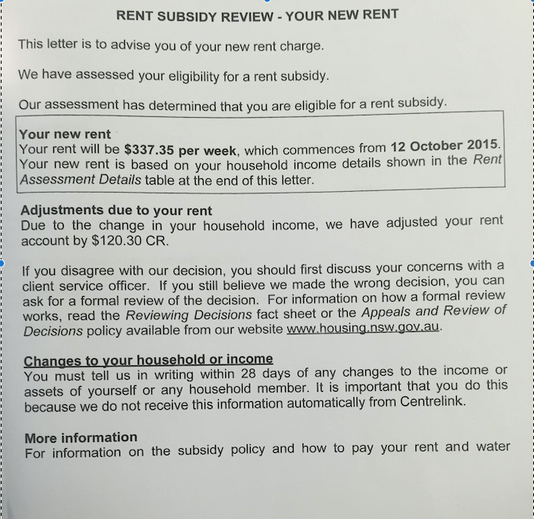
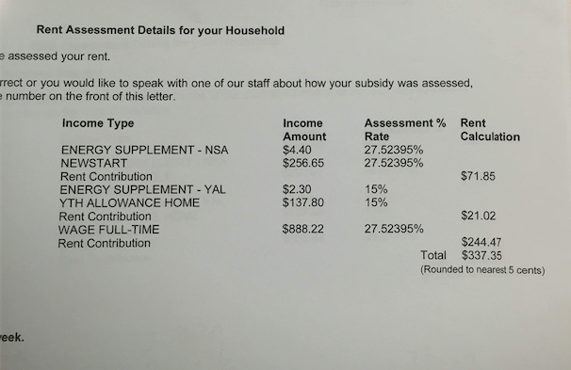

Slide 12
Water Charges
Percentage
Or
Actual usage

Slide 13
Tenant repair costs
Property damage caused by the tenant or a guest
Only if tenant accepts the damage, or it’s proven in the NSW Civil and Administrative Tribunal (NCAT)
Some exceptions: Fair wear & tear, criminal damage, damage caused through domestic or family violence

Slide 14
Debts after a tenancy ends
Combined former debt account
Debt collection / legal action
Categorisation when tenant re-applies for housing:
Satisfactory
Less than satisfactory
Unsatisfactory
Ineligible

Slide 15
2. Rent & Water Arrears

Slide 16
Rent & water arrears
Tenant’s rent or water remains unpaid for 14 days
Termination notice (14 days)
NCAT (tribunal):
termination and vacant possession
specific performance order
dismissed
Application for / enforcement of a warrant by the Sheriff

Slide 17
Can the tenant pay-to-stay?
No finding of frequent failure to pay rent
Finding of frequently failed to pay rent
Termination order or warrant issued has no effect if a tenant pays all the rent or charges owing before the warrant is enforced.
Termination process must stop.
A termination order stands even if the tenant pays all rent owing.
Sheriff can still enforce a warrant for possession.

Slide 18
Management of arrears
“Whenever a tenant’s account goes into arrears, DCJ will work with the tenant to try to resolve the problem. When deciding how to respond to a tenant’s account being in arrears, DCJ will consider the following factors:

Slide 19
Management of arrears (cont.)
The tenant’s payment patterns
The amount of time the tenant has been in arrears and the arrears amount
The reason the tenant is in arrears
The tenant’s capacity and willingness to repay the arrears
The need for involvement of support services
Previous arrears patterns, including the steps that have been taken to resolve the problem.”
- DCJ Housing Account Management Policy

Slide 20
Repayment Arrangements
DCJ Housing repayment proposal
Tenant to show what is manageable for them / their financial position:
Statement of financial position and/or budget
Letters of support
Evidence of other debts / repayments

Slide 21
3. Subsidy Cancellations

Slide 22
Subsidy Cancellations
Eligibility
No response to subsidy review request
Rent subsidy non-disclosure
Rent subsidy fraud

Slide 23
Rent Subsidy Non-Disclosure
Occurs when a tenant has failed to advise DCJ of any change to their household circumstances but has not done so deliberately.
- DCJ Housing Rent Subsidy Non-Disclosure Policy

Slide 24
Rent Subsidy Fraud
Occurs when:
A tenant is aware of their obligation to advise DCJ of any change to their household circumstances; and
Deliberately does not advise of the change. This can occur either by deliberate omission, or through a false, incomplete or misleading statement.
- DCJ Housing Rent Subsidy Non-Disclosure Policy

Slide 25
Obligations before cancelling
rent subsidy
Investigate
Advise tenant of allegation in writing
Give the tenant an opportunity to respond to the allegation
Advise tenant of the outcome and right to appeal

Slide 26
Consequences of rent subsidy non-disclosure / fraud investigation
No further action by landlord
Adjust rent subsidy
Cancel rent subsidy → debt, possible termination for arrears or on eligibility grounds
Criminal prosecution
Internal Appeals – Housing Appeals Committee

Slide 27
Leanne O’Reilly
Tenancy and Housing Law Advisor
Redfern Legal Centre
Resources: https://rlc.org.au/training/resources/housing

Slide 28
Tenants Advice & Advocacy Services
free confidential legal advice on social housing
Enter your suburb at www.tenants.org.au

Slide 29
Before You Go

