Slide 1
Has Your Client Been Underpaid?
Sharmilla Bargon Senior Solicitor
Employment Rights Legal Service at RLC

Slide 3
Outline
What is wage theft?
Who gets exploited?
Migrant Workers
What should you do if your client is underpaid?
Questions and further resources
RESOURCES: www.rlc.org.au/events/underpaid

Slide 4
1. What is wage theft?

Slide 5
What’s the problem?
FULL PAYMENT
OF ENTITLEMENTS
Sham contracting or
incorrect employment
status or misclassification
Incorrect wage under the
Award / contract (including
casual rates and non-payment
of penalty rates)
Other unpaid entitlements,
including superannuation,
personal leave, annual leave
loading, long service leave,
redundancy and tax
Unknown employers or occasional payments
to keep employees
interested
Misrepresenting of
entitlements or
workplace rights
Employee not paid for
all hours worked
(e.g. casual rates,
overtime)
NO PAYMENT

Slide 6
Spotting the signs: wage theft
“I got my job from Gumtree/a WhatsApp Group”
“I’ve never received a payslip”
Unable to check hourly rate against the Modern Award
Difficult to keep track of hours
Unable to check if entitlements and penalty rates are being paid
“I get paid $15 per hour cash in hand”
Underpaid per national minimum wage of $23.23 FT or $29.04 casual
Tax, superannuation, leave
Missed pay and hours
Who is the employer and what is their ABN?
Is your client protected if they crash a company car or have an accident at work?
Manipulation of respect and trust
“My boss pays me when he can”

Slide 7
Spotting the signs:
sham contracting
“I have an ABN”
“My boss pays me $20 per hour flat rate”
“My boss tells me when and where I will work”
“I don’t use any of my own tools, I use my boss’s!”
“My boss says I can’t work for anyone else”
No access to sick leave or other kinds of leave
No protection from unfair dismissal
No insurance, workers compensation
Hourly underpayment

Slide 8
2. Who gets exploited?

Slide 10
3. Migrant workers

Slide 11
Why do migrant workers get exploited?
I don’t want any visa problems
Who will help me?
I don’t know about my workplace rights
It’s just how you are treated when you are an international student
Everyone else at work is paid the same. Why should I complain?
There are no jobs. At least I am being paid.

Slide 12
4. What should you do if your client is underpaid?

Slide 13
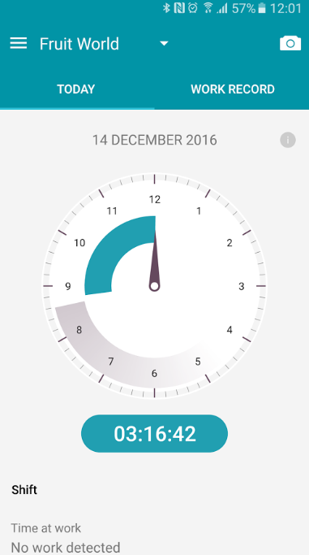
How can you help?
Start a conversation about your clients’ jobs, ask them how much they are being paid? Are they getting superannuation?​
​Help them to learn how much they should be paid – Fair Work Ombudsman P.A.C.T calculator​
Encourage them to find out exactly who they work for ie. ABN, email, mobile, name etc​
Talk about to them about recording hours – FWO app
​Have clients review their payslips (and keep them!)​
Get them to take these steps and help them to get legal advice!

Slide 14
What to do if your client is underpaid
Work out how much they are owed
Raise the issue with the employer
Write a letter of demand
Make a complaint to FWO
Make a claim at court

Slide 15
What to do if your client is underpaid
Work out how much they are owed
Raise the issue with the employer
Write a letter of demand
Make a complaint to FWO
Make a claim at court

Slide 16
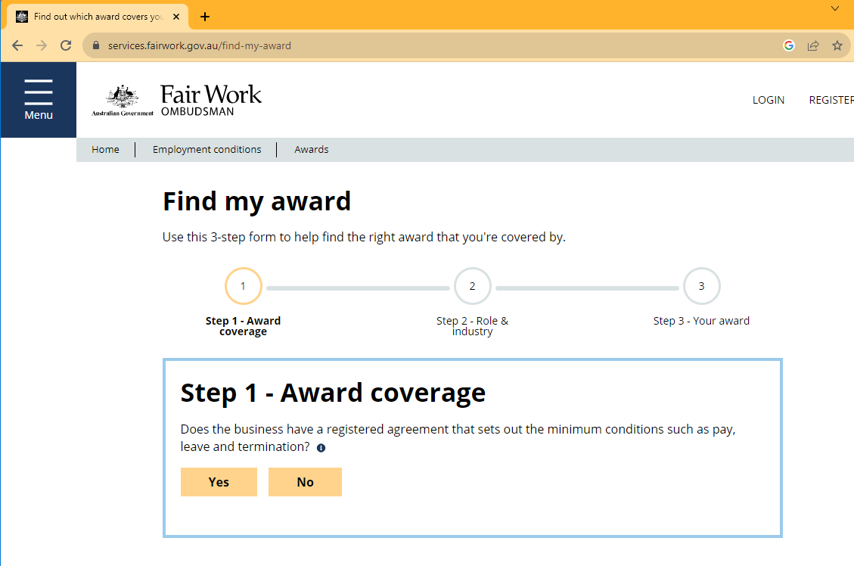

Slide 17
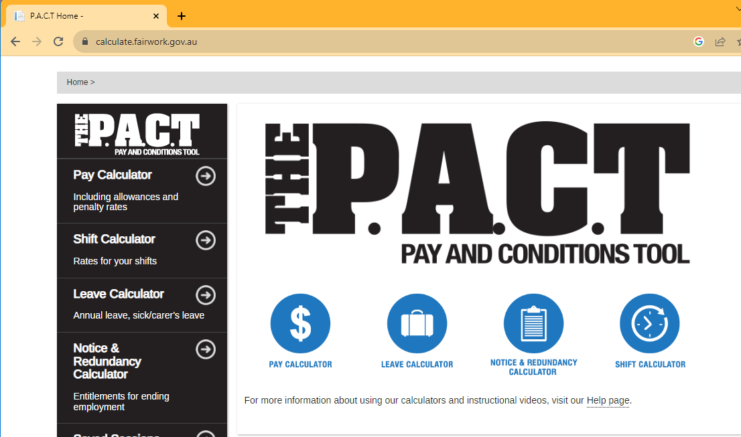

Slide 18
What to do if your client is underpaid
Work out how much they are owed
Raise the issue with the employer
Write a letter of demand
Make a complaint to FWO
Make a claim at court

Slide 19
What to do if your client is underpaid
Work out how much they are owed
Raise the issue with the employer
Write a letter of demand
Make a complaint to FWO
Make a claim at court

Slide 20
What to do if your client is underpaid
Work out how much they are owed
Raise the issue with the employer
Write a letter of demand
Make a complaint to FWO
Make a claim at court

Slide 21
What to do if your client is underpaid
Work out how much they are owed
Raise the issue with the employer
Write a letter of demand
Make a complaint to FWO
Make a claim at court

Slide 22
5. Questions and further resources
Sharmilla Bargon, Senior Solicitor Employment Rights Legal Service
Redfern Legal Centre
RESOURCES: www.rlc.org.au/events/underpaid

Slide 23
Where to get free confidential legal advice on employment issues
(NSW only) Employment Rights Legal Service (ERLS) www.erls.org.au
Most local community legal centres: https://clcs.org.au/legal-help
Legal Aid NSW https://www.legalaid.nsw.gov.au/my-problem-is-about/my-job and Legal Aid in other states and territories

Slide 24
Before You Go
Your feedback helps us improve our training.
Please stay with us for another 60 seconds…
Training: rlc.org.au/training
Enquiries: Nick Manning
education@rlc.org.au
This workshop is a guide to the law in Australia. It is not a substitute for legal advice. If you have a legal problem, seek legal advice from a legal centre or Legal Aid.

