Slide 1
Repairs in NSW public housing
& private rentals Alison Mackey Solicitor, Inner Sydney Tenants Advice & Advocacy Service, RLC

Slide 3
Outline
The right to repairs
Enforcing the right to repairs
Navigating the DCJ Housing repairs and maintenance system
Questions. Where to get legal advice
Resources: https://rlc.org.au/events/training/repairs

Slide 4
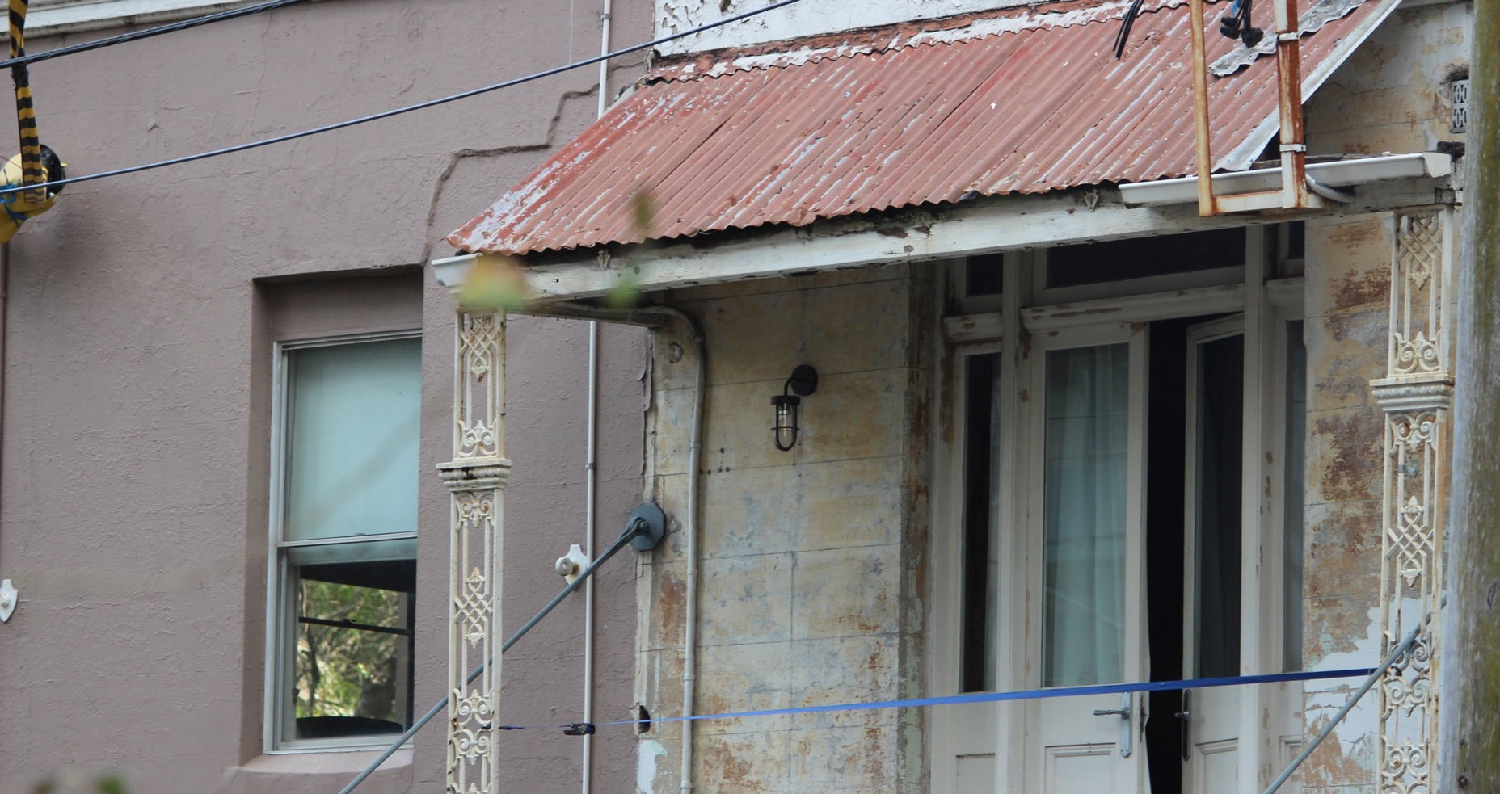
1. The right to repairs

Slide 5
The right to repairs
A tenant is entitled to live in a property that is in a reasonable state of repair
…having regard to:
the age of the premises,
rent payable for the premises, and
prospective life of the premises.

Slide 6
The right to repairs
Other things to know:
Includes common property
Applies even if a tenant knew about the state of property before they moved in
Doesn’t apply unless landlord knew or ought to have known about the repair issue (notice).
Landlord has to act with reasonable diligence to address the problem.
Landlords are not obliged to fix damage caused by the tenant.

Slide 7
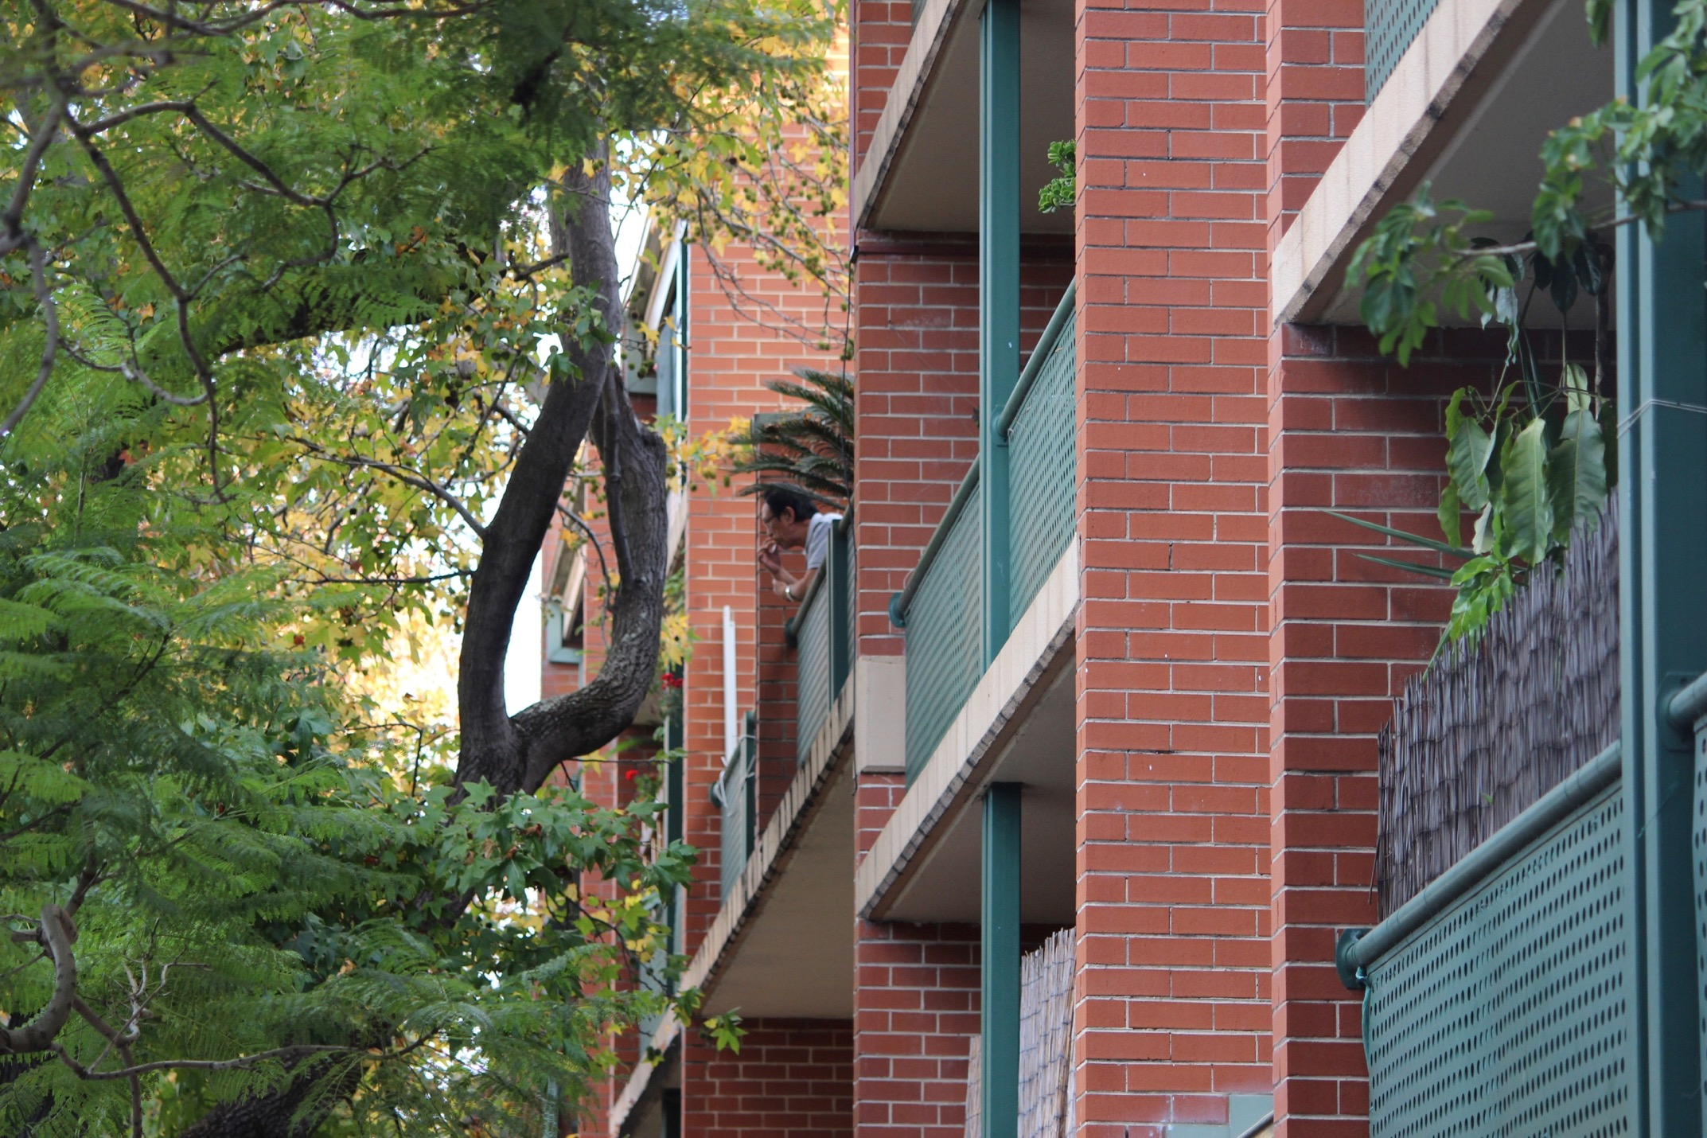
2. Enforcing the right to repairs
o

Slide 8
Enforcing the right to repairs
Write to landlord or real estate agent
Pay a tradesperson and seek reimbursement (urgent repairs only)
NSW Fair Trading Complaint Service
Local council
NSW Civil & Administrative Tribunal

Slide 9
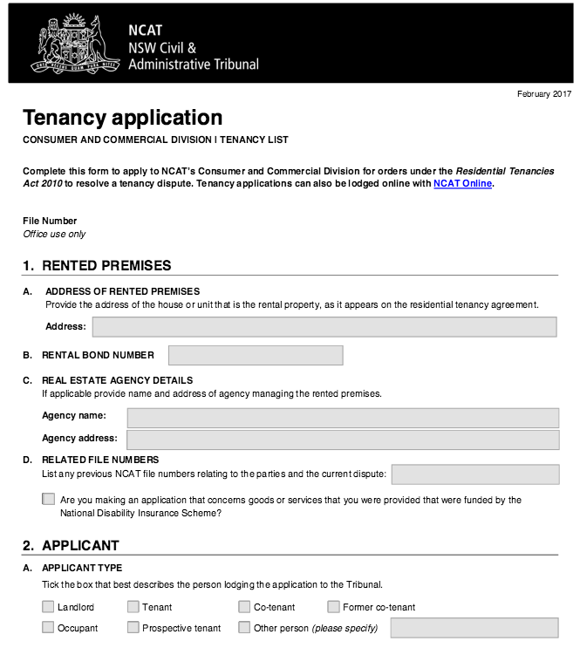
NCAT application

Slide 10
NCAT: Who do you apply against?
Private tenants: the ‘respondent’ is your landlord (not your Real Estate Agent). Check your Residential Tenancy Agreement for their details.
DCJ Housing tenants: the ‘respondent’ is the NSW Land and Housing Corporation. It is usually best to address your NCAT application to the local DCJ Housing team. eg. NSW Land and Housing c/- DCJ T101 232 Pitt St Waterloo 2017

Slide 11
NCAT: Orders
Section | Orders | Time limit for applying to the NCAT
65(1)(a) | An order that the landlord carry out repairs | Three months or no limit if the breach continues.
44(1)(b) | An order that the rent payable is too high (excessive) due to the reduction or withdrawal of any goods, services or facilities supplied with the residential premises | Must be brought to the tribunal during the tenancy. You cannot lodge an excessive rent claim once the tenancy has ended.
187(1)(d) | An order for compensation for economic loss or loss of quiet enjoyment of the premises Note: Maximum claim is $15,000 | Within three months of becoming aware of the breach.
From NCAT Tenancy Application Form

Slide 12
Online application

Slide 13
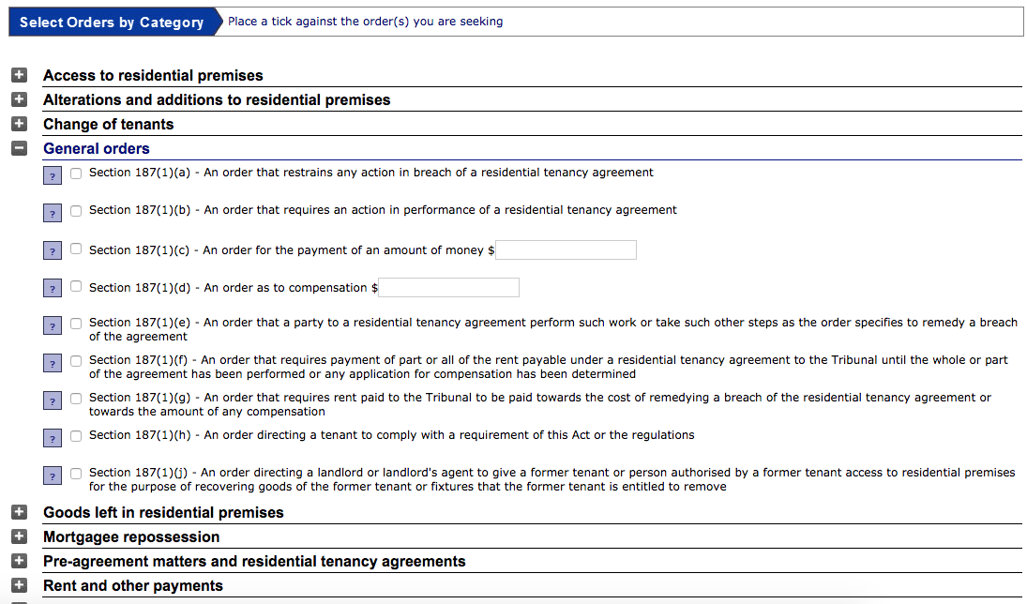
Online application (cont.)

Slide 14
Conciliation & hearing
Image: LawAccess NSW
Image: NCAT

Slide 15
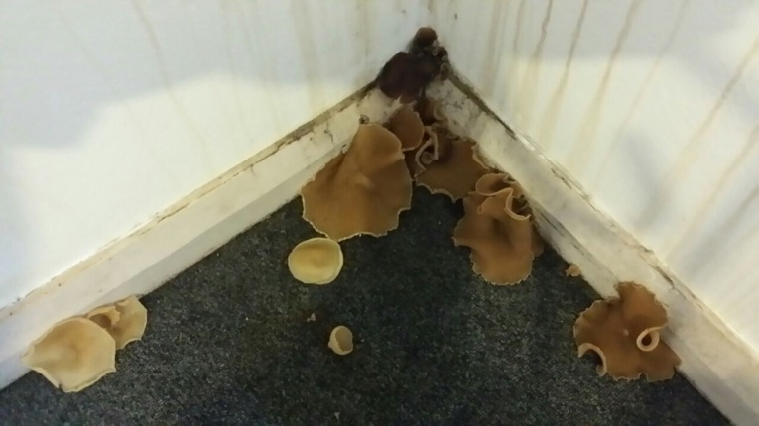
Evidence
Photos
Emails
Job ref. numbers
Written statements
Receipts, invoices or quotes

Slide 16
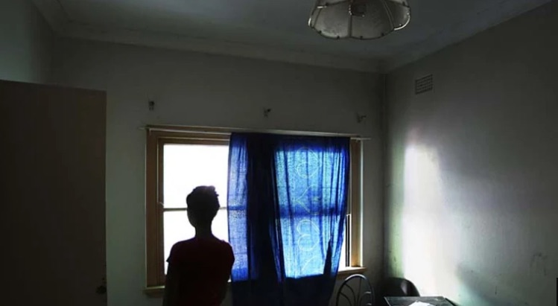
3. Navigating DCJ Housing repairs and maintenance system

Slide 17
DCJ (FACS) Housing tenants
Maintenance Line: 1800 422 322
Write down:
the date and time of your call
the name of the person you spoke with
what you discussed
the expected response time
the job reference number
Upcoming creation and implementation of HOMES NSW

Slide 18
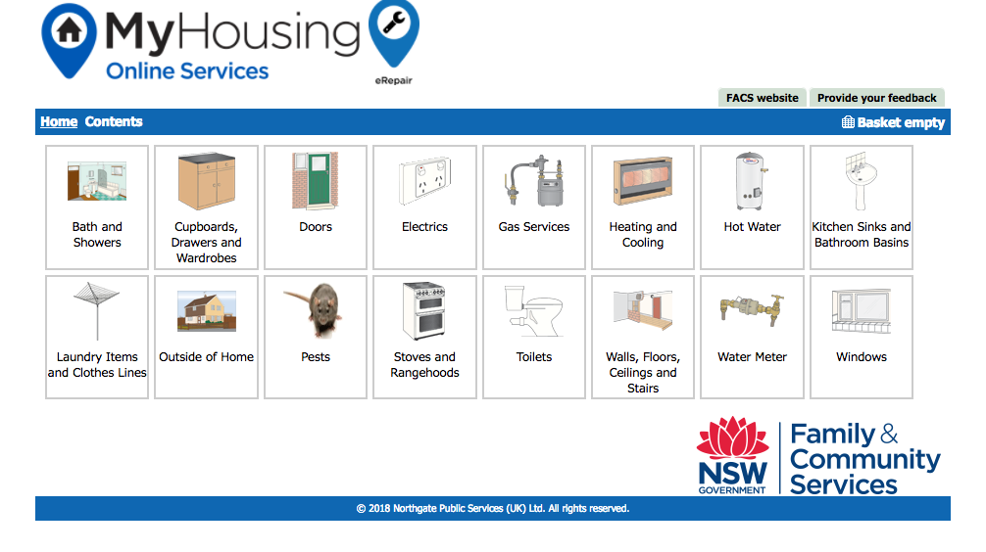
DCJ (FACS) Housing tenants

Slide 19
DCJ (FACS) Housing tenants
“Planned Program of Works”
Keep re-reporting the issue:
If tradesperson didn’t show up
If tradesperson just did an inspection and didn’t return to do the work when they said they would
If the work wasn’t completed to a satisfactory standard
If the repair issue comes back
Keep a written record of all calls.

Slide 20
DCJ (FACS) Housing tenants: Further options
Apply to NCAT (same as any other tenant)
Contact Local Member of NSW Parliament
Contact NSW Housing Minister’s Office
Make complaint to DCJ Housing (online or using Client Feedback Form)
Make Complaint to NSW Ombudsman

Slide 21
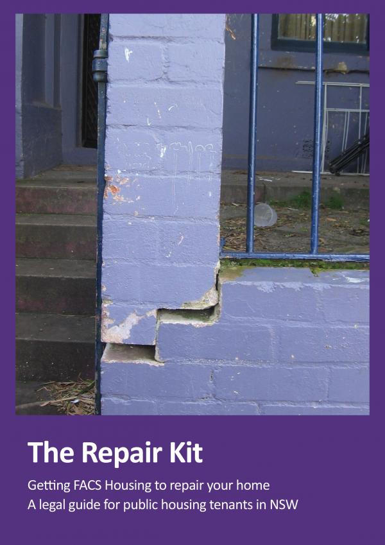
DCJ (FACS) Housing tenants: The Repair Kit
www.rlc.org.au/publication/repair-kit-getting-facs-housing-repair-your-home

Slide 22
Alison Mackey Solicitor Inner Sydney Tenants Advice & Advocacy Service Redfern Legal Centre
Resources: https://rlc.org.au/events/training/repairs

Slide 23
Tenants Advice & Advocacy Services
www.tenants.org.au
fact sheets and sample letters
free confidential legal advice on social housing
- enter your suburb

Slide 24
Before You Go

