Slide 1
Women @ Work

Slide 2
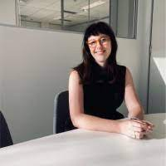
Regina Featherstone
Solicitor Employment Rights Legal Service
Redfern Legal Centre

Slide 4
Outline
What’s the problem?
Case study: meet Antonia
What is sexual harassment
What’s new in the law?
What can Antonia do?
Questions and further resources
RESOURCES: www.rlc.org.au/training/women-work

Slide 5
1. What’s the problem?

Slide 6
What’s the problem?
53% of women and 25% of men have experienced sexual harassment in their lifetime (ABS, December 2021)
Almost 2 in 5 women have been sexually harassed at work (39%) (Respect@Work Report)

Slide 7
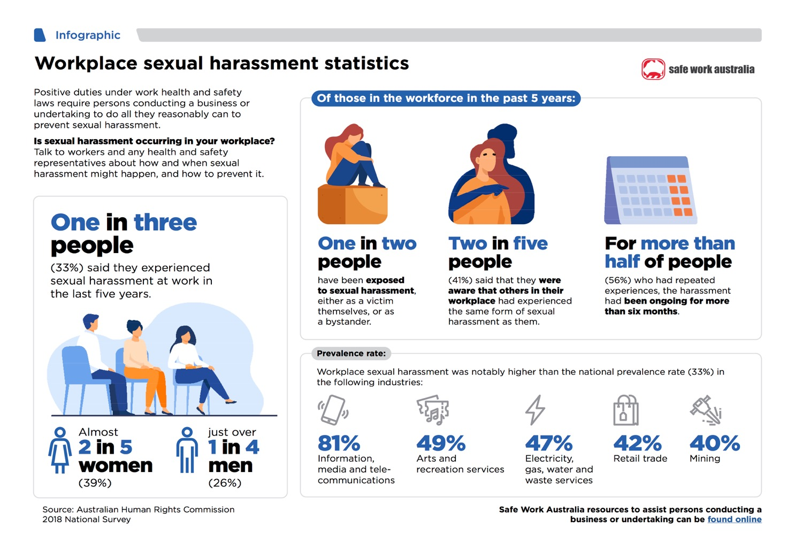

Slide 8
2. Case study

Slide 9
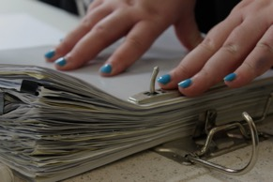
Meet Antonia
Antonia is 26 years old. Antonia was a bookkeeper at a chain store called ‘Champ’s Camp’ which sells camping equipment.
One day in June 2022, Antonia was sitting next to her boss Steve as they went through the books.
Steve pointed to her finger and said ‘what’s that? Don’t tell me you’re knocked up or something?’
Antonia felt uncomfortable. She laughed and said ‘I’m engaged’.
Her boss responded with ‘that’s a shame, I just always thought you and I would have sex. Maybe we still can?’ and he placed his hand on her thigh.
Antonia began to panic and diffused the situation by saying ‘well that can’t happen because I’m engaged’.

Slide 10
Meet Antonia #2
The next day Antonia wrote to HR at the business to tell them of the interaction.
HR replied and gave Antonia a link to Beyond Blue.
Since June 2022, Antonia has had to continue working with Steve and feels uncomfortable near him. He continues to sit very close to her and most recently, asked her if she will be buying anything special for her wedding night.
Antonia has seen a doctor and been diagnosed with anxiety. She has typed up her resignation.

Slide 11
3. What is sexual harassment?

Slide 12
Sexual harassment defined
Sexual harassment is defined* as:
“Unwelcome sexual advance or unwelcome request for sexual favours; or
Engages in other unwelcome conduct of a sexual nature
in circumstances in which a reasonable person, having regard to all the circumstances, would have anticipated the possibility that the person harassed would be offended, humiliated or intimidated.”
*Sex Discrimination Act 1984 (Commonwealth) - “the SDA”

Slide 13
Sexual harassment described
🚩🚩🚩
unwelcome touching, kissing or hugging, staring, leering, sending sexually explicit pictures, unwelcome invitations to date or have sex, questions about private life, sexual comments or jokes, sexually explicit texts
🚩🚩🚩

Slide 14
4. What’s new in the law?

Slide 15
So what’s new in the SDA*
Persons who cause, instruct, induce, aid or permit sexual harassment and sex based harassment may be personally liable under the SDA.
Workplace participants are protected: employees, contractors, interns and volunteers
2 years to make a claim under the SDA
Sex based harassment is unlawful – ie conduct of a seriously demeaning nature by reason of a person’s sex
*Sex Discrimination Act 1984 (Commonwealth) - “the SDA”

Slide 16
And what’s new in the Fair Work Act?
Miscarriage leave (2 days of paid or unpaid for casuals)
Stop sexual harassment orders
Sexual harassment now considered serious misconduct
Proposed change: 10 days paid family and domestic violence leave (currently 5 days unpaid)
Fair Work Act 2009 (Commonwealth)

Slide 17
What hasn't changed Dismissal >>> 21 days to file an application for unfair dismissal

Slide 18
5. What can Antonia do?

Slide 19
Back to Antonia
Antonia is 26 years old.
Antonia was a bookkeeper at a chain store, Champ’s Camp which sells camping equipment.
One day in June 2022, Antonia was sitting next to her boss Steve as they were going through the books.
Steve pointed to her finger and said ‘what’s that? Don’t tell me you’re knocked up or something?’
Antonia felt uncomfortable. She laughed and said ‘oh I’m engaged’.
Her boss responded with ‘that’s a shame, I just always thought you and I would have sex. Maybe we still can?’ and he placed his hand on her thigh.
Antonia began to panic and diffused the situation by saying ‘well that can’t happen because I’m engaged’.

Slide 20
Back to Antonia #2
The next day Antonia wrote to HR at the business to tell them of the interaction. HR replied and gave Antonia a link to Beyond Blue.
Since June 2022, Antonia has had to continue working with Steve and feels uncomfortable near him. He continues to sit very close to her and most recently, asked her if she will be buying ‘anything special’ for her wedding night.
Antonia has seen a doctor and been diagnosed with anxiety. She has typed up her resignation.

Slide 21
What can Antonia do?
Antonia should seek legal advice immediately:
Where? CLC, Legal Aid, paid lawyer
Make a complaint alleging sexual harassment, and seeking compensation, to the Australian Human Rights Commission - within 2 years of harassment occurring (or within 1 year if the Anti Discrimination Board NSW).
Seek an order to stop harassment - make an application for a ‘stop sexual harassment order’ at the Fair Work Commission.

Slide 22
6. Questions and further resources
Regina Featherstone Solicitor Employment Rights Legal Service
Redfern Legal Centre
RESOURCES: www.rlc.org.au/training/women-work

Slide 23
Where to get free confidential legal advice on employment issues
(NSW only) Employment Rights Legal Service (ERLS) www.erls.org.au
Most local community legal centres: https://clcs.org.au/findlegalhelp
Legal Aid NSW www.legalaid.nsw.gov.au/contact-us/legal-aid-nsw-offices and Legal Aid in other states and territories

Slide 24
Before You Go
Your feedback helps us improve our training.
Please stay with us for another 60 seconds…
Training: rlc.org.au/training
Enquiries: Nick Manning
education@rlc.org.au
This workshop is a guide to the law in Australia. It is not a substitute for legal advice. If you have a legal problem, seek legal advice from a legal centre or Legal Aid.

