Slide 1
Fines & Penalty Notices 1: Challenging a fine

Slide 2
Elle Triantafillou
Police Accountability Solicitor
Redfern Legal Centre

Slide 4
Outline: Fines & Penalty Notices 1: Challenging a fine
Types of fines
Internal Review
Electing to go to court
Court-imposed fines
Children and fines
Questions. Where to get legal advice
Resources: www.rlc.org.au/training/resources/fines

Slide 5
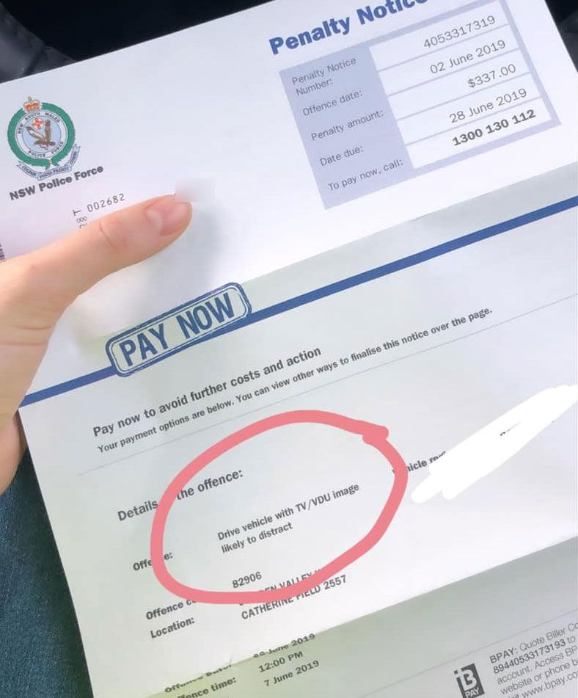
Types of fines
There are two types of fines:
Penalty notices
Court fines

Slide 6
Penalty Notices: Options for review
Internal review
Court election

Slide 9
Internal review

Slide 10
Time limits
Internal Review Application
An application can be made at any time, including if the fine has been partially paid or an enforcement order has been made.
Exception
If paid in full and haven’t received a penalty reminder notice you have 60 days from the Penalty Notice being issued.

Slide 11
Why would you request a review?
Penalty notice issued contrary to law
Mistaken identity
Exceptional circumstances - eg. medical emergency
Intellectual disability, cognitive impairment, mental illness

Slide 13
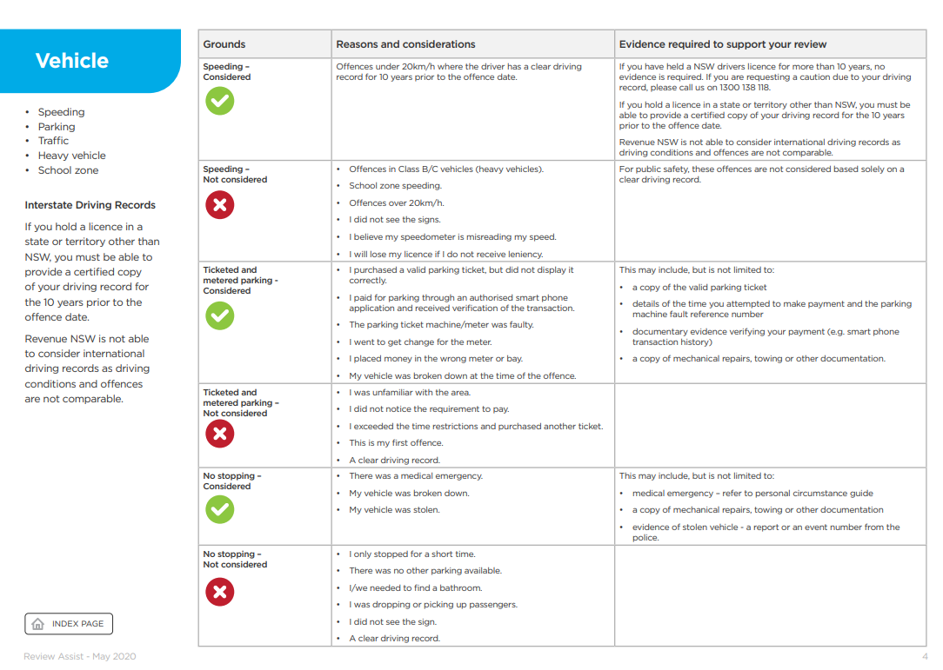

Slide 14
Evidence
Depending on the reason you are requesting a review, supporting documents should include:
copies of tickets
permits
police reports
medical evidence
proof of vehicle repairs
statutory declaration or statement

Slide 15
Example: Paula’s internal review
Paula was feeling unwell and got a PCR test. She was required to isolate after taking the test.
She arrived home and parked in a 2 hour parking spot as there were no other all day spots available.
She later received a fine for parking in the spot for longer than two hours.
Paula applied for internal review.
Fine withdrawn.

Slide 16
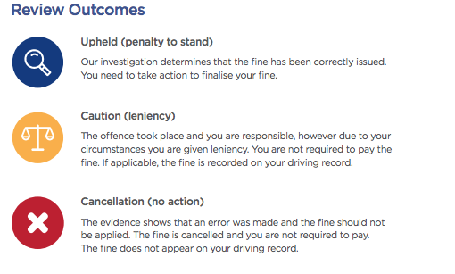

Slide 17
Electing
to go to
court
Image: Tom Parsons on unsplash

Slide 18
Time limits: Electing to go to court
If you have not applied for review:
If no payment or part-paid:
The due date of the first penalty reminder notice
If paid in full:
90 days from the date the penalty notice was received
If you have applied for review:
28 days from being notified of the outcome of the review

Slide 19
Why would you take a penalty notice to court?
Don’t believe you broke the law
Seeking a more lenient penalty
About to lose licence

Slide 20
Pleading
Guilty
Not guilty

Slide 21
The dangers
Cost
‘Strict liability’ offences
Sometimes what you think is a defence is only an explanation, which means you are still guilty of the offence
Criminal record

Slide 22
The dangers (cont.)
Court could impose a higher penalty
Time consuming
Emotional
No guarantee of a good outcome

Slide 23
Court costs levy
A 'court costs levy' is a fee for having your case heard at court. If you plead guilty or are found guilty of any offence the court will order that you pay mandatory court costs of $85 (as at 1 July 2022) unless you:
are convicted in the Drug Court or the Children's Court
get a section 10(1)(a) dismissal for an offence that does not impose a prison sentence
receive a prison sentence (other than a suspended sentence).

Slide 24
Victims Support Levy (VSL)
An amount imposed on people who plead guilty or are found guilty in court. The money goes to the Victims Support Fund.
If you are plead or are found guilty of a summary offence, you will need to pay a VSL of $90 (as of July 2022).

Slide 25
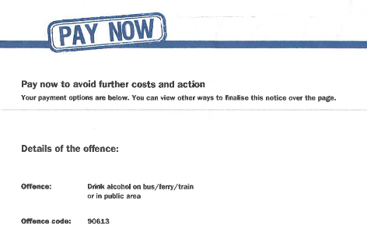
Higher Penalty
Check Lawcodes - https://lawcodes.judcom.nsw.gov.au/

Slide 26
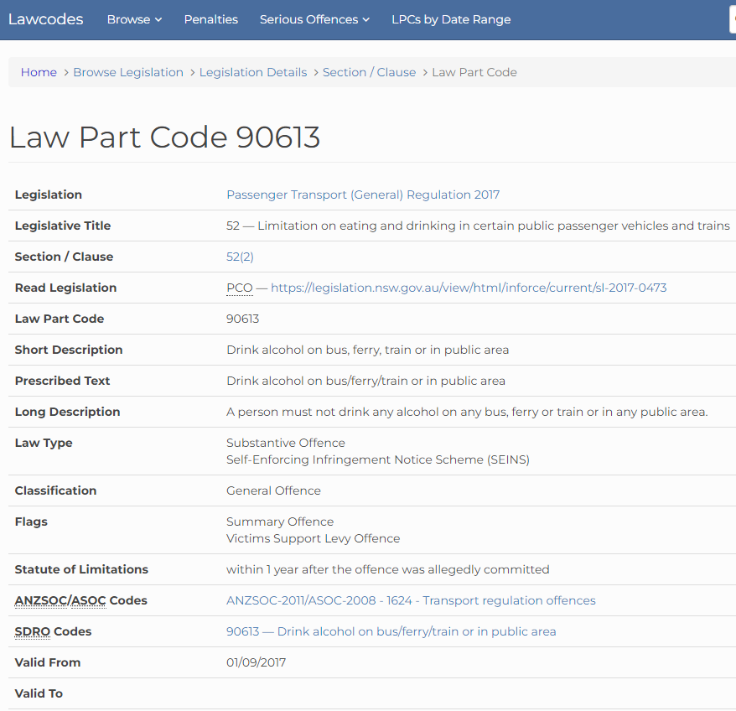

Slide 27
Strict liability
A strict liability crime is a crime that requires no “mens rea”.
That is, proof is not required that you intended to commit an offence.
For example: speeding, drink driving.

Slide 28
Strict liability - defence
Honest and reasonable mistake of fact

Slide 29
Best matters to take to court
Clear evidence that you did not break the law
Person with good driving record
Exceptional circumstances
You are willing to plead guilty, but seek leniency
You are about to lose your licence

Slide 30
Asking for leniency - what will the court consider
Seriousness of the offence (safety)
Traffic record
Financial situation
Age

Slide 31
What will the court consider (cont.)
Circumstances surrounding the offence
Evidence
Remorse
Alternatives

Slide 32
What can the court do
Find the accused not guilty – offence dismissed
Finding of guilt, dismissal and no conviction - s10(1)
Remove any demerit points
Reduce the cost of the fine
Impose a more significant fine
Nothing. Fine stands.

Slide 33
Court-imposed Fines

Slide 34
Contesting a court fine
Appealing to the District Court
Applying to the court for annulment

Slide 35
Time limits: Appealing to the District Court
Must lodge a Notice of Appeal up to 28 days after the sentence date.
You can lodge an appeal up to 3 months from the sentence date if you get leave (permission) from the court.
Fee: $126

Slide 36
Annulment: not present when fine imposed
If convicted or sentenced in the Local Court less than 2 years ago, and you weren’t present, you can apply to have the sentence or conviction annulled.

Slide 37
Proof for annulment
You were not aware of the original case
You were unable to attend for a good reason
It is in the interests of justice to do so

Slide 38
Children
and
fines

Slide 39
Children (under the age of 18)
Electing to go to court:
Matter heard in the Children’s Court
Exception – traffic offence where the young person is old enough to have a licence:
Matter heard in the Local Court.

Slide 40
What can the Children’s Court do?
Caution
Refer to Youth Justice Conference
Dismiss the matter
Fine
If Court imposes a fine, the fine can’t be more than 10 penalty units ($1,100) for one offence.

Slide 41
Elle Triantafillou
Solicitor, Police Accountability and Administrative Law
Redfern Legal Centre
Resources:: www.rlc.org.au/training/resources/fines

Slide 42
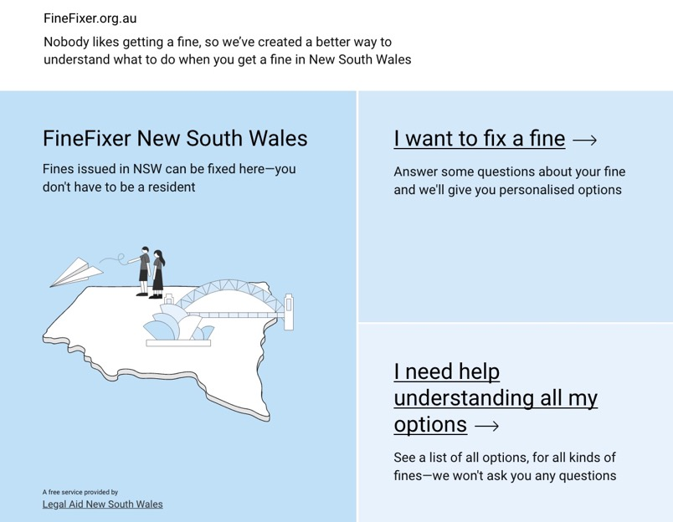
finefixer.org.au
https://nsw.finefixer.org.au

Slide 43
When to get legal advice on fines
If you want to challenge the penalty notice in court
If you want to annul old penalty notices, and then challenge them in court

Slide 44
Where to get free, confidential legal advice on fines
Most local community legal centres: www.clcnsw.org.au/find-legal-help
Legal Aid NSW: - Law Access 1300 888 529 - Legal Aid Hotline for Under 18s: 1800 10 18 10
The Shopfront Youth Legal Centre (under 25 year olds) www.theshopfront.org
Aboriginal Legal Service (ALS) www.alsnswact.org.au
Homeless Persons Legal Service www.piac.asn.au/legal-help/hpls-clinic-times-locations

Slide 45
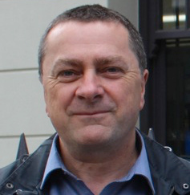
Before You Go

