Slide 1
Termination of Residential Tenancies in NSW (and how to challenge them)

Slide 2
Alison Mackey
Tenancy Solicitor
Inner Sydney Tenants Advice & Advocacy Service
Redfern Legal Centre

Slide 4
Outline
Overview of termination process
When can a tenant be evicted?
When can a tenant terminate the tenancy agreement?
Unlawful lockouts
Questions and where to get help
Resources: https://rlc.org.au/events/terminations-evictions-nsw

Slide 5
1. Overview of the termination process

Slide 6
Overview of the Termination Process
Notice of termination
Application to NSW Civil and Administrative Tribunal (NCAT)
NCAT hearing
NCAT orders termination and possession
NCAT issues warrant for possession
Office of NSW Sheriff executes warrant for possession; locks are changed

Slide 7
Overview of the Termination Process (a)
Notice of Termination
A valid notice of termination should include:
the address of the residential premises
the date on which the tenancy agreement is terminated AND the date by which vacant possession of the premises is to be given
the ground for the notice (reason for terminating the tenancy).
You DO NOT HAVE TO MOVE OUT on the date on the Notice of Termination.

Slide 8
Overview of the Termination Process (b)
b. Application to NSW Civil and Administrative Tribunal (NCAT)
In a situation where a tenant is still in the premises after the date of vacant possession, landlord must apply to NCAT for orders for termination/possession.
The landlord cannot just come and change the locks of the premises or bring police to get a tenant out.
There are some circumstances where a landlord (or a tenant) can apply directly to NCAT for termination orders without first issuing a notice of termination.

Slide 9
Overview of the Termination Process (c)
c. NCAT hearing
Will receive notice of conciliation hearing
Conciliation hearing – first hearing in the NCAT process. NCAT will ask both parties to try and conciliate/negotiate to try and reach an agreement
If no agreement can be reached, the matter will either be heard on the day or adjourned for formal hearing at later date
Very important – always attend the hearing unless the NCAT tells you in writing that you do not need to attend.

Slide 10
Overview of the Termination Process (d)
d. NCAT orders – termination and possession
If NCAT agrees tenancy should be terminated, it will make termination and possession orders.
A new date will be set by which the tenant is required to give vacant possession of the premises.
If you think the wrong decision has been made – seek advice ASAP about whether there are grounds to have the orders set aside or to appeal! Strict time limits for these actions.

Slide 11
Overview of the Termination Process (e)
e. NCAT issues warrant for possession
If tenant is still in premises after the vacant possession date ordered by NCAT, landlord can apply to NCAT for warrant for possession.
Once NCAT issues warrant for possession, it will be sent to NSW Sherriff’s Office.
Landlord and Sherriff’s Office will book a time for the warrant to be executed – they don’t have to tell the tenant when this will be.
If notified that warrant for possession has been issued, you should pack a bag of all important documents, possessions and medications.

Slide 12
Overview of the Termination Process (f)
f. Sheriff of NSW executes warrant for possession and locks are changed
When Sheriff turns up with warrant to be executed, very important to comply with the Sheriff.
Have a bag packed with important documents and possessions, medications and other essential items.
Important to note that once the warrant has been executed by the Sheriff, any NCAT decision cannot be set aside or appealed. The tenancy is over at this point.

Slide 13
2. When can a tenant be evicted?

Slide 14
When can a tenant be evicted?
Most common types of evictions by landlords in NSW:
Breach of the residential tenancy agreement (including for rental arrears) – 14 days written notice
End of fixed term agreement – 30 days written notice
No grounds – 90 days notice (only in periodic or ‘rolling’ tenancy agreements; not during fixed term)
Sale of premises – 30 days notice (only in periodic or ‘rolling’ tenancy agreements)
Remember – you do not have to be out of the premises by the date on the Notice of Termination.

Slide 15
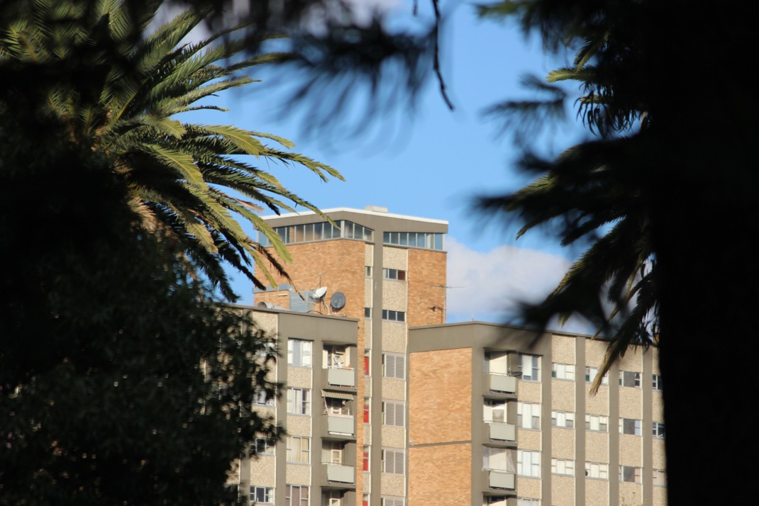
3. When can a tenant terminate the tenancy agreement?

Slide 16
When can a tenant terminate the tenancy agreement?
Landlord has breached the agreement – 14 days written notice (or application directly to NCAT under s 103)
End of fixed term – 14 days notice
No grounds – 21 days notice (periodic agreements only, not allowed in fixed term)
If the premises has become uninhabitable – notice can take effect immediately
Domestic violence – notice can take effect immediately, needs to be accompanied by evidence such as ADVO or competent person statement

Slide 17
4. Unlawful lockouts

Slide 18
Unlawful lockouts
Landlords cannot just change the locks/kick a tenant out of the premises.
Proper process we discussed at the beginning of the webinar MUST be followed.
Only the Sheriff of NSW can execute a warrant for possession.
A person who unlawfully locks out a tenant can face a penalty of up to $22,000.

Slide 19
Public Housing Redevelopment Tenants’ Advice Service
Quick note for tenants affected by public housing relocations:
RLC has just obtained funding to assist public housing tenants who are affected or likely to be affected in any way by current or proposed relocations of public housing properties in the inner Sydney area.
Can assist tenants with any enquiries related to relocations, including: issues with relocation statements/interviews, identified housing needs, repairs not being completed due to proposed relocation etc.

Slide 20
5. Questions & where to get help

Slide 21
Alison Mackey
Solicitor
Redfern Legal Centre
Resources: https://rlc.org.au/events/terminations-evictions-nsw
esources: www.rlc.org.au/training/resources/dvt

Slide 22
Tenants Advice & Advocacy Services
www.tenants.org.au
fact sheets and sample letters
free confidential legal advice on social housing
- enter your suburb

Slide 23
Before You Go

