Slide 1
How to Appeal a COVID-19 Fine
in NSW

Slide 3
Outline
Where to find the law
The main rules and issues
Where to start
Going to court
Questions and further resources
RESOURCES: http://www.rlc.org.au/training/resources/covid

Slide 4
1. Where to find the law

Slide 5
Public Health Act 2010 (NSW)
Allows Health Minister to deal with public health risks by implementing Public Health Orders (s.7)
Makes it an offence to not follow directions in Public Health Order (s.10)
Provides power to police to issue a penalty notice (s.118)
Public Health Orders

Slide 6
Other relevant legislation
Public Health Regulation 2012 - Schedule 4 – penalty notice offence – fine amounts
Fines Act 1996 (NSW) – administration of fines
Law Enforcement (Powers and Responsibilities) Act 2002 – limits to police powers

Slide 7
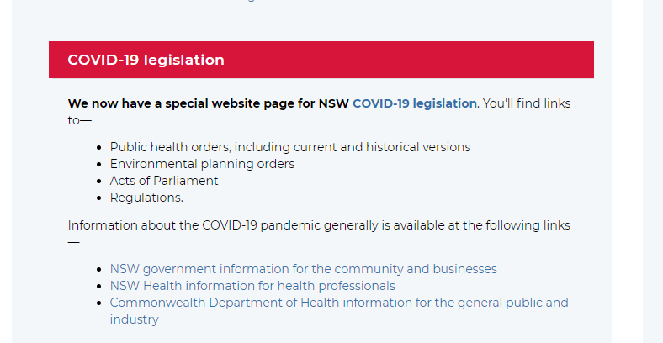
Where do I find the public health orders?
https://legislation.nsw.gov.au/

Slide 8
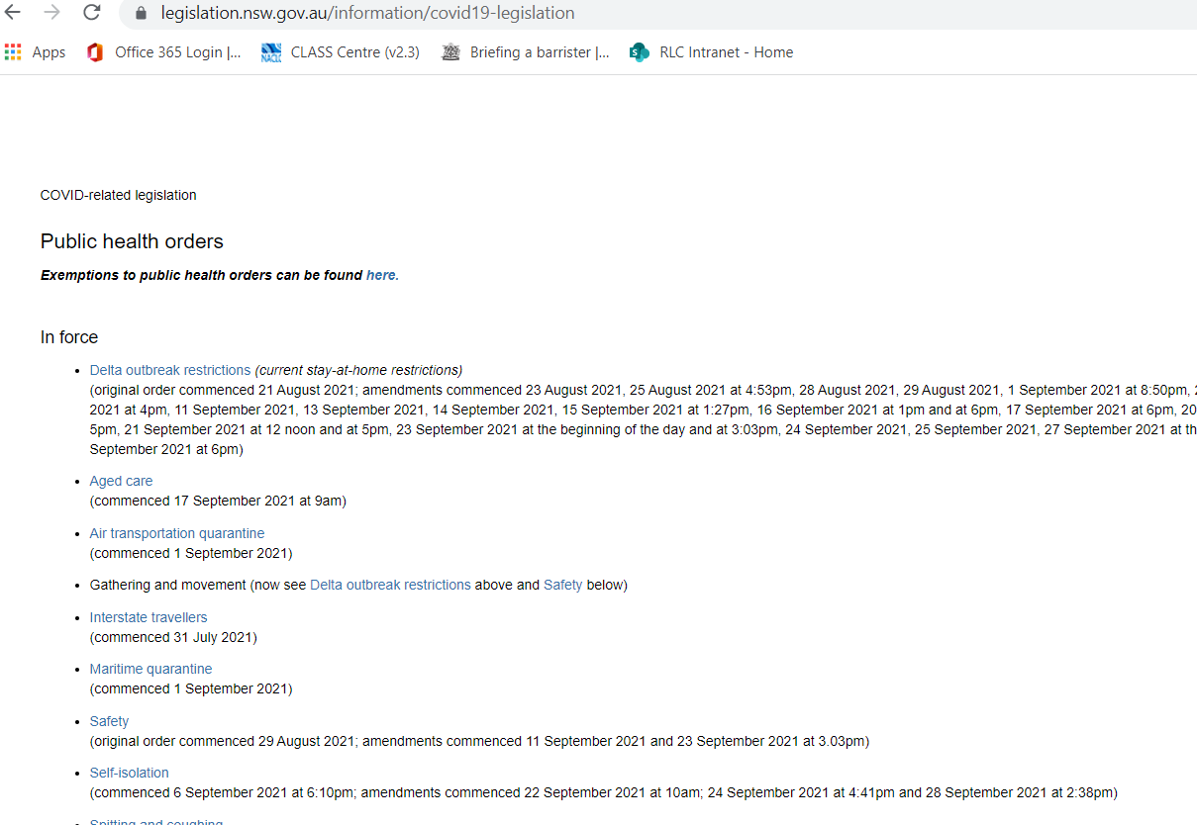

Slide 9
Orders at a particular date https://legislation.nsw.gov.au/information/covid19-legislation/temporary-movement-gathering-restrictions

Slide 10
Which public health order?
There are ten Public Health Orders in place.
The two main ones:
Deltra outbreak restrictions order
Self-isolation order

Slide 11
Delta Outbreak Restrictions Order
Public Health (COVID-19 Additional Restrictions for Delta Outbreak) Order (No 2) 2021 under the Public Health Act 2010
Previously titled -Temporary Movement and Gathering Restrictions Order
Order has been amended over 70 times
Crucial you go to the correct order in place at the time alleged offence occurred!

Slide 12
2. The main rules and issues

Slide 13
Main rules
Breakdown of areas
stay at home
areas of concern
general areas
Leaving home – reasonable excuse
Visitors to your home
Outdoor gatherings
Attending work
Vehicles
Masks

Slide 14
Key issues clients present with
Exercise and outdoor recreation
Distance rule: 5km/LGA
Areas of concern and stay at home areas
Entering areas of concern
Gathering rule
Compassionate reason
Shopping with others

Slide 15
Reasonable excuses to leave home
Buying food and goods
Work
Exercise and outdoor recreation
Childcare
School
Medical
Carer’s responsibility
Compassion
Shared custody
Emergencies
Animal welfare
Legal reason
Access public service
Move or inspect home
Accommodation
Relocate business
Religious functions
Nominated visitor
Came in on June 21.
Applied to all of Greater Sydney – includes Blue Mountains, Central Coast and Wollongong

Slide 16
The distance rule
Applied only to: Exercise and outdoor recreation, shopping and authorized workers
23 June - 4 LGAs have movements restricted to stay within LGA.
26 June – Affected areas
26 June – all of GS must not leave house without a reasonable excuse.
In early July – all of GS km rule came in but only applied to exercise and outdoor recreation – 10km – later the 10km for shopping.
18 July – Workers in areas of concern could not leave LGA unless authorised worker
31 July - Areas of concern to stay within 5km of home for shopping, exercise and outdoor recreation – unless not reasonably available from closest place within GS.
16 August – stay at home area –within 5km came in for shopping, exercise and outdoor recreation – shopping exempt, unless not reasonable available locally.
13 Sept – curfew for areas of concern.

Slide 17
Exercise and outdoor recreation
First question: Which LGA? Is it an ‘area of concern’, ‘stay at home’ or ‘general area’?
From 31 July:
Areas of concern - could do exercise and outdoor recreation within 5km of home.
Stay at home areas – could do exercise and outdoor recreation within LGA or 10km of home. This later changed to within LGA or 5km of home.
From 14 August area of concern only exercise, not outdoor recreation. This changed on 13 Sept to allow outdoor recreation for those fully vaccinated.
13 Sept – areas of concern curfew (9pm-5am), one hour of exercise.

Slide 18
Exercise and outdoor recreation
The order does not define ‘exercise’ or ‘outdoor recreation’.
NSW Government website states:
Exercise is an activity that requires physical effort and is designed to maintain or improve health. Examples include running, walking, cycling, water sports or swimming.
Recreation includes outdoor leisure activities such as sitting for relaxation, or to eat, drink or read outdoors.
https://www.nsw.gov.au/covid-19/rules/changes#sport-recreation-and-entertainment

Slide 19
Shopping – Food, goods and services
First question: Which LGA? Is it an ‘area of concern’, ‘stay at home’ or ‘general area’?
From 26 June – could leave your house to shop for food, goods and services
From 9 July: only one person to leave household to shop, unless it is not reasonably practicable. Can be accompanied by a dependent if it is not reasonably practicable for the dependent to remain at home.
From 31 July: Areas of concern – must shop within 5km of home. If not reasonably available in the 5km radius, can shop from another place in the LGA, or if not reasonably available in the LGA, from the closest place in Greater Sydney that they are available.
From 14 August: Stay at home areas – must shop locally, defined as within LGA or no more than 10 km from home – not area of concern. Mid-August changes to 5km. Locally exception - not reasonably available locally.

Slide 20
Entering Areas of concern
Can enter areas of concern if you have a reasonable excuse.
If area of concern is within 5km from home for exercise/outdoor recreation.
Can’t enter area of concern for shopping – exception – not reasonably available ‘locally’
In late August cannot enter an area of concern for work unless you have a permit.

Slide 21
Outdoor gathering
26 June – limit of ten for GS
Early July – limit of two people - GS
Same for area for concern and stay at home area. Two people limit rule did not apply to:
members of same household
providing care to vulnerable people
to fulfill legal obligations
those exempt in Schedule 2
workplaces
hospitals etc.

Slide 22
Outdoor gathering – new rules
Stay at Home areas and Areas of Concern:
no more than 5 people if all people 16 years old and over are fully vaccinated.
Children12 years of age and under are not counted as part of the 5 people.
All people 16 years and above must carry evidence of their vaccination and produce the evidence if requested by a police officer.
For unvaccinated people – you can gather outdoors with no more than 2 people.

Slide 23
Visitors to home
8 July – GS no visitors, outside GS limit of 5 people
GS exceptions: to engage in work, childcare, parenting arrangements, moving residence, emergency, viewing of property.
31 July singles bubble – nominated persons and only prescribed work to occur in homes.
Stay at home areas - for carer’s responsibilities, to provide care or assistance to a vulnerable person or for compassionate reasons.

Slide 24
Compassionate reasons
26 June – reasonable excuse to leave home for emergencies or compassionate reasons, including where 2 persons are in a relationship but do not necessarily live together.
Order does not define ‘compassionate’.
You could visit another residence for compassionate reasons.

Slide 25
Masks
Mid-June – mandatory indoor and public transport
Exemptions for those 12 years and under, and persons with a physical or mental health illness or condition, or disability, that makes wearing a fitted face covering unsuitable
Can take off masks for eating, drinking etc – list of reasons in Order
22 July – required to carry evidence that cannot wear a mask.
31 July – must wear mask in areas of concern
23 Aug – masks mandatory in all areas except home

Slide 26
Penalties
On-the-spot fines:
$1000 - breach of public health order
$5000 - not provide information contract tracer
$3000 - participate in an outdoor gathering of more than 2 people
Not wearing or carrying a mask:
Adults $500
persons aged 15 and under $40
persons aged 16-17 $80
Court: Individuals - a maximum penalty of imprisonment for 6 months and/or a penalty of up to $11,000, plus a further $5,500 fine each day the offence continues.

Slide 27
How can police deal with a breach?
Exercise discretion
Explain and warn
Issue a caution
Issue a penalty notice
Issue a Court Attendance Notice
March 2020 - NSW Police COVID-19 guidelines.

Slide 28
What powers do police have under the public health orders?
Very limited powers
Can ask for proof of residence -16 years and above
Can issue penalty notice
Can issue Court Attendance Notice (CAN)
There are no specific arrest powers
Search, arrest, move-on powers are based in the Law Enforcement (Powers and Responsibilities) Act 2002 - must still adhere to legal thresholds.

Slide 29
3. Where to start

Slide 30
Where to start with a fine?
Date of offence
Location
What happened?
What did police say?
How much?
Where is the fine process up to?

Slide 31
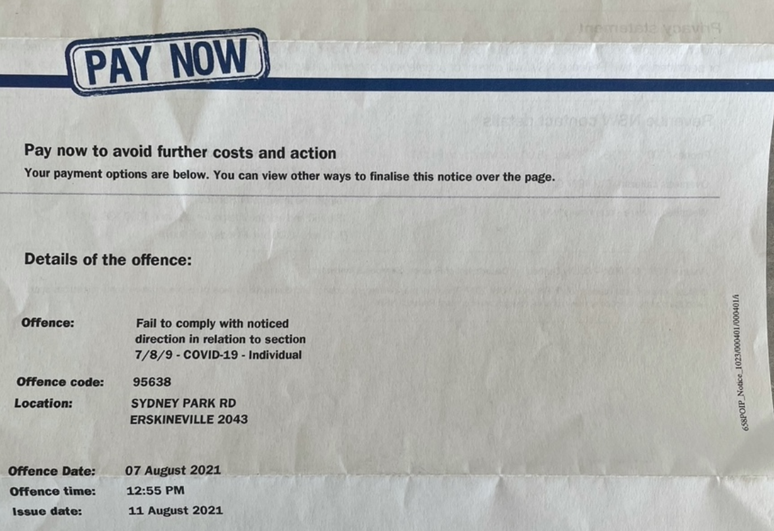

Slide 32
Problems with COVID-19 fines
No particulars as to which direction within public health order has been breached
No information about how person failed to comply with direction
Too complex to be an on-the-spot fine – not strict liability.
Can submit a review with Revenue NSW seeking further particulars – seeking copy of PART A – Electronic Police General Penalty Notice.

Slide 33
Advising clients
Identify which public health order was in place at the time of alleged offence
Have police applied the law correctly?
Advise client of timeframe for payment, election for review by Revenue NSW and court election
Advise client of payment options: pay by installment, WDO, write-off application

Slide 34
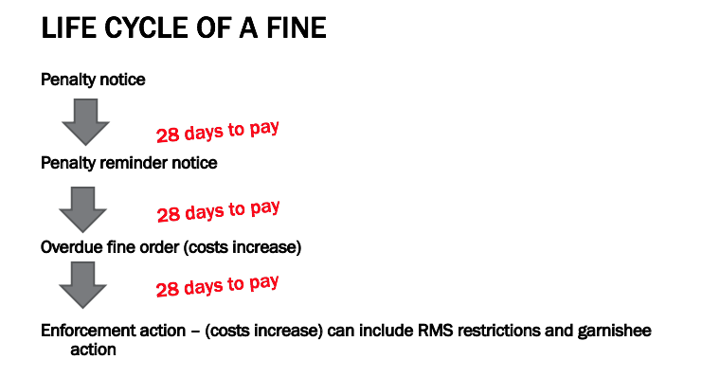
21
21
Note: Can take up to 21 days from when police inform a person they will receive a fine before they get it in the post.
- $65 added to the fine
Source: Inner City Legal Centre

Slide 36
Timeframes for requesting a review
Review to Revenue NSW
If you have not paid the fine, by the due date on the penalty reminder notice
If you have already paid the fine, within 60 days from the date the penalty notice was issued
Fine put on hold when you request a review until outcome

Slide 37
Timeframes for court election
Have option to go straight to court and by-pass Revenue NSW OR Revenue NSW first and then court.
You should apply to go to court before the due date on your penalty reminder notice
If you have already paid the fine, you have 90 days from the date the penalty was issued

Slide 38
Why go to Revenue NSW first?
No cost
No risk of criminal record
Not entering plea
Less time commitment
Easier to self-represent
Fine is put on hold
Note:
If issued a CAN, then Revenue NSW is not an option
If elected to go to court, you cannot go back to Revenue NSW

Slide 39
How to set out your review application
Penalty Notice No.: XXX Offence: XXX
Date of issue: XXX Cost: XXX
I request the penalties be dismissed based on the following factors:
Details about incident: On (insert date, time, location).
The law: At the time of the offence the Public Health Order in place at the time was (provide link). Refer to clauses within the PH Order relevant to you case (i.e. reasonable excuse, adherence to gathering rules, adherence to 5/10km or LGA rule).
Application of fact to law: Outline how you/ client was not in breach of the law based on the above PH clauses.
Attachments: Copy of penalty notice and any evidence in support.

Slide 40
When should a fine be withdrawn?
s 24E of the Fines Act 1996 must withdraw a penalty notice if:
issued contrary to law,
involved a mistake of identity,
should not have been issued, having regard to the exceptional circumstances,
the person to whom the penalty notice was issued is unable, because the person has an intellectual disability, a mental illness, a cognitive impairment or is homeless: (i) to understand that the person’s conduct constituted an offence, or (ii) to control such conduct, (e) an official caution should have been given instead of a penalty notice, (f) any other ground prescribed by the regulations.

Slide 41
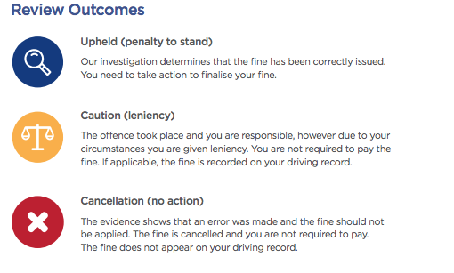

Slide 42
What to do if the fine still stands?
Elect to take to court
Other options:
WDO
Payment plan
Apply to have debt written-off
Hardship Review Board application
COVID-19 fines are not included within Revenue NSW 50 per cent reduction scheme

Slide 43
4. Going to court

Slide 44
Going to court
If sought a review via Revenue NSW, that application will form part of court documents
Once elect to court, the legal matter is no longer a fine and becomes a criminal law court process
Must enter a plea
If found guilty, offence goes on criminal record
Cost: representation, court cost - levy

Slide 45
Why take a COVID-19 fine to court?
Fine issued contrary to law
To put prosecution to the test
Have time and energy to pursue
Have sought legal advice
Want to seek leniency - remember this is still entering a plea of guilty
Can afford to take risk

Slide 46
How to start case at court?
Enter plea and seek orders to obtain a copy of the brief orders – not obliged to provide in these matters.
Write to OIC:
Ask for particulars
What was the direction the defendant was subject to on the date of the alleged offence?
How was notice of the direction said to be given to the defendant?
What were the acts or omissions of the defendant that are alleged to have constituted failure to comply with the direction?
Please specify the manner in which it is said that the defendant failed to comply with the direction (i.e. where, when and how?)
Seek for offence to be withdrawn

Slide 47
Key take-aways
Locate and analyse public health order in place at time of alleged offence
When seeking a review identify PH and clauses relevant to the alleged offence
Seek further particulars if unclear as to why fine was issued
Police powers under Public Health Act and Orders are limited. Police powers are in LEPRA. Police must meet legal thresholds
If not a strong legal case, explore options regarding payment/hardship

Slide 48
5. Questions and further resources
Sam Lee Solicitor, Police Accountability Practice
Redfern Legal Centre
RESOURCES: http://www.rlc.org.au/training/resources/covid

Slide 49
Free, confidential legal advice on fines
Most community legal centres www.legalanswers.sl.nsw.gov.au/advice/about_clcs.html
Aboriginal Legal Service https://www.alsnswact.org.au/covid-19
Legal Aid www.legalaid.nsw.gov.au/contact-us/legal-aid-nsw-offices
Legal Aid Hotline for Under 18s: 1800 101810
Homeless Persons Legal Service www.piac.asn.au/legal-help/hpls-clinic-times-locations
Redfern Legal Centre (for residents of our inner-Sydney catchment) https://redfernlegal.wufoo.com/forms/contact-redfern-legal-centre

Slide 50
Before You Go
Your feedback helps us improve our training.
Please stay with us for another 60 seconds…
Training: rlc.org.au/training
Enquiries: Nick Manning
education@rlc.org.au
This webinar is a guide to the law in NSW. It is not a substitute for legal advice. If you have a legal problem, seek legal advice from a community legal centre or Legal Aid.

